Slide 1
REPORT OF THE CHILDREN’S WARD
RBF PROJECT 2018-2020
April 21° 2022
Team of St.Mary’s Hospital Lacor
Team of Ambrosoli Hospital Kalongo
Data Analysis : L.Greco M.Arcidiaco

Slide 2
Outcome of Internazional Solidarity Projects
Why : Joseph Ki-Zerbo, african filosofer, wrote:
“ The real help is the one that helps to eliminate help ”
Failures: Unlimited assistance offered to African governments increased economic dependence, encouraged corruption, ultimately perpetuated poverty (Dambisa Moyo, Zambia, World Bank executive).
From 50 to 70% of the cooperation interventions in the last 20 years have not achieved the set objectives and have not constantly changed the context in which they have operated

Slide 3
Improve the quality of pediatric care
Save lives: on average 3 children die every day in Lacor : providing resources is not enough to effective health interventions:
we verified the excessive use of drugs (eg antibiotics) or the inappropriate request for investigations
The quality of the healthcare intervention makes a big difference in terms of 'case-fatality-ratio', saving lives and morbidity.
Therefore, quality control, in Africa easily turns into a life-saving intervention.

Slide 4
Result Based Financing procedure:
Parameters for the Pediatric wards:
A shared definition of quality objectives for services and assistance, to be checked every 3 months for 3 years.
For each hospitalized child, for any duration and complexity, a basic cost of € 15
A quarterly quality control, carried out by an independent commission, with a member of the Ugandan Ministry of Health, on the progress of the quality objectives set in the project.
The commission assigns a score from 1 to 5 based on the percentage of achievement of the objectives.

Slide 5
The staff compensation mechanism:
the project pays € 15 for each hospitalization and an additional fee of of 0%, 5%, 10%, 15%, 20%, 25% depending on the score achieved in the quarterly assessment, equal to a total, for each hospitalization of 1 if there was no progress, of € 1.5 for 2 points, € 2.25 for 3 points, € 3 for 4 points and € 3.75 for 5 points.
This compensation was distributed to the staff of the entire hospital, not just that of Pediatrics.
Score Total | <60% | 60-70% | 70-80% | 80-90% | 90-100%
Quality | 1 | 2 | 3 | 4 | 5
Multiplicator | x 1 | x 1,10 | x 1,15 | x 1,20 | x 1,25
Euro added to €15 | 0 | 1,5 | 2,25 | 3 | 3,75

Slide 6

SITUATION BEFORE THE PROJECT RBF

Slide 7
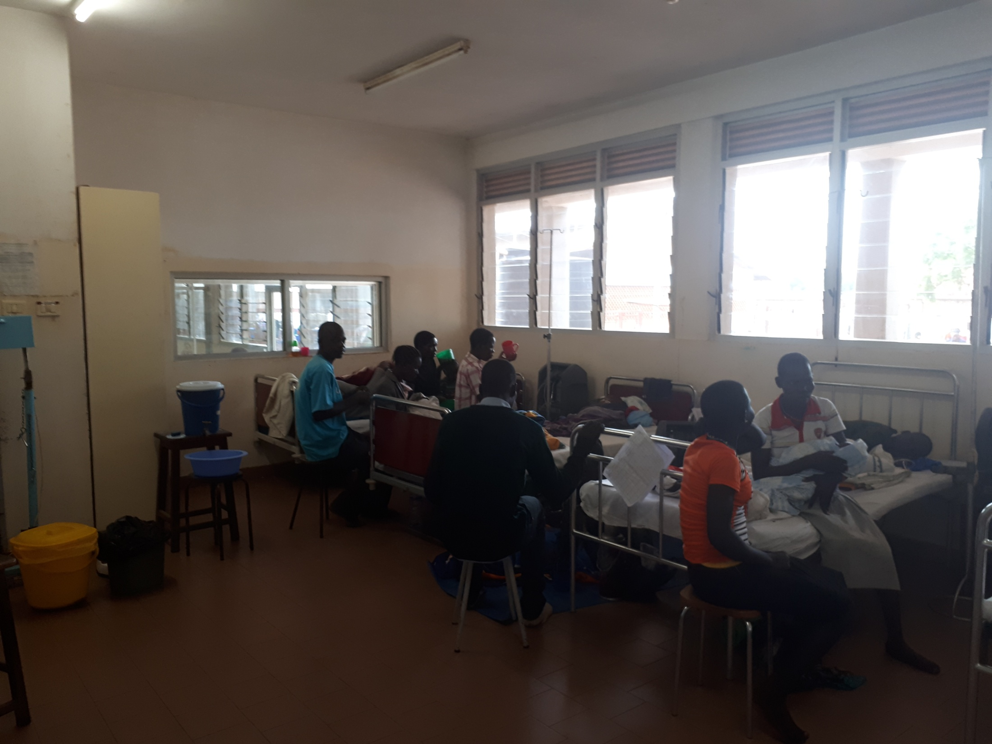
GAPS BEFORE THE START OF THE RBF PROJECT FEB 2018
RESPIRATORY UNIT : BABIES SHARE BEDS AND CROSS-CONTAMINATE – O2 CONCENTRATORS SHARED, often tubes lay on the floor

Slide 8
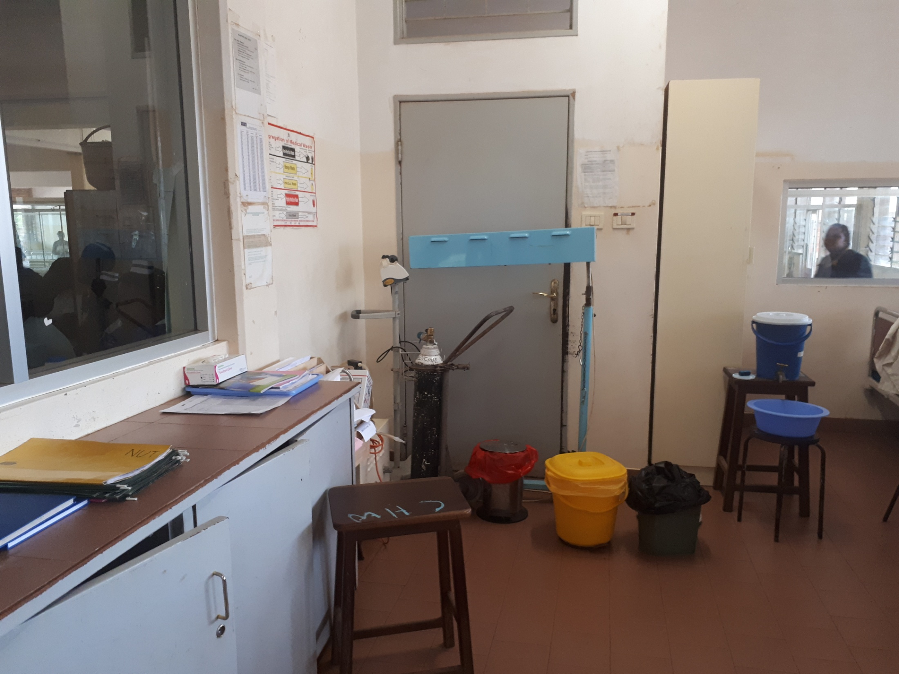
Need to rearrange the Cupborad for Emergency Prepardness, EMERGENCY PROCEDURES AVAILABLE ON THE WALL AS POSTERS
Need a new Ambu Balloon with sized masks for children to neonates
Suction to be repaired.
Desired 2 nebulizer + 2 infusion pumps

Slide 9
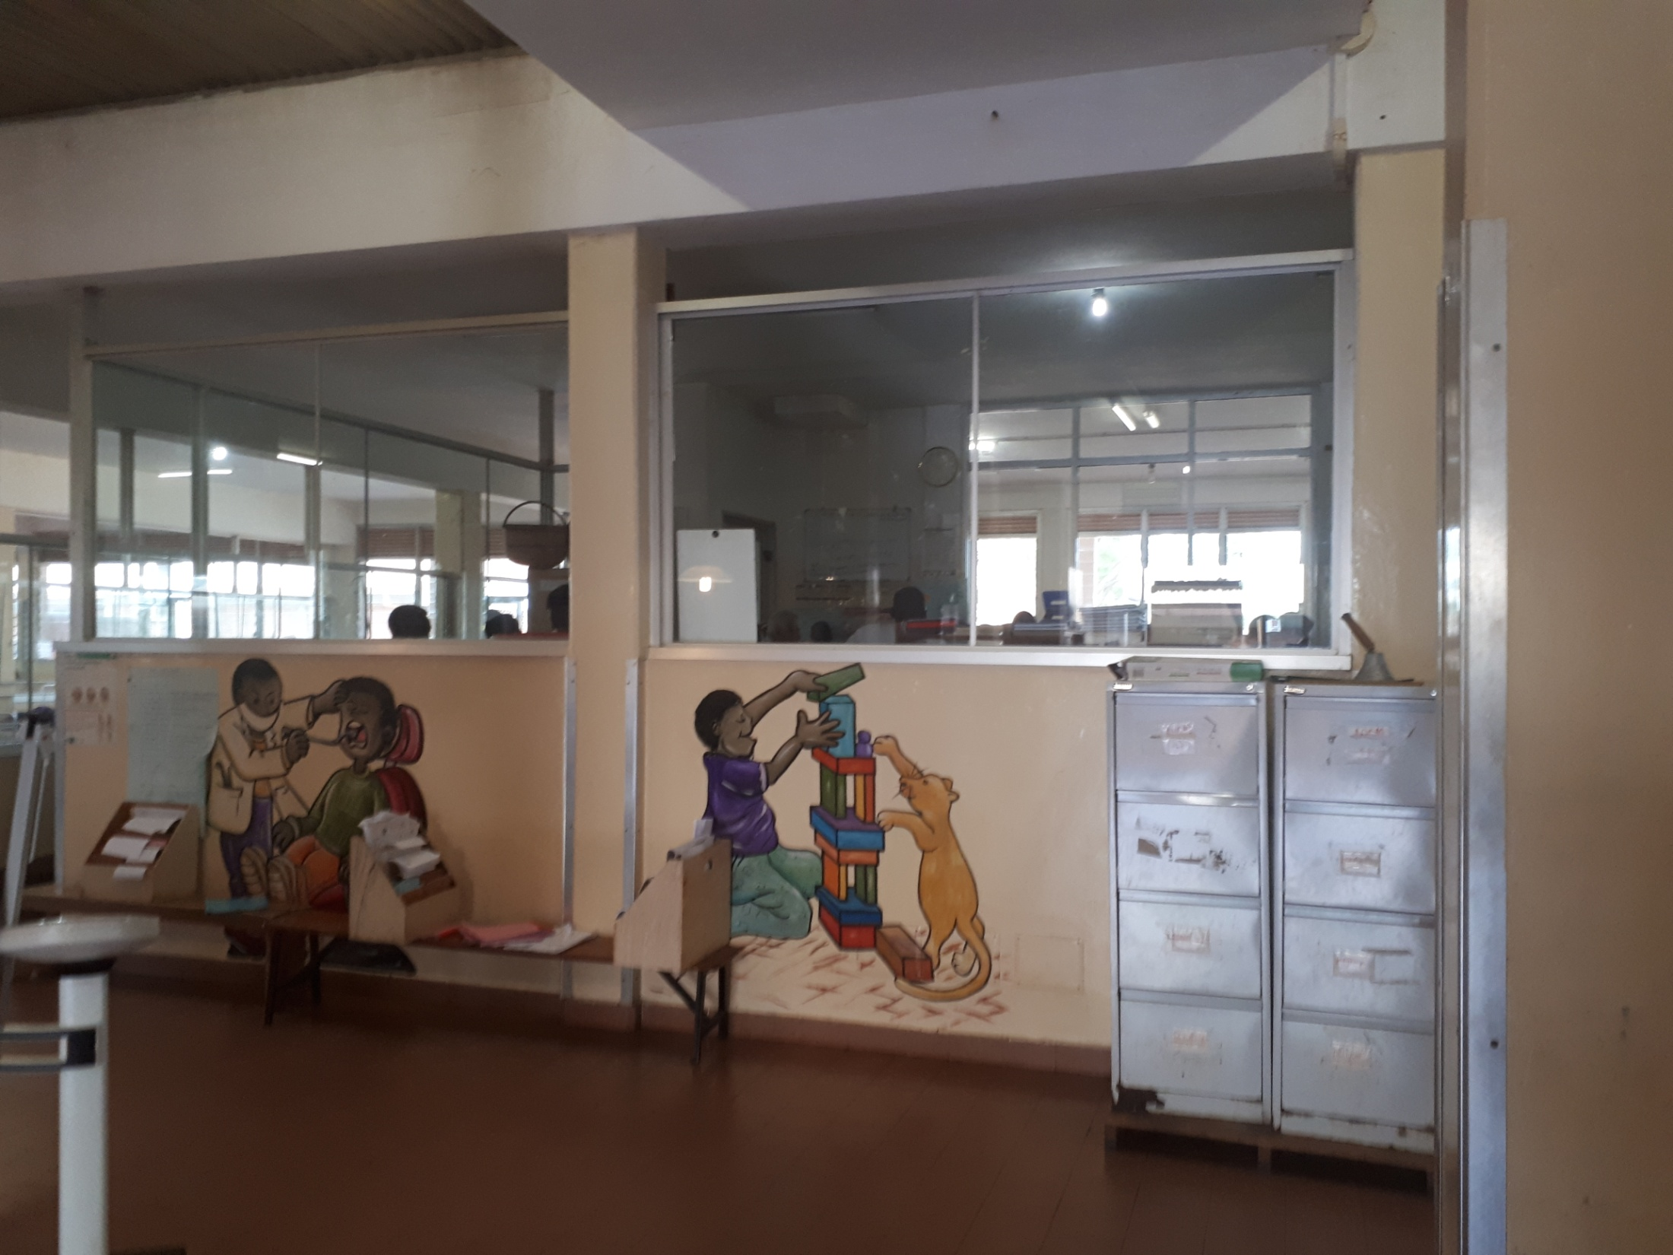
Trash Bins should not be ‘mini’ but large and functional

Slide 10
Checklist: Structures and Management
CKECKLIST ITEMS 1. | CRITERIA | SCORES | Your Priority 1 to 5
Basic infrastructures working and in acceptable conditions 1) Doors and windows regularly checked, 2) Beds and ward facilities repaired when required, 3) Mattress changed when required, 4) Baby and children height and weight scale available and in working condition | 3-4 items controlled | 0-3 |  | 1 MORE WEIGHT SCALE NEEDED
Hygienic conditions appropriate 1) Cleanliness of the ward, 2) Accurate disposal of sick children vomit/feces, 3) Disposal of remains of foods | Bad, moderate, good, optimal | 0-3
Safe environment 1) Electrical safety for children(cover etc), 2) Children's don’t have access to drugs, 3) Fire readiness | 1.% safe electric 2=100% 3.Accept- good- excel | 0-3 |  | Cover the great Main at the rx end of corridor (Meter Box?)
Prevention of infections 1) Facilities to wash hands, 2) Alcohol available, 3) Reduce cross-contamination among children (beds?) | Renovation of O2 room | 0-3 | Infants sharing beds is a CRITICAL point that has to be changed , espec in O2 room | More large beds than small: change 10-20, not in Burkitt & Nutrition & Neonates
Available and functional equipment and supplies: Oxig tester, Infusion pump, Suction machine, O2 concentrator | O2 line coming | 0-3 | Nose prongs and tubes on the floor | Suction to repair. Need an Head Lamp for procedures. Desired 2 nebulizer + 2 infusion pumps
Are the right Drugs available when needed? 1) Essential Medicine and Health Supplies are available 2) Timely provision of drugs after requests | List 20 drugs % Check 3 request-time | 0-3
Adequate support from the laboratory ? 1) Lab is functional every day of the week 2) Scheduled time kept as planned (delivery of samples and provision of results) | 1. OK 2. Check 3 request-time | 0-3 |  | Only 1 technit on weekends, loaded. Lab send children from YCC to be sampled especially in we: OPD nurses should do.
Adequate support from the Radiology Department? 1) Lab is functional every day of the week 2) Scheduled time kept as planned (delivery of samples and provision of results) | US critical, Cardiac US critical | 0-3 |  | Lack of staff, many request
TOTAL SCORE |  | 24
Cleanliness
Safety
Hygiene
Equipment
Drugs
Laboratory
Radiology

Slide 11
Checklist: 2. HYGIENE AND CLEANLINESS
CHECKLIST ITEMS | CRITERIA | SCORES | Your priority 1 to 5 | CRITICAL
Presence of cleaning products: Supply record cards indicating amounts in and out correspond to physical supplies (soap, bleach, chloramine, chlorhexidine, and at least one detergent) | Record card monthly of supplies on ordering-requisition book once a wk Thursday | 0-3 |  | To be checked with in Charge
Stock Management. Reserve of disinfectants, equipment used soaked in disinfectants in treatment rooms, | Requisition book | 0-3
All beds having mattresses covered with impermeable plastic intact | Check monthly | 0-2 |  | Most are torn/spoiled, need new covers, done locally
Cleanliness of rooms, halls, and grounds: 1) presence of trash receptacles (in waiting room and corridor) 2) no loose trash;3) receptacles for syringes present in treatment rooms | N. trash bins N. special dispensers Sharp containers | 0-3 | Tiny ‘Paediatric’ dust bins useless | Dispensers not always functional, change to big dust bins
No organic waste, syringes, or dangerous products in any location that is easily accessible to the public | Inspection 1 to 3 score | 0-3
Availability of water source (running water or well, pump, or water tower/tank) | Yes/not | 0-2
Water dispensers available in service rooms where there is no tap w. | Yes/not | 0-2
Presence of latrines and showers 1) usable; 2) no organic matter within or outside; 3) door that closes from the inside; 4) covered pit (for latrines) | To be checked | 0-3 | None of 20 latrines flushes, showers dismantled | Repair flushes and reassemble 4 showers
Available and functional sterilization materials: cocotte, autoclave, or heat sterilizer | Check transport of drums from ward to steril centre | 0-3
Clean, neat uniforms worn by all staff | Inspection 1-3 | 0-2
TOTAL SCORE |  | 26
Supplies
Beds
Rooms
Waste
Water
Latrines
Sterilization

Slide 12
CLINICAL AND NURSING PROCEDURES
CHECKLIST ITEMS | PROTOCOLS | YOUR SUGGESTIONS | Your priority 1 to 5 | CRITIC
Proper diagnosis of 10 admitted cases (analysis of randomly selected hospitalization records): 1) identification of patient 2) complaints or symptoms on admission reported 3) clinical examinations guided by anamnesis 4) no unnecessary diagnostic tests prescribed, 5) Malaria is excluded or treated in patients with fever 6) Malnutrition diagnosis according to WHO - Check sub-liminal malnutrition, 7) Percentile charts available and in appropriate use 8) Anemia diagnosed according to guidelines, 9) Sepsis: Increasing the percentage of specific diagnosis (origin) | 1.Triage of sick child 2. Paediatric Life Support 3. Malaria 4. Dehydration 5. Convulsions 6. Anemia 7. LRTI-Pneumonia 8.Urinary Tract Infect 9. Meningitis 10. Sepsis | 0-8 |  | Very hard to specify origin of sepsis : rotation of interns is critical : require a month to be trained and then have to be surveilled ESR and blood count – scarce microbiology
Proper prescription of therapy of at least 10 admitted cases (analysis of selected hospitalization records): 1) proper treatment according to evidence from anamnesis, and accepted protocols, 2) no unnecessary prescriptions, especially antibiotic, 3) Appropriate prescription of drugs in children with URTI, 4) Appropriate use of Oxygen & Antibiotics for children with LRTI, 5) Appropriate request of blood transfusions. 6) Checking regularly the vaccination record and recommend accordingly | According to previous protocols | 0-8 |  | Blood often not available –in Kalongo they may use their own donors, screened for HIV & Hep B and Syphil Oximeter required, HoD engaged into this performances (drug use etc) Mother do not bring vaccination record
Proper administration of therapies of 10 admitted cases 1) Therapies have been given properly (Oral, injection, IV line, fluids) , 2) Charts correspond to the correct patients, 4) Fluids have been changed and are dropping correctly 5) IV lines changed correctly 6) doctor's check and nurse's check x24 hours for Gastroenteritis | OK 1 to 5. N 6 important : give 500ml plastic bottle with rehydration dose for the night | 0-8 |  | Nurses’ project ongoing Difficult collaboration by mothers
Deaths properly reviewed 1) Death reviews regularly carried out 2) staffs informed about findings of death reviews, 4) evidence of follow up of consistent follow up of findings from death reviews | In the daily morning meeting, not ready for 3 & 4 | 0-3 |  | in Kalongo once a week
Appropriate supervision and mentorship by Specialists and Head of Department 1) Clinical Audits carried out on a regular basis, findings shared, and followed up, 2) death reviews regularly carried out, findings shared, and followed up, 3) Evidence of effective specialist supervision and mentoring, 4) Evidence of proper consultation and referral with specialists 5) evidence that staffs are encouraged to consult with Specialists and consultants | Audit in the daily morning meeting, Distribution of responsibilities between specialist and medical officer | 0-3 |  | Kalongo: only two people, do not need meeting, they work together, general meeting once a week
Nice and caring communication to Patients and attendance | Talk with mothers at discharge, explain problems and therapy | 0-3 |  | COMMUNICATION project ongoing in Lacor e Kalongo
TOTAL SCORE |  | 33
Diagnosis according to protocols
Proper Prescription of Therapy
Proper Administration of prescribed Therapy
Deaths reviewed
Mentorship available and functional

Slide 13
Checklist: Emergency readiness
CHECKLIST ITEMS | CRITERIA FOR SCORING INDICATORS | SCORE | SCORE OBTAINED | SCORING JUSTIFICATION
Emergency CUPBOARD ready 1) Emergency equipment checklist filled and signed correctly at each shift 2) emergency drugs and equipment present on the box in the shelf, not expired, functioning, clean, dust free and easily accessible | Kalongo, not a trolley but a BOX with drugs & Equipment Are preparing basic guidelines for emergency according to international standards | 0-4 |  | Trolley not there, equipment: a new Ambu with sized masks In Charge
Emergency protocols available and known 1) staff trained on the protocols 3) Students know it and trained 4) updated and consistent National and International Standards 4) key parts hanging on the wall close to emergency trolley | Refer to Lacor-made booklet Updated WHO guidelines available in Kalongo. | 0-4 |  | Posters-Cartoon in preparation (dr.Smarrazzo)
TOTAL SCORE |  | 8

Slide 14
Checklist: Training
CHECKLIST ITEMS |  | SCORE
Student Nurses Give basic written guidelines at entry Students are exposed to basic nursing procedures Students actively collaborate to keep the objectives | Acquire basic nursing skills, manage nursing report, sit with mothers also in overtime | 0-3
Medical Students Instruction of students about their task at entry Students are exposed to basic protocols (locally available and listed) Students participate to reaching objectives Students participate to scheduled verification | Sit at bedside, collect anamnesis, survey therapies, learn basic nursing procedures | 0-3 |  | Medical students have to participate to the 8,30-9,30 ward meeting. Immediately allocated to a specific line of patients. To be cared for along the term
Post-Doc Residents acquire responsibility of medical objectives Regular audit on clinical forms to comply with 'Outcome' listed items Resident participate to data collection and reporting Residents interact regularly with nursing staff | Presentation of cases at morning meeting Participate to the application of protocols | 0-3
TOTAL SCORE |  | 9

Slide 15
DIAGNOSIS OF THE CHILDREN ADMITTED
LACOR | YEAR |  | KALONGO | YEAR
 | 2016 | 2020 |  | 2016 | 2020
Sepsis | 34 | 4 | Pneumonia | 50 | 21
Malaria | 33 | 34 | Sepsis | 45 | 9
Diarrhea | 29 | 2 | Malaria | 40 | 27
Pneumonia | 13 | 5 | Diarrhea | 38 | 10
Sickle | 11 | 15 | Sickle | 24 | 13
Anemia | 10 | 7 | Meningitis | 4 | 0
NeonatalSepsis | 7 | 13 | URTI | 4 | 6
URTI | 5 | 2 | Malnutrition | 3 | 0
Cerebral Malaria | 4 | 0 | Allergy | 2 | 0
Meningitis | 4 | 0 | Anemia | 2 | 8
Hepatitis | 2 | 0 | Bronchiolitis | 2 | 0
Ileus | 2 | 0 | Convulsion | 2 | 0
Other | 8 | 29 | Other | 2 | 17
TOTAL | 162 | 111 | TOTAL | 218 | 111

Slide 16
SITUATION AFTER THE PROJECT RBF

Slide 17
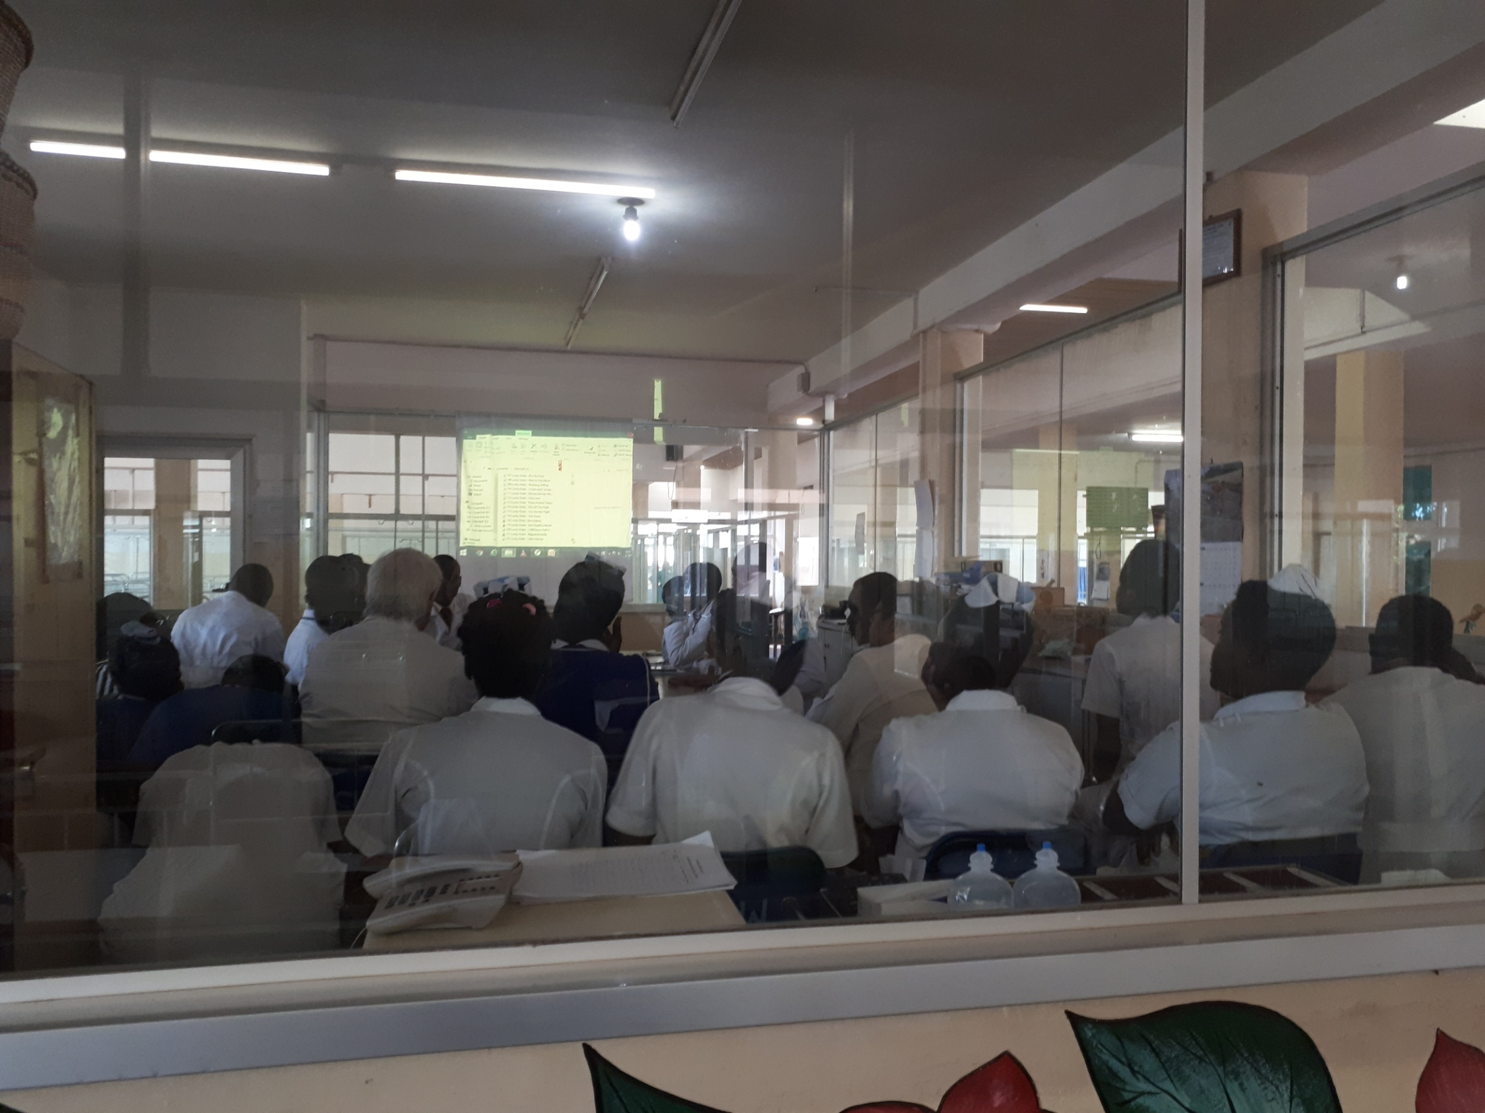
Weekly meetings to discuss general management with doctors and nurses

Slide 18
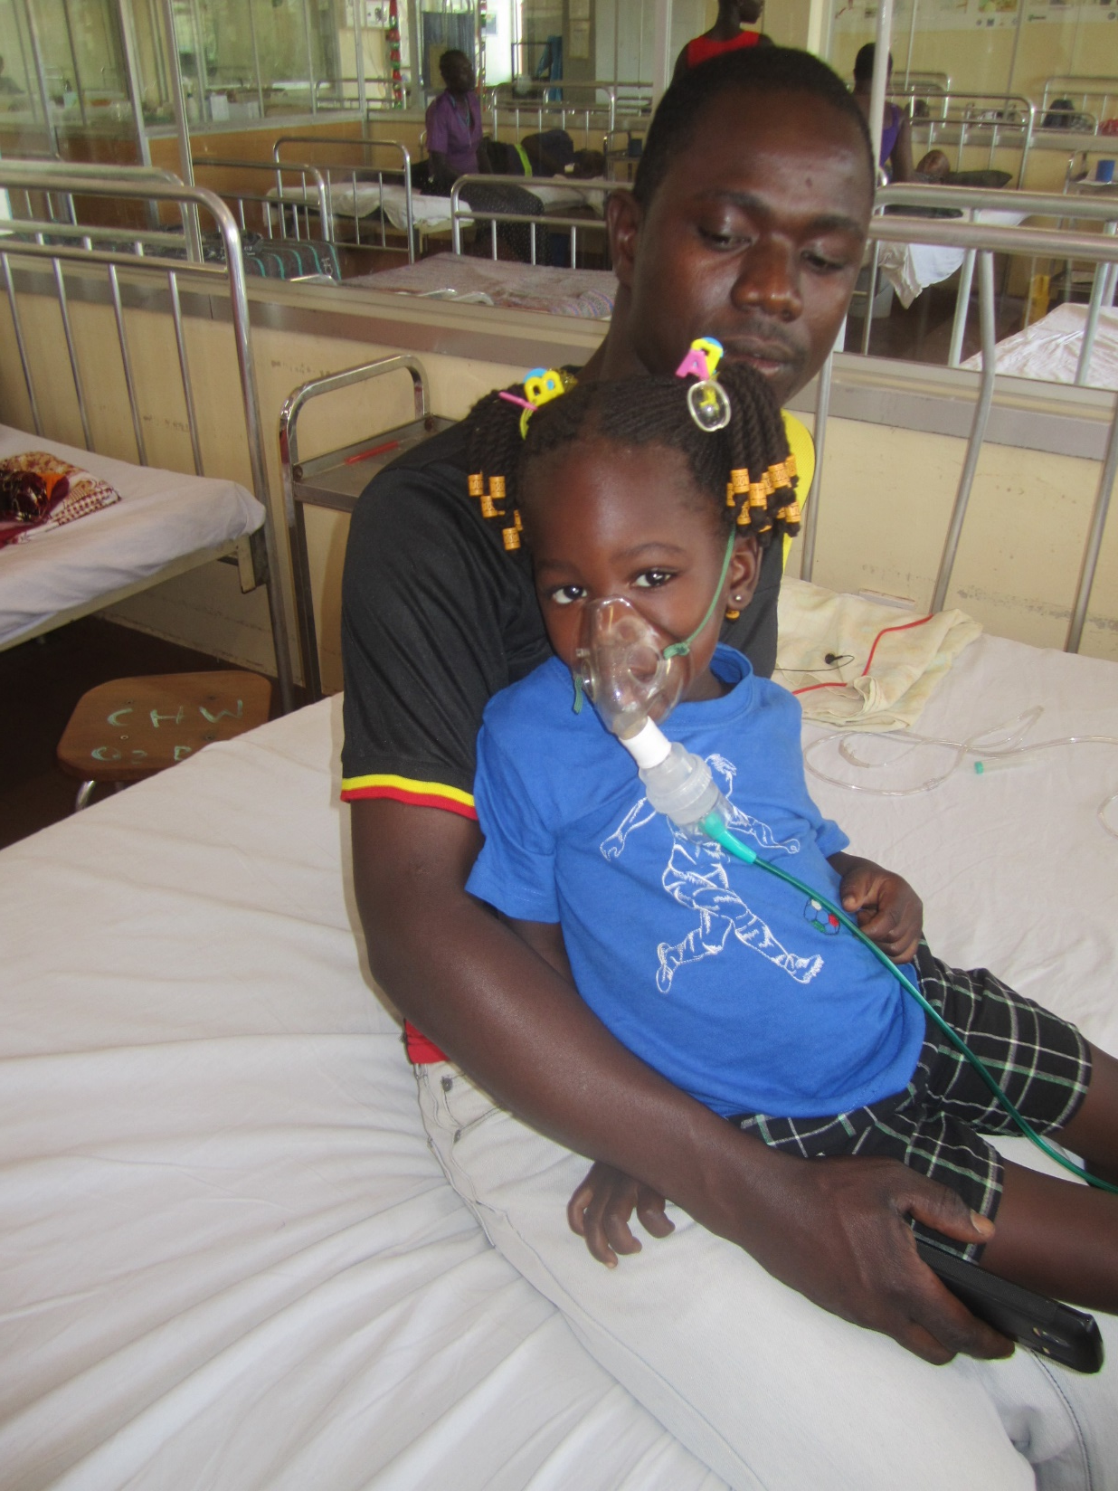
LESS BED SHARING – INDIVIDUAL EQUIPMENTS

Slide 19
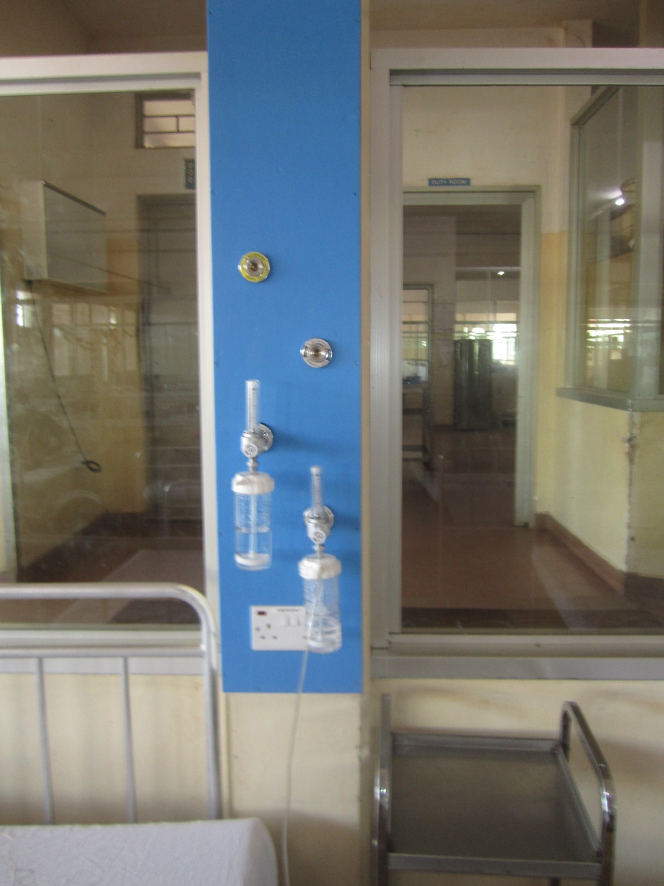
OXIGEN WIDELY AND INDIVIDUALLY AVAILABLE

Slide 20
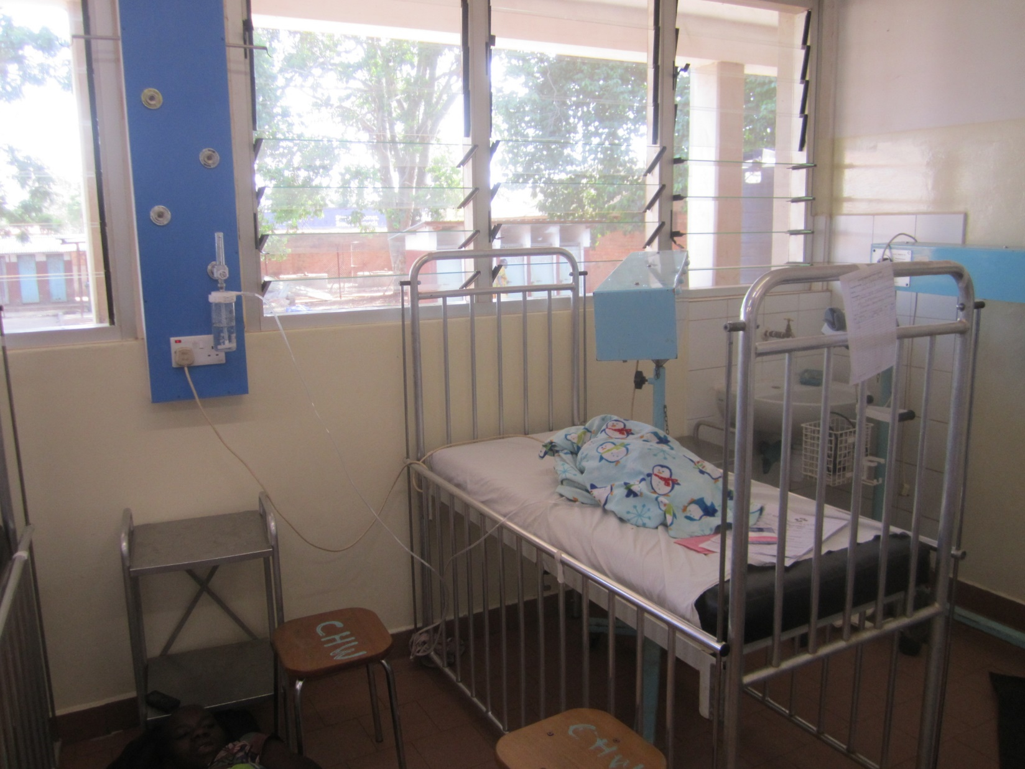
INTENSIVE CARE IMPROVED

Slide 21
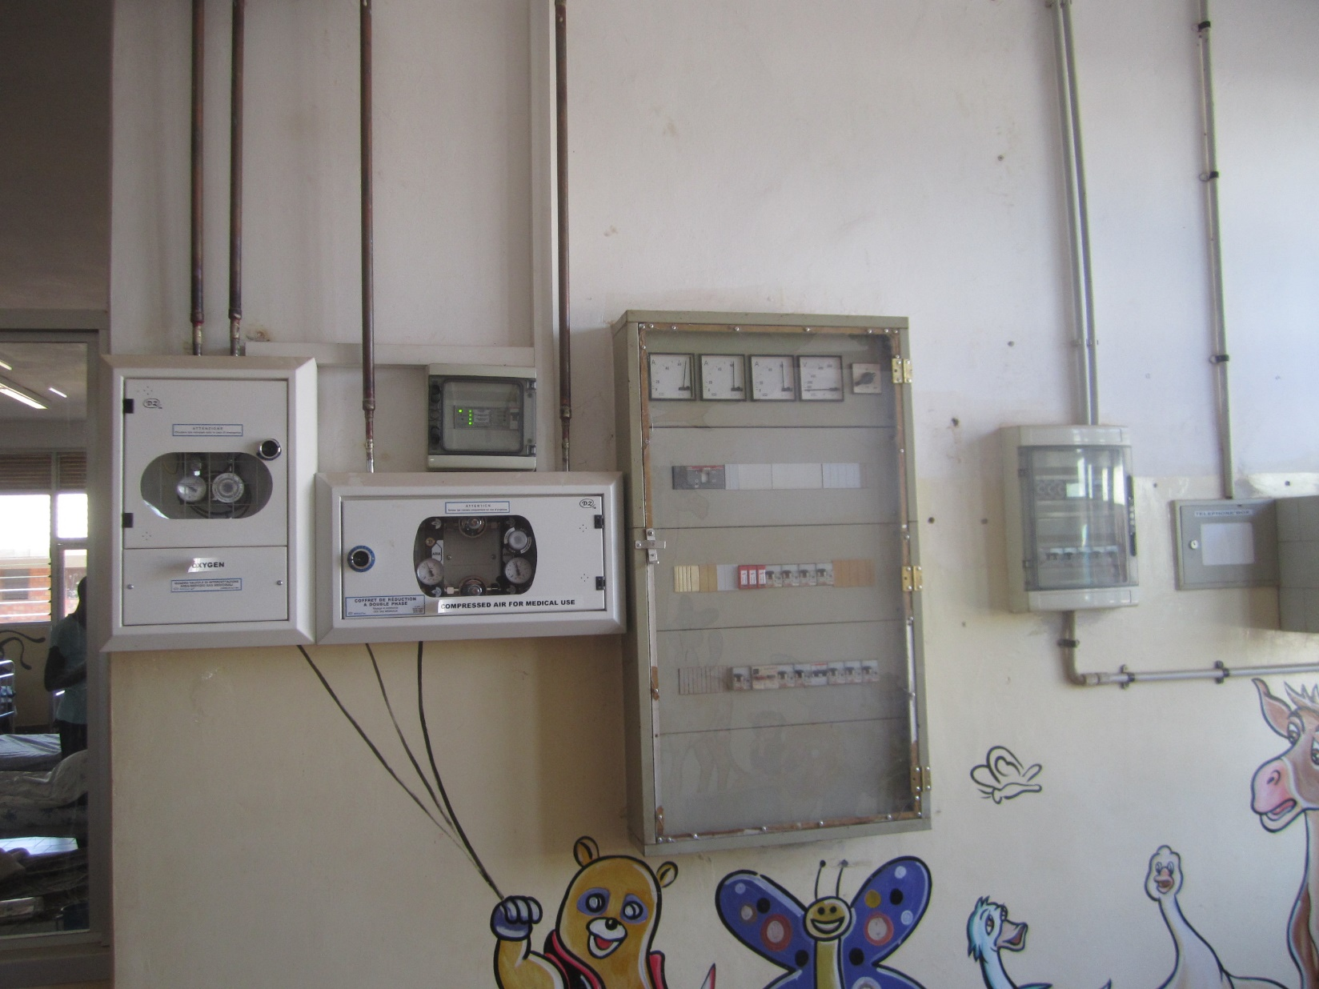
ELECTRICAL SAFETY IMPROVED

Slide 22
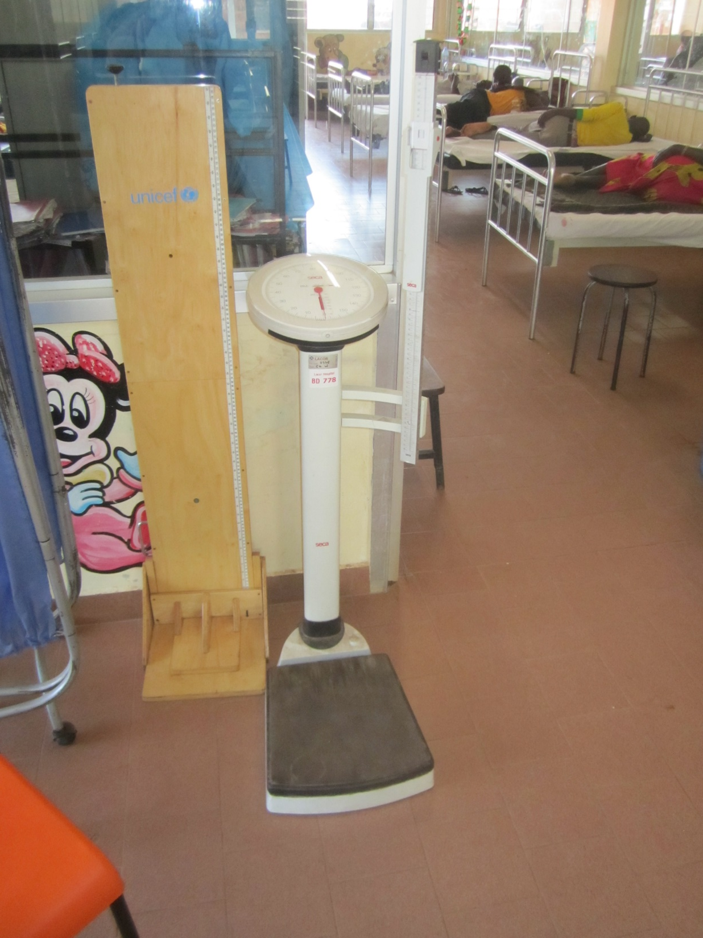
WEIGHING SCALES AVAILABLE

Slide 23
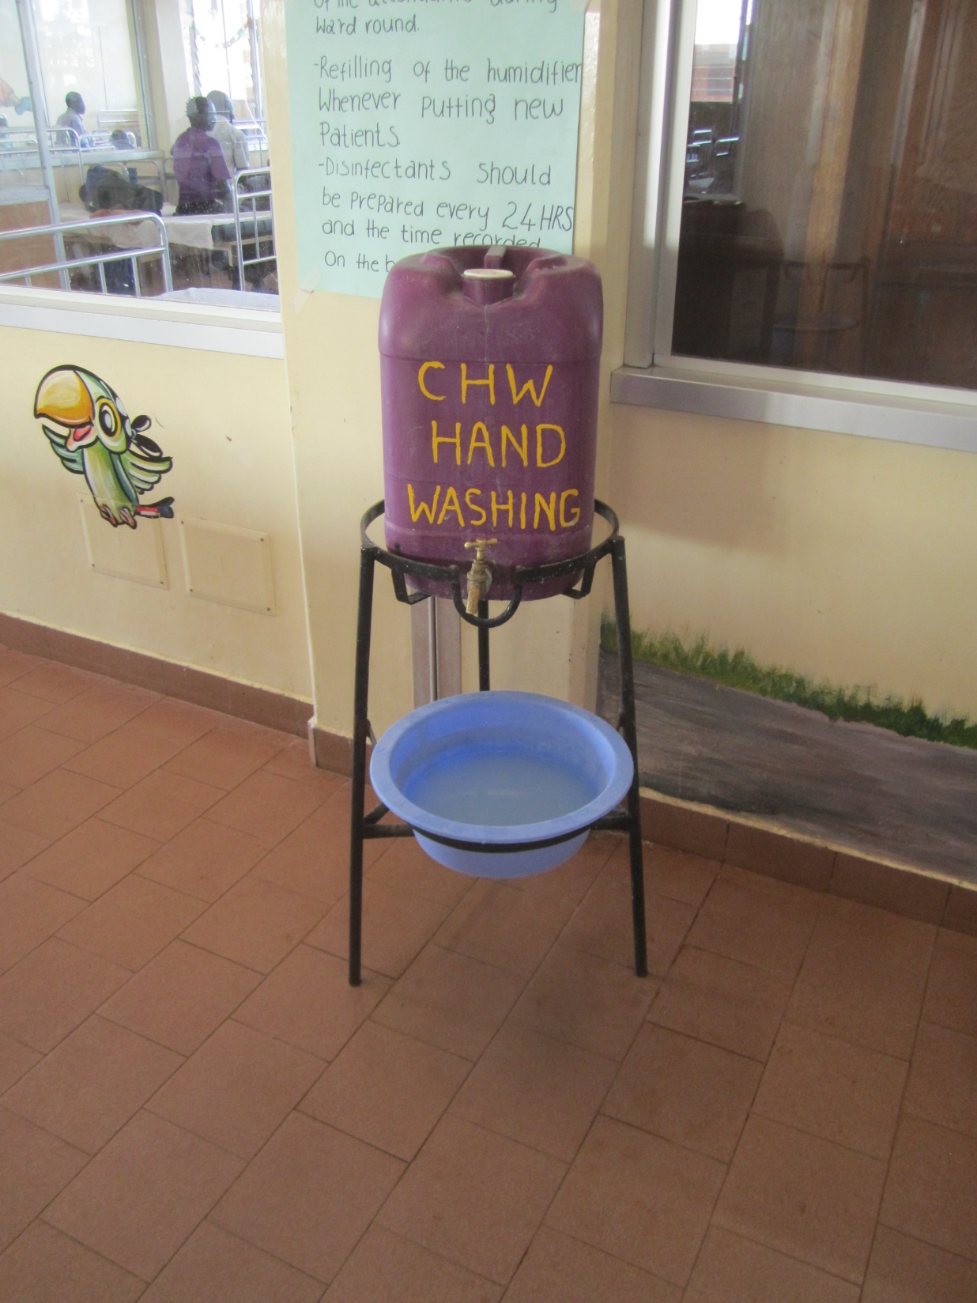
HAND WASHING IN USE

Slide 24
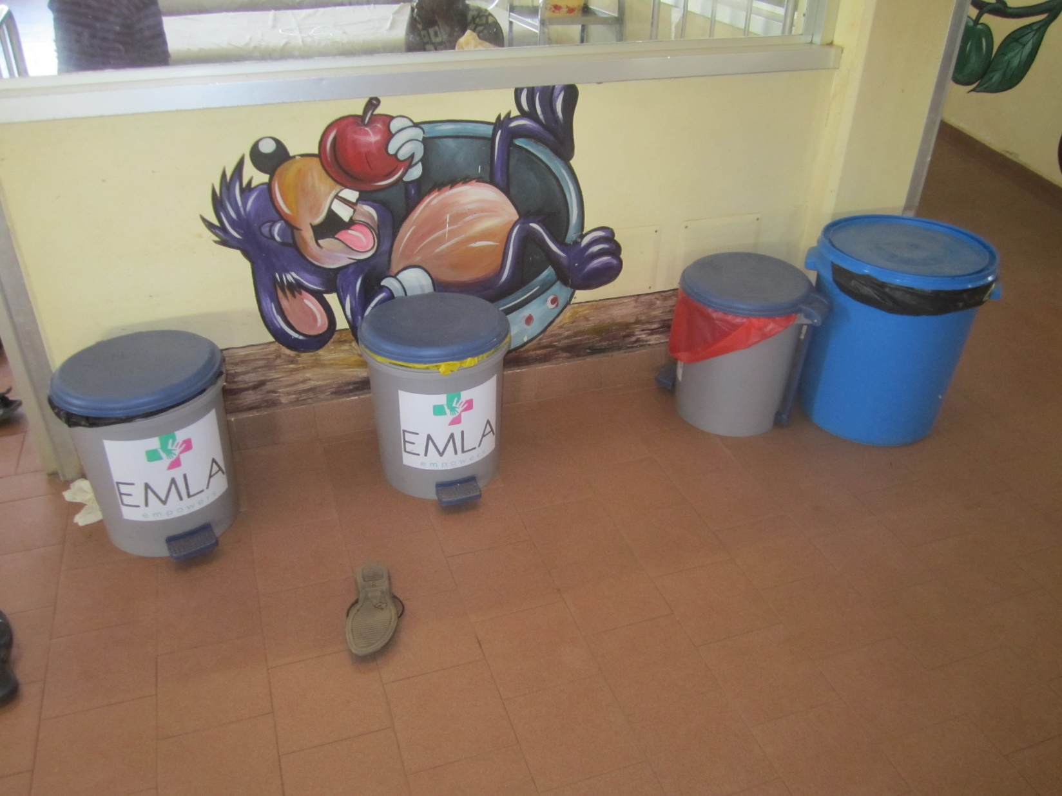
WASTE MANAGEMENT IMPROVED

Slide 25
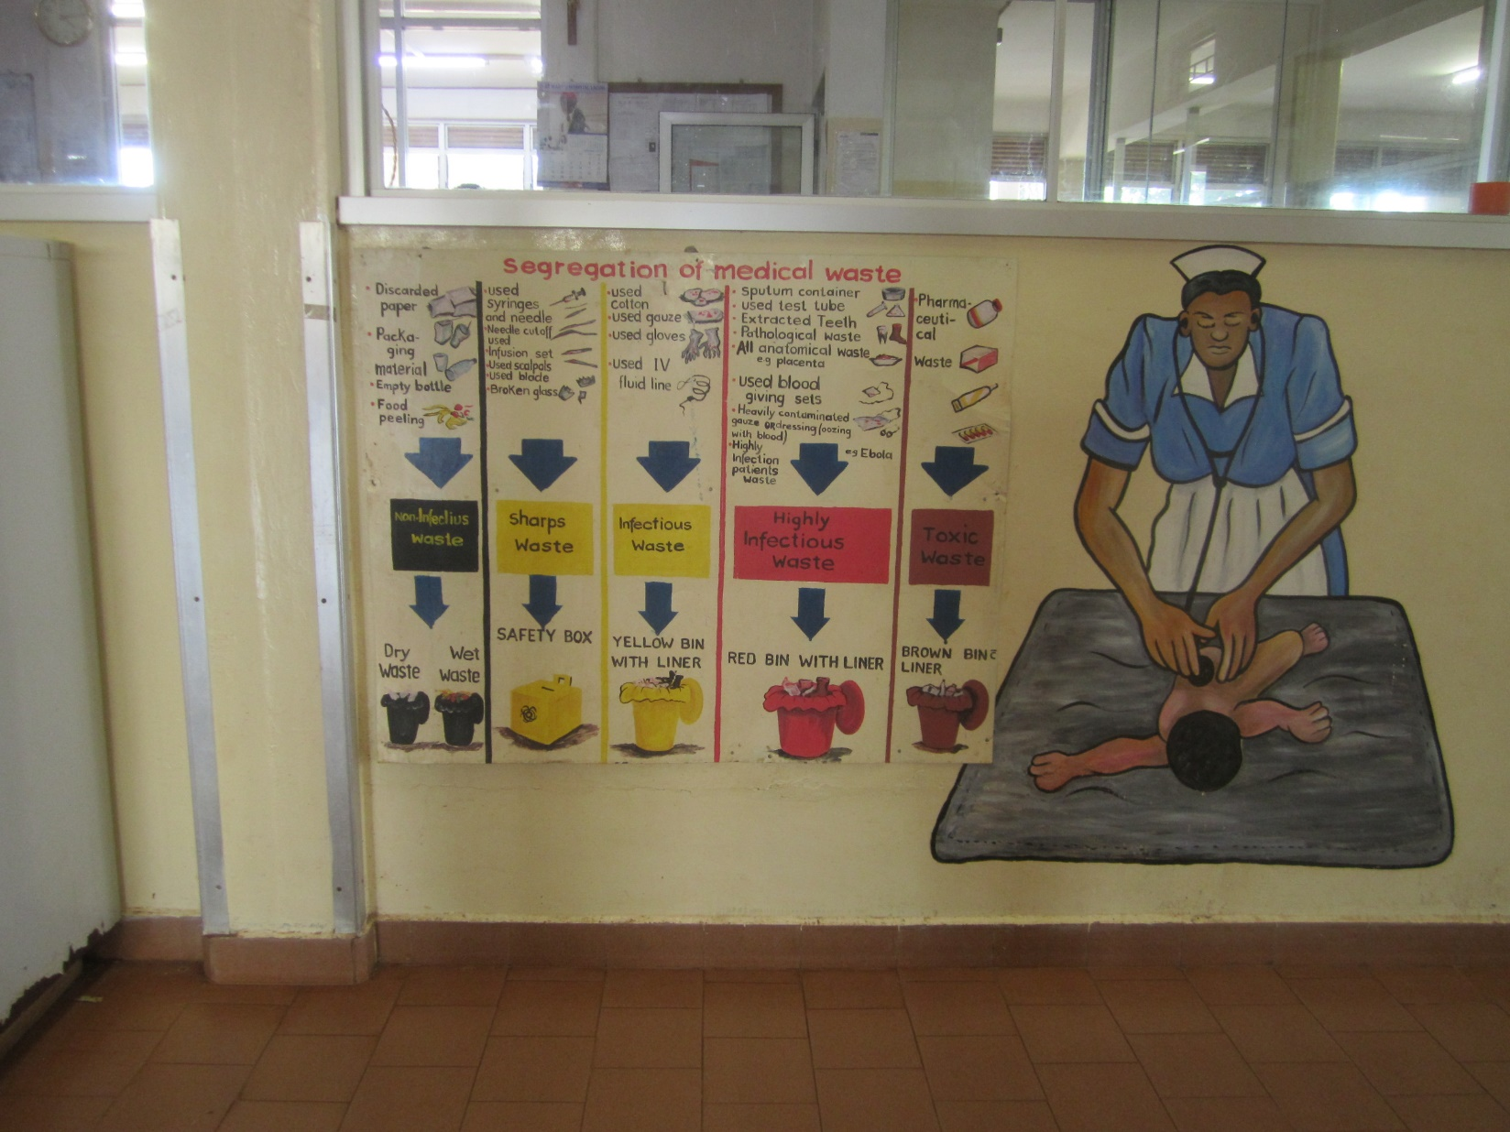
INSTRUCTION FOR WASTE MANAGEMENT

Slide 26
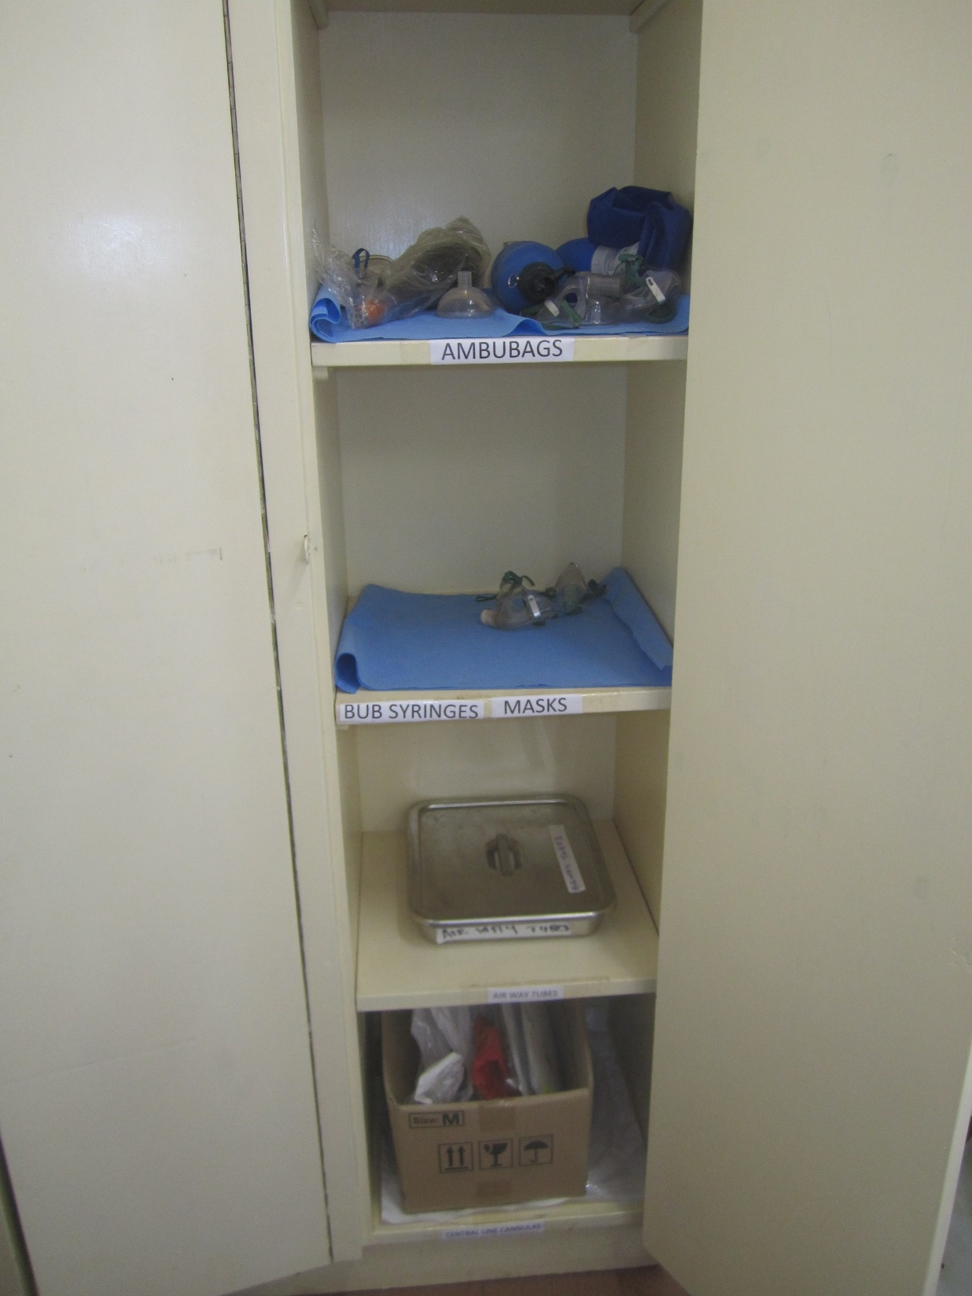
EMERGENCY CUPBOARD IMPROVED

Slide 27
Increase by time of the 5 scores at Lacor
3rd degree polinomial fitted

Slide 28
Increase by time of the 5 scores at Kalongo
Exponential model fitted

Slide 29
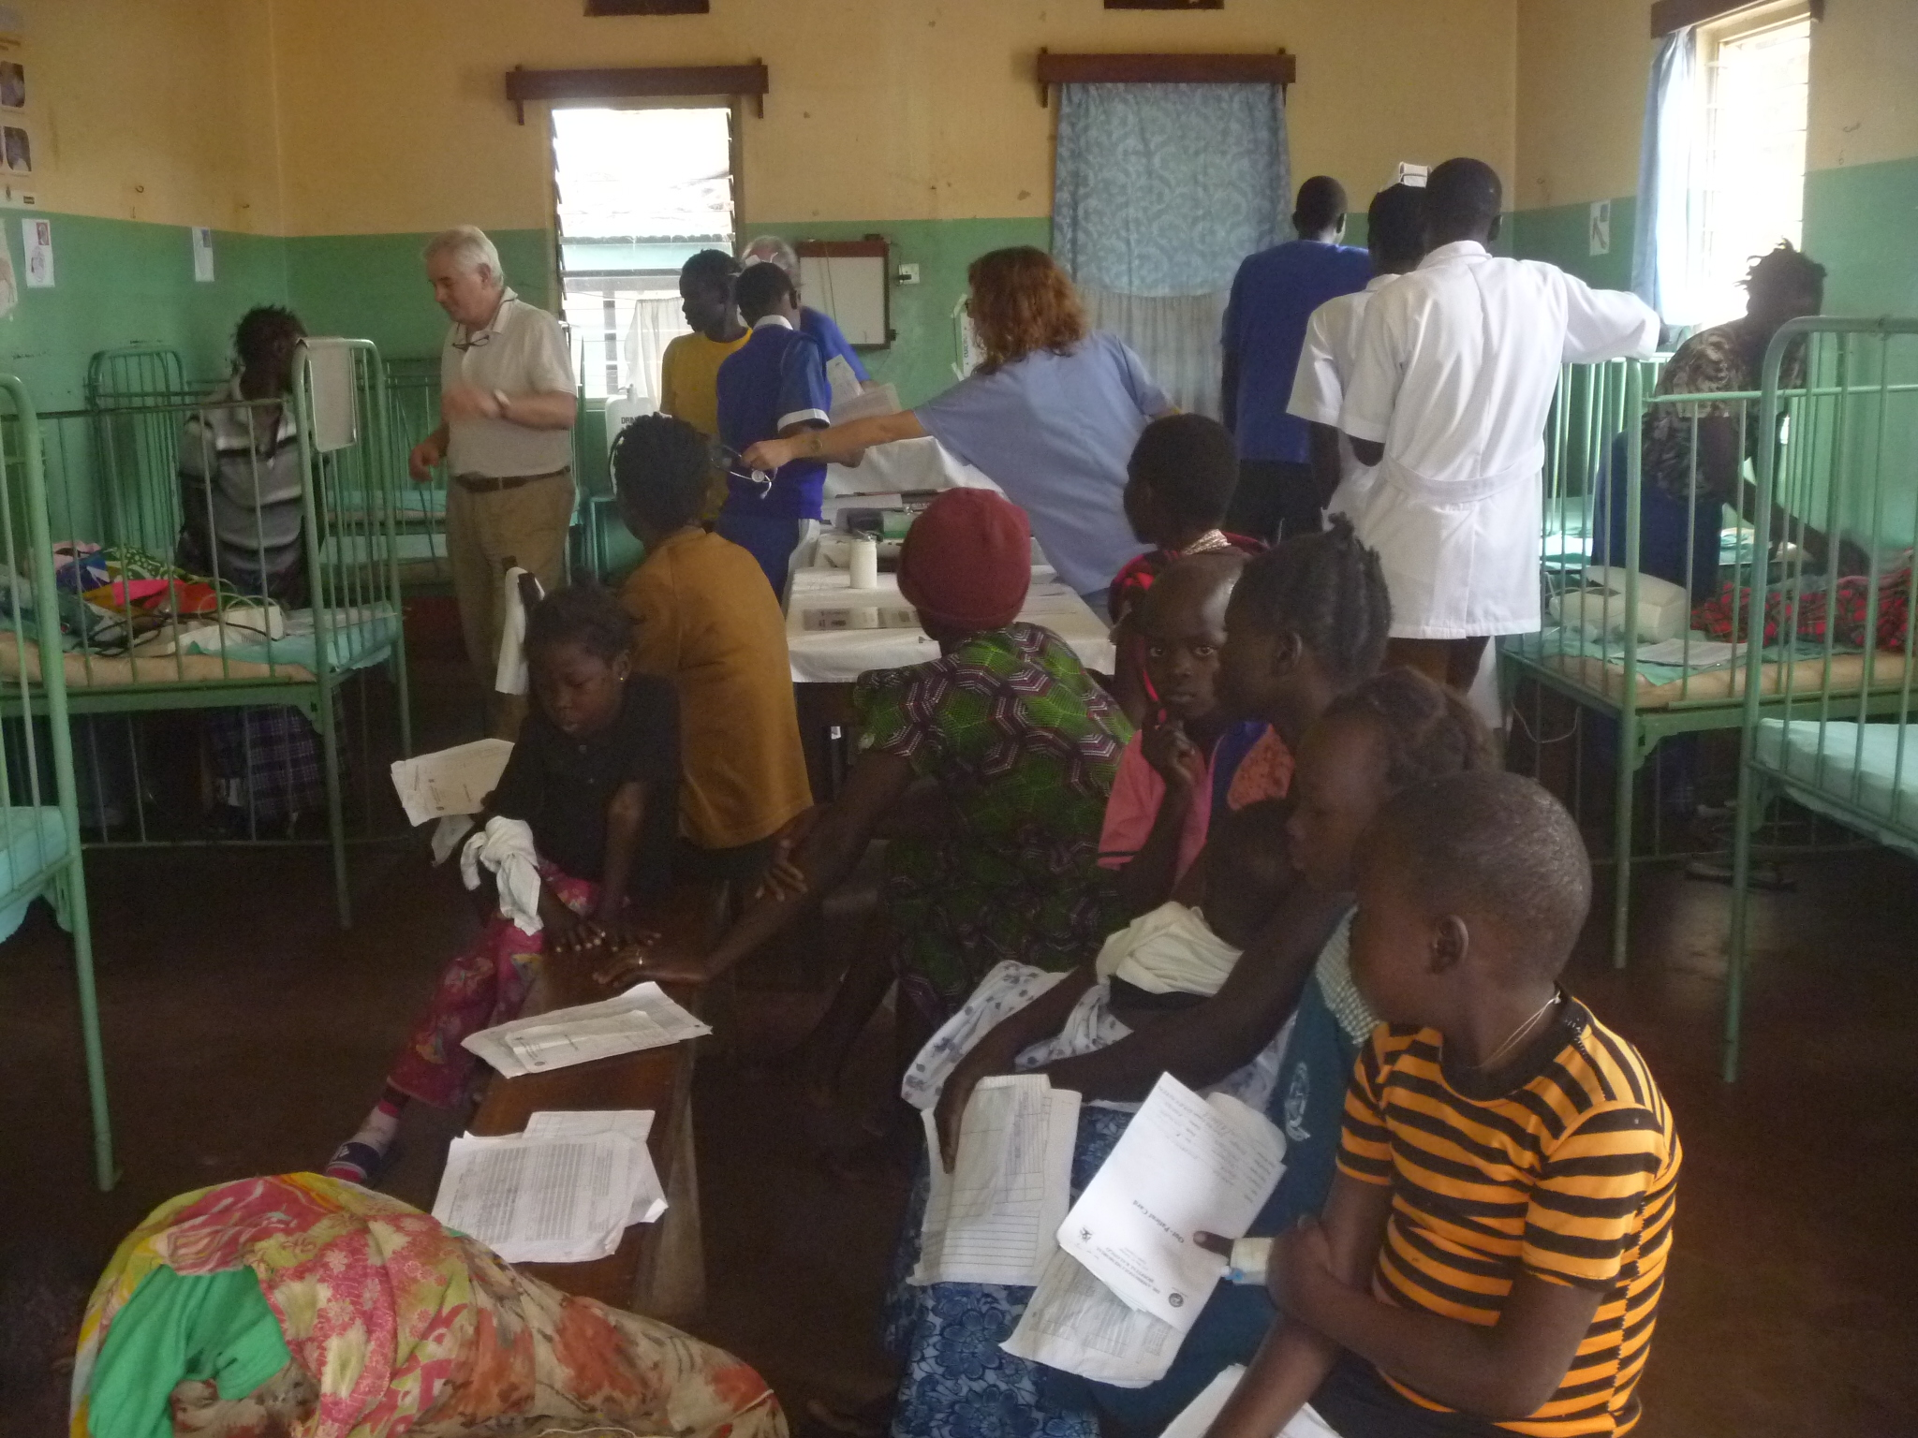
The ‘old’ children’s Ward in Kalongo 2018

Slide 30
Percentage of the Optimal Target Score Lacor

Slide 31
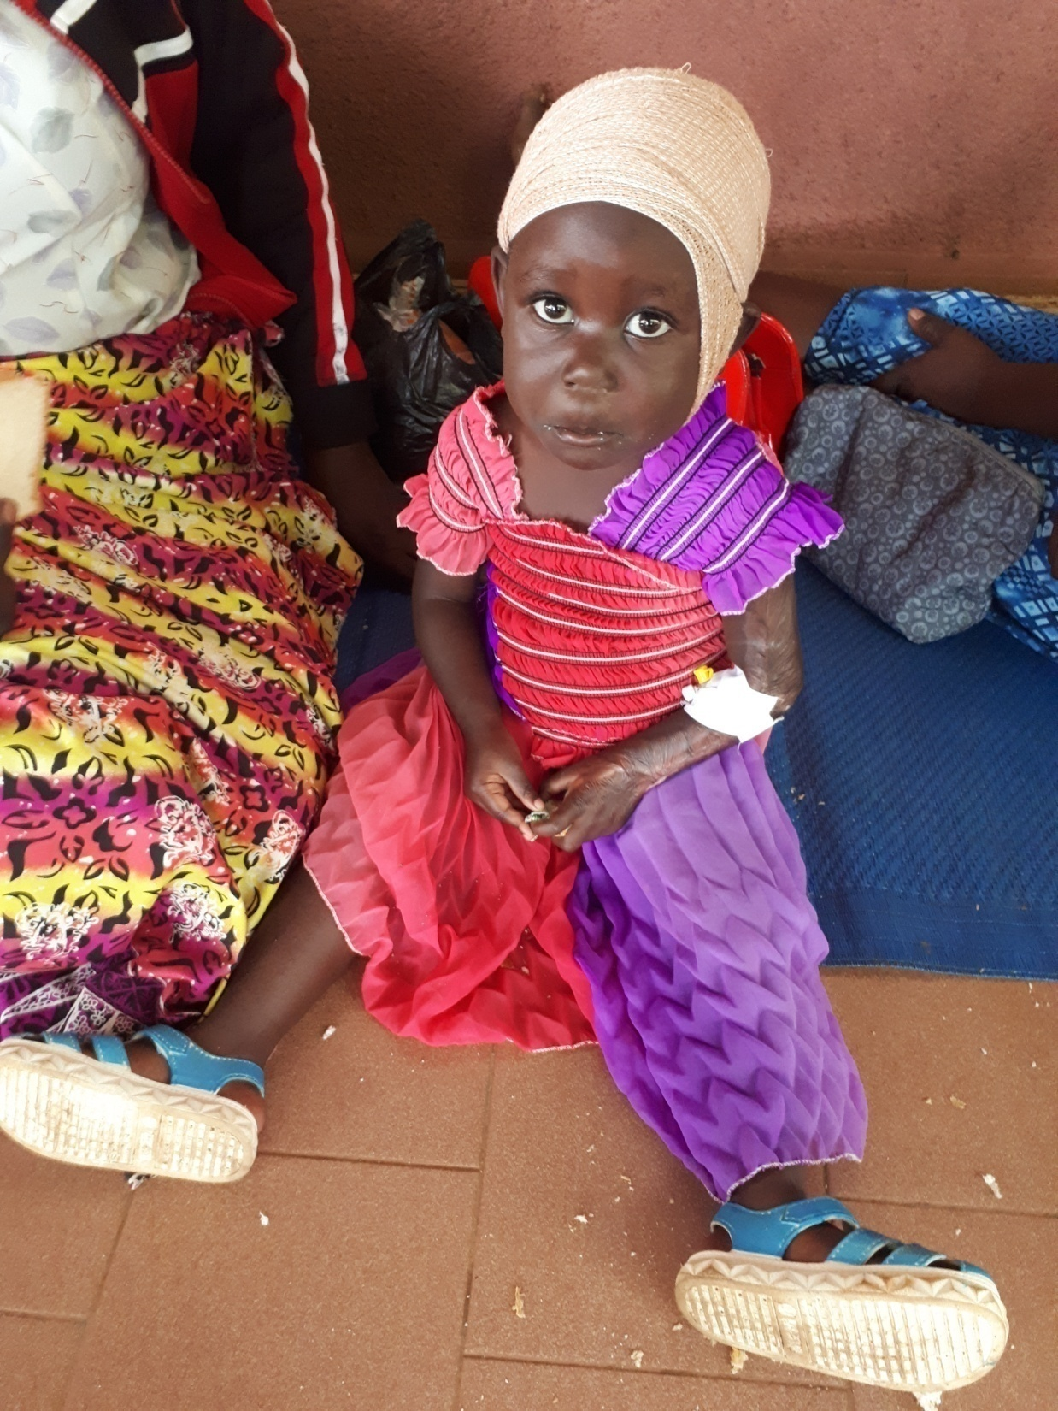

Slide 32
Percentage of the Optimal Target Score Kalongo

Slide 33
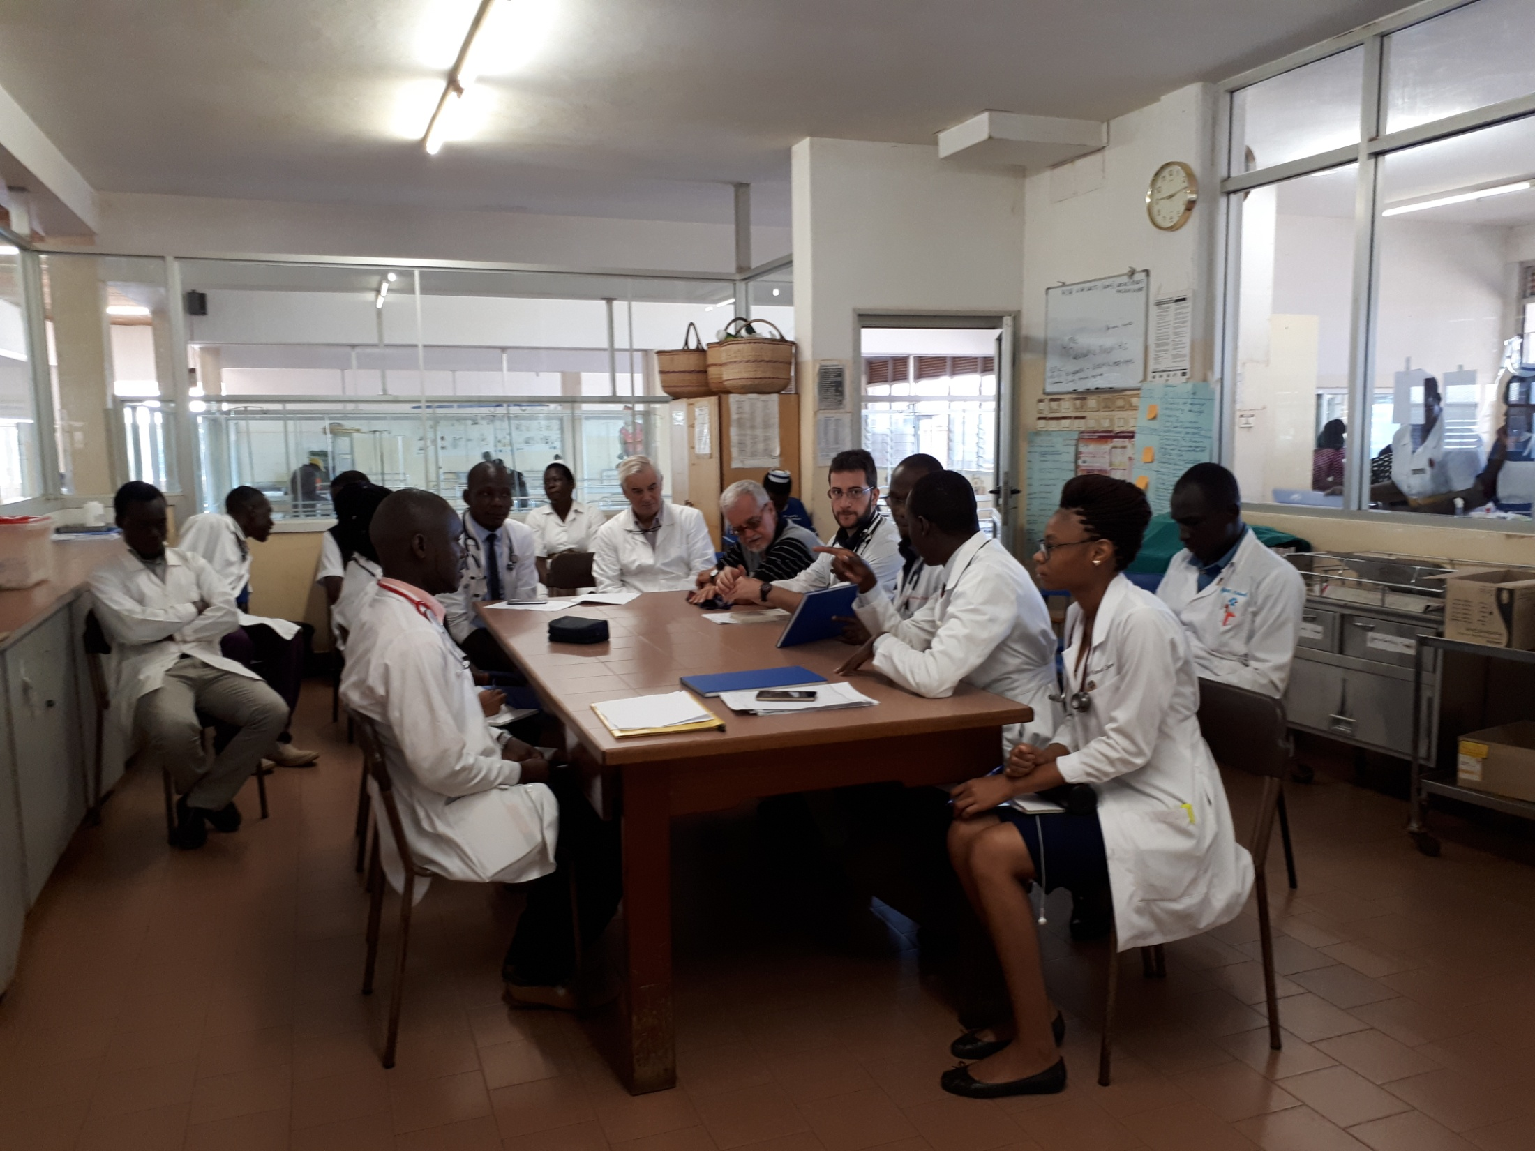
Daily morning meeting to discuss deaths and clinical cases

Slide 34
Change in the quality scores from 2018 to 2020 as % of starting score

Slide 35
PRELIMINARY COMMENTS
LACOR: the actions put in place to improve the structure, the management and the procedure at the Children’s ward, allowed a steep rise in the achieved percentage of the maximum score.
The starting status at Lacor was very decent in 2018, so dramatic changes could not be expected. After the first year (Time 3 = 3rd trimester) minimal changes were observed for most items.
KALONGO: The starting status at Kalongo suffered in 2018 by several gaps, so the scores of each domain improved gradually over the first 5 trimesters.
The children’s ward was completely re-established in 2018-2019, and this allowed a significant catch up in the scores achieved.
The erratical presence of a paediatric specialist was related to the several gaps observed in the Clinical procedures.
Training suffered from the absence of supervision and the occasional presence of trainees.

Slide 36
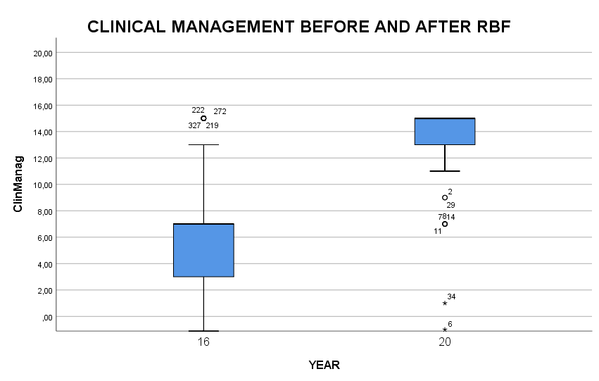
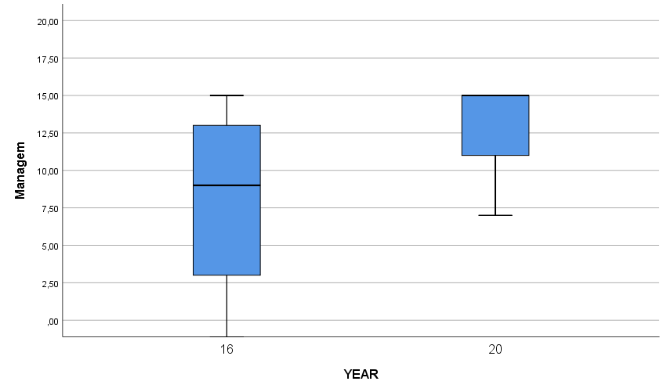
Improvement of Clinical Management at Kalongo and Lacor comparing 150 clinical records of 2016 (Start) to 150 of 2020 (End) in each hospital
KALONGO
LACOR

Slide 37
Multivariate analysis of variables discriminating before/after the RBF initiative
Fase | ACTION
 |  | WilKsl
 |  |  | Variance R. | Sign.
1 | Symptom | 0,816 | 58,451 | 0,000
2 | Weigth | 0,731 | 47,521 | 0,000
3 | Exam | 0,711 | 34,865 | 0,000
The accuracy of reporting the symptoms of the patient according to his clinical history and environment
The detailed examination of the child
The systematic reporting of weight and growth parameters
DO BUILD THE SIGNIFICANT IMPROVEMENT AFTER THE RBF INITIATIVE

Slide 38
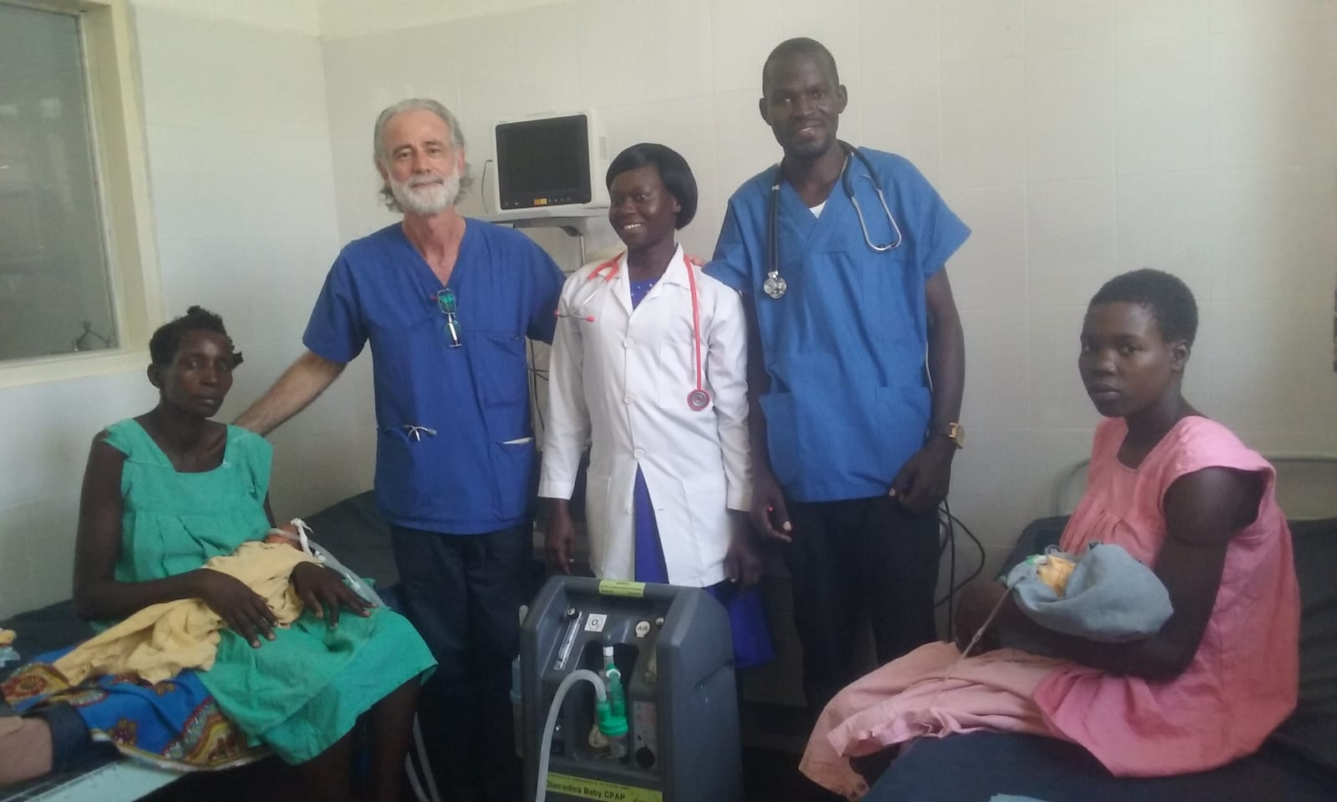
Staff of Kalongo dealing with a new oxygen concentrator

Slide 39
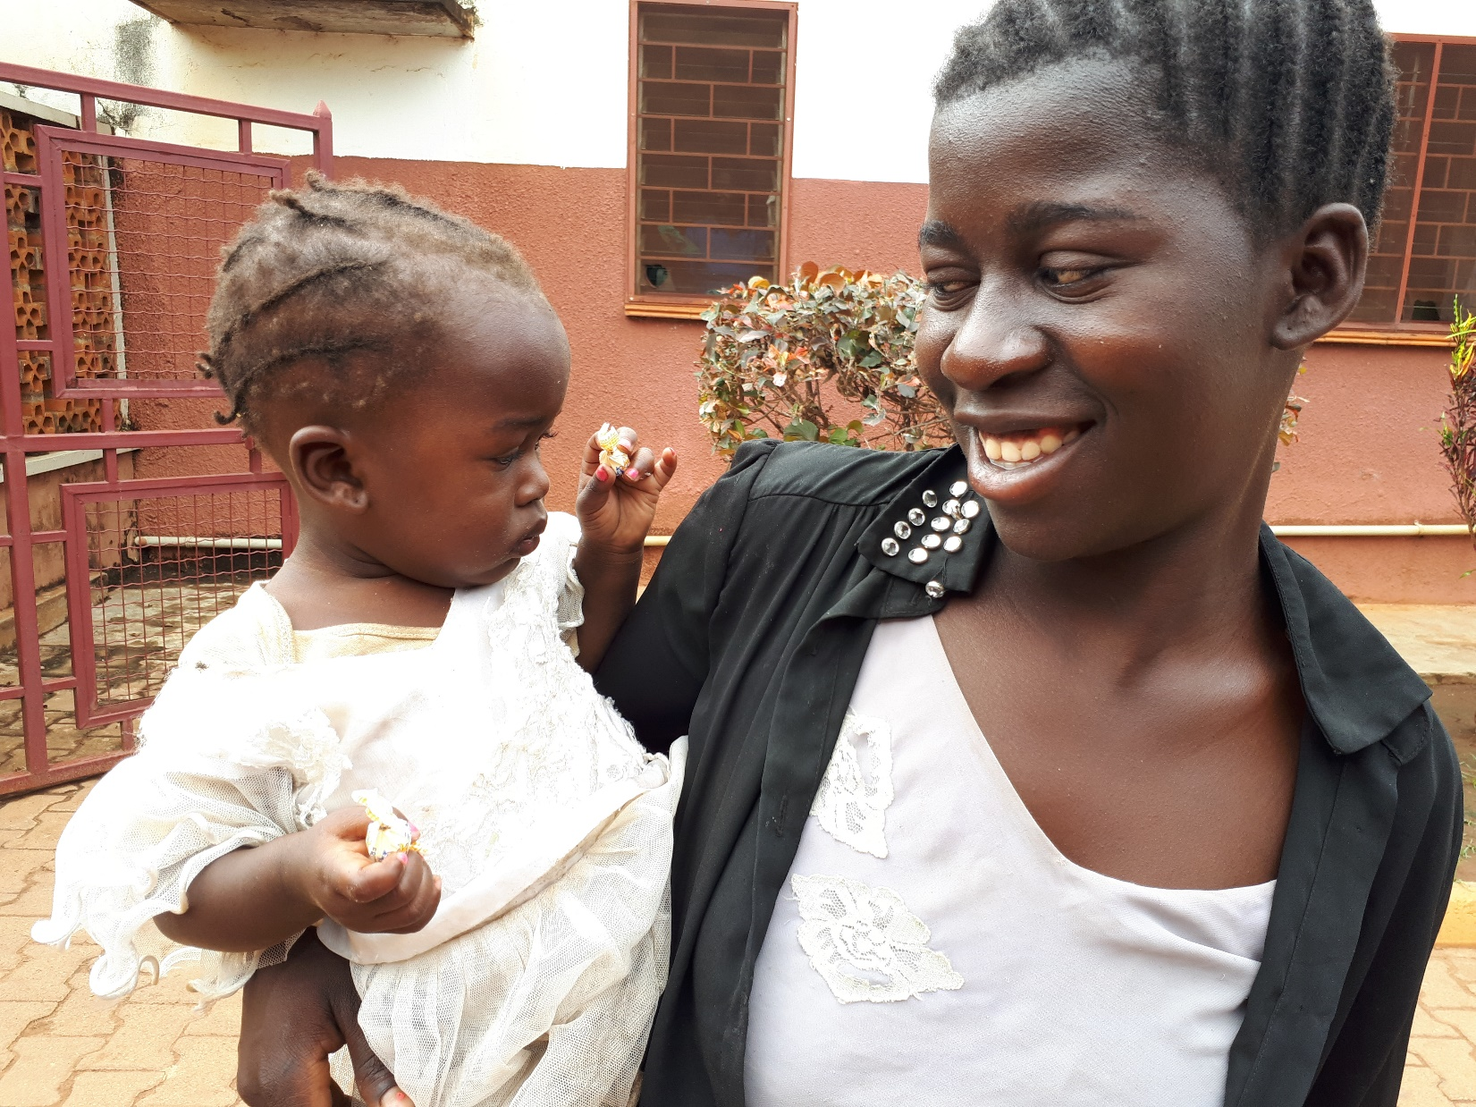

Slide 40
NURSING PROCEDURES REVIEW FORM
CASE ID __________ Admitted |__|__|____| Discharged |__|__|____| Age mo|_____|
DIAGNOSIS:_______________________________________________________________
Proper administration of therapies of 10 x 8 admitted cases | SCORE
1) Therapies have been given properly (Oral, injection, IV line, fluids) | N.A. 0□ NO -1□ Unclear 1□ YES 3□
2) Charts correspond to the correct patients | N.A. 0□ NO -1□ Unclear 1□ YES 3□
3) Weight and vital signs recorded (Wt, Temp, Resp Rate etc) | N.A. 0□ NO -1□ Unclear 1□ YES 3□
4) Fluids balance chart is present, when applicable | N.A. 0□ NO -1□ Unclear 1□ YES 3□
5) Bowel actions recorded in case of diarrhea - dehydration | N.A. 0□ NO -1□ Unclear 1□ YES 3□
TOTAL SCORE

Slide 41
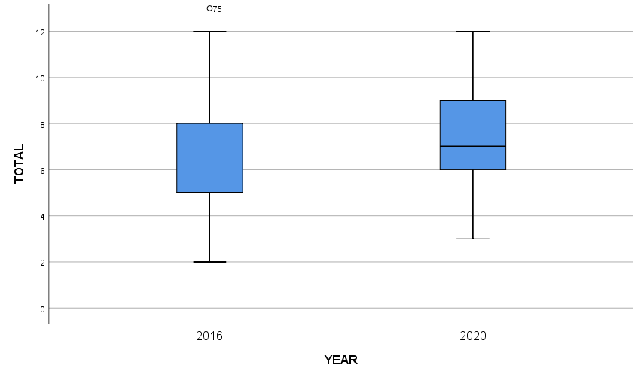
Score of Nursing Procedures in Kalongo and Lacor comparing > 100 Nursing records Before/After by Valentina Mozzi (R.N.)
KALONGO
LACOR

