Slide 1
Genetics of Celiac Disease :
Il Giardino da esplorare
Debating with luigi greco on March 2023
European Laboratory for Food Induced Diseases
Univ. Federico II

Slide 2

QUANTA GENETICA ?
Possiamo chiedere a loro?
CONCORDANZA PER CELIACHIA :
MONOZIGOTI = 85-90%
DIZIGOTI = 10-18%
FRATELLI = 10-12%
Greco L, Stazi M, Clerget-Darpoux F. Twins and family contribution to genetics of celiac disease,(2008) Pediatric and Adolescent Medicine, 2008;12:46-56.

Slide 3

Carmela is …..
DR3-7
DQ2-8
Chrom 5q31-33
HLA DR Extended
Chrom 19p13.1
MIC-A-B / TNF
Chrom 11, 9, 15
CTLA4
+ Hundreds more genes with minor effect
…ggeniale !!

Slide 4
Genetica della malattia celiaca
Geni HLA associati
(40% della ereditarietà)
Geni non HLA
(60% della ereditarietà)

Slide 5
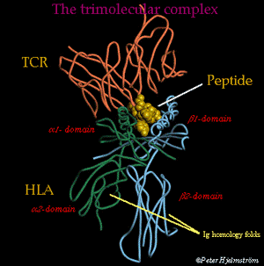
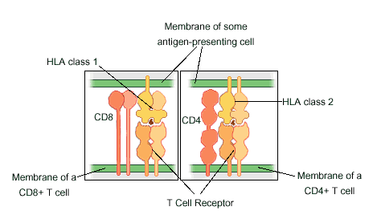
La funzione dell’ HLA
L’ HLA di Classe I presenta antigeni presenti nella cellula (Self)
L’ HLA di Classe II presenta antigeni presenti fuori dalla superficie cellulare (Non Self)

Slide 6


DQ2= Una Coppia di Poliziotti
TED
DQB1*0201
JANE
DQA1*0501
Sono questi due che arrestano il peptide e lo presentano alla Cellula T

Slide 7
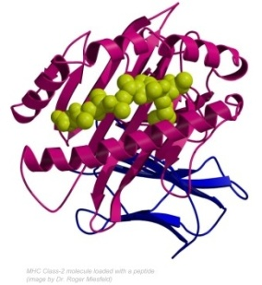


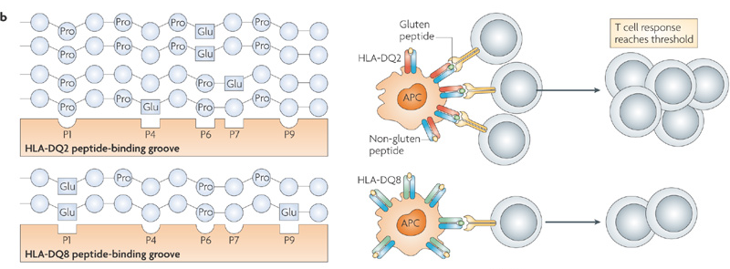
DQ2 + DQ2
DQB1*0201/DQA1*0501
DQB1*0201/DQA1*0501
La coppia DQ2 può ‘arrestare’ peptidi a carica negativa nelle tasche P4, P6, P7 e riesce a localizzare bene le sequenze a Prolina : questa la rende così importante nel generare la risposta T-cellulare
Notes:
7

Slide 8


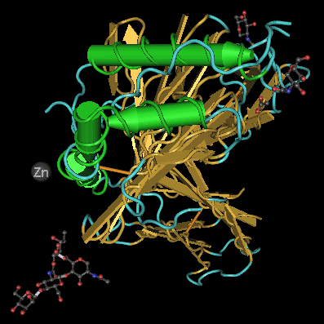
DQ2 + DQ2
DQB1*0201/DQA1*0501
DQB1*0201/DQA1*0501
DQ2 in trans
DQB1*0201/DQA1*0501
DQ2 in cis
DQB1*0201/DQA1*0501
DQ8
DQB1*0302/DQA1*0301

Slide 9

Genetica della malattia celiaca
Fattori associati all’ HLA
circa il 90-92% dei pazienti ha l’ HLA-DQ2 (formato dall’eterodimero DQA1*0501,DQB1*02)
  nei casi HLA-DQ2 negativi vi è l’ HLA-DQ8
  (formato dall’eterodimero : DQA1*0301,DQB1*0302)
  L’assenza di questi aplotipi comporta un rischio praticamente nullo (< 0,1%) di sviluppare la intolleranza al glutine

Slide 10
Rischio associato all’HLA DQ
 |  |  | HLA DQ | Rischio%
Popolazione generale |  |  | Ignoto | 1-2%
Popolazione generale |  |  | DQ2 o 8+ | 2-4%
Popolazione generale |  |  | DQ2 o 8- | 0%
Parenti di primo grado |  |  | Ignoto | 10-15%
Parenti di primo grado |  |  | DQ2 o 8- | 0%
Parenti di primo grado |  |  | DQ2 o 8+ | >15%
N.B. Circa il 40% della popolazione porta geni HLA DQ2 o DQ8

Slide 11
Rischio per un fratello di un probando in accordo al genotipo DQ dei genitori
DQA05/05
DQA07/03
DQB02/02
DQB1*02/02
Stima del rischio in base al genotipo dei genitori
Rischio > 20%
15% < Rischio < 20%
10% < Rischio < 15%
1% < Rischio < 10%
Rischio < 1%

Slide 12
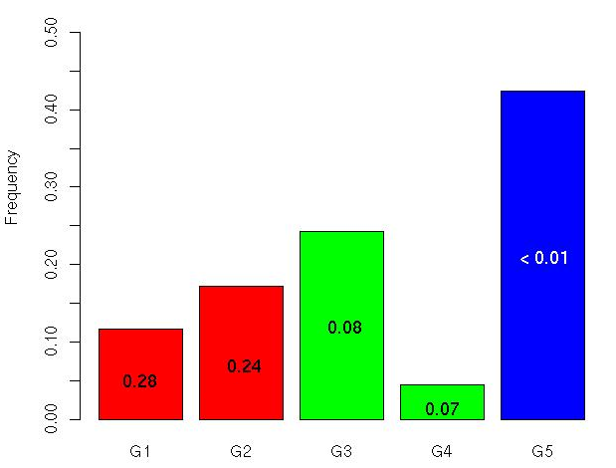
PROBABILITA’ PER UN FRATELLO DI UN PROBANDO DI APPARTENERE A Gi E RISCHIO CORRISPONDENTE
DQ8 o 1/DQ2
Risk < 1 %
1% < Risk < 10 %
Risk > 20 %
0.42
Un solo DQ2
0.24
Doppio DQ2
0.17
0.12
0.05

Slide 13
CONCLUSIONI
Un fratello di un celiaco probando ha un rischio di ricorrenza medio del 10-15% di sviluppare la celiachia;
Secondo l’HLA DQ del probando, la stima del rischio per il fratello varia dal 2 al 20%;
Secondo l’HLA dei genitori, la stima del rischio può essere rifinita dall’ 1 al 29%;
Nel 40% dei casi, l’ HLA dei genitori sarà sufficiente a dare una stima accurata del rischio per il loro bambino. In altri casi sarà necessario conoscere il genotipo del bambino, subito dopo la nascita, al fine di dare maggiore precisione alla stima del rischio.

Slide 14
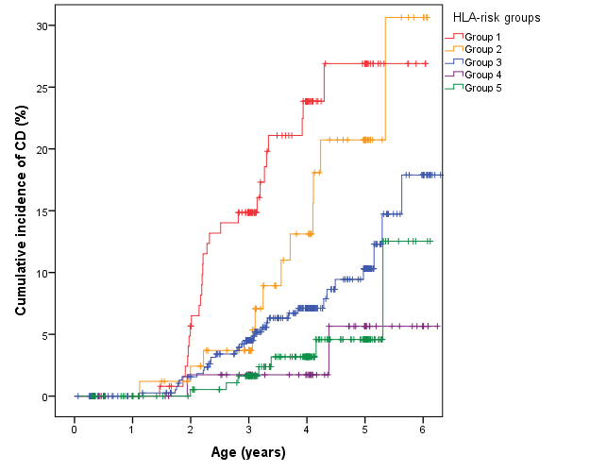
New cases by HLA Risk Group – PREVENT-CD
1000 nati da famiglie con un probando CD
28-30%
DQ2/2
DQ2 trans
DQ2
DQ8/X

Slide 15
CONCLUSIONI
40% dei fratelli di un celiaco probando avrà un rischio trascurabile (< 1%);
in tal modo 40% delle famiglie di un celiaco potranno ricevere un messaggio davvero rassicurante
30% avrà un rischio alto o molto alto (> 25%)
in tal modo sarà possibile proporre speciali attenzioni durante il follow-up di questi bambini ad alto rischio

Slide 16
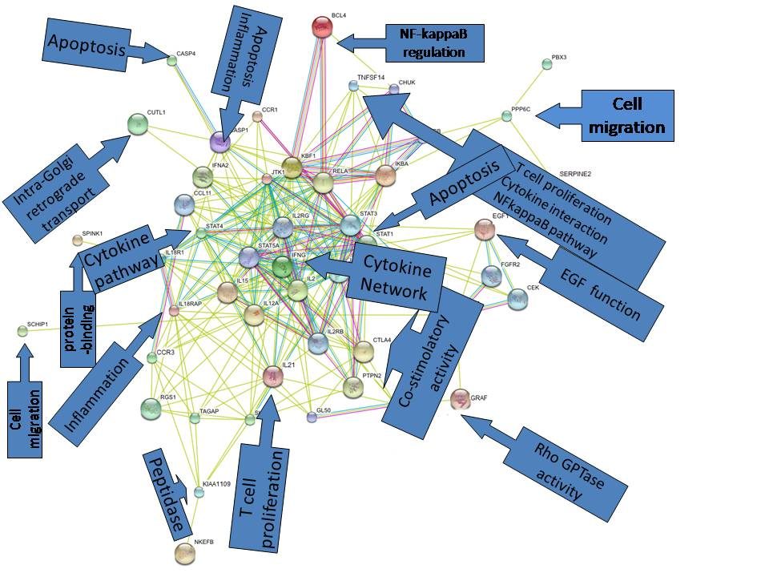
NON-HLA
Celiac disease,
associated
genes and
pathways

Slide 17
How many genes explain the very strong genetic component of CD ?

Slide 18
Half of heredity is missing:
How many polymorphisms will explain this half ??
Nature Genetics, May 2012, 483
Malattia | Ereditarietà | % Varianza spiegata | N. di Polimorfismi SNPs
Celiachia | 0,5-0,87 | 44% (40-47) | 2550
Diabete | 0,2-0,69 | 49% (46-53) | 2919
Artrite Reumatoide | 0,53-0,68 | 18% (15-20) | 2231
Infarto | 0,3-0,63 | 48% (43-54) | 1766
Polymorphisms in very common genes have a very low risk: from 1,001 to 1,1 : which show near identity with non affected people , but could be explored with immense samples

Slide 19
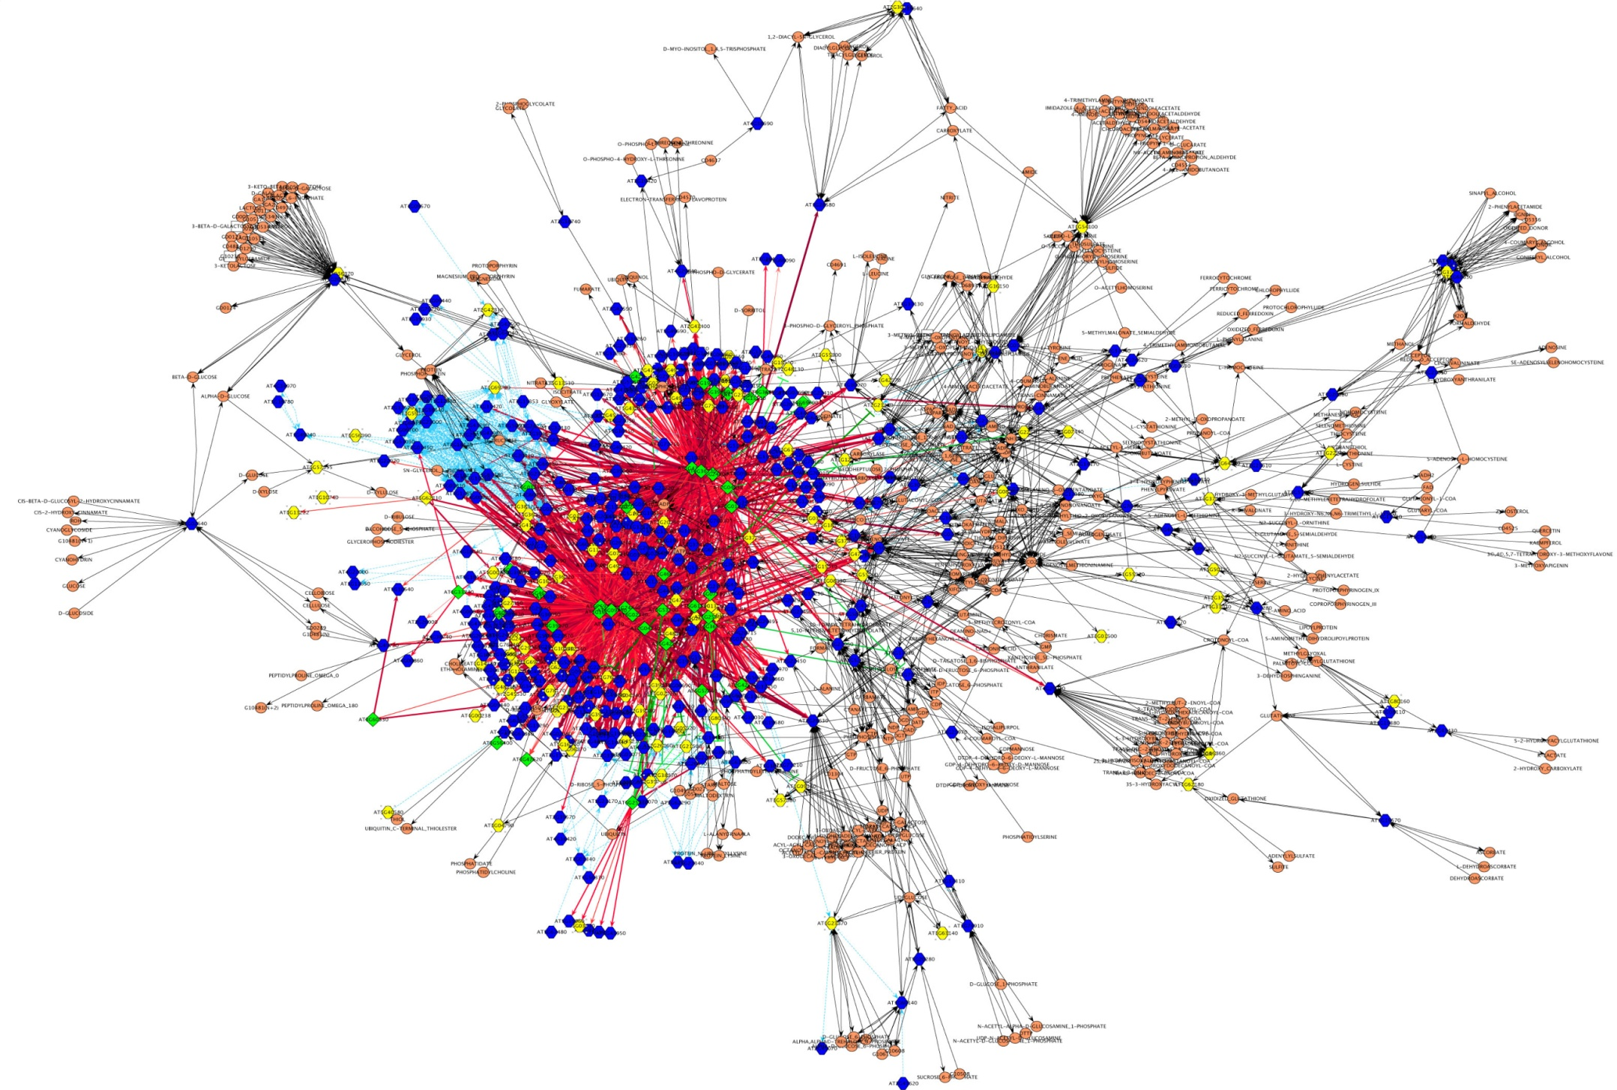
CD Associated Pathways??? Physiology ?

Slide 20
Che ci dicono questi geni?
Non ci sono geni alterati
La maggior parte dei loro Regolano la Espressione Genica
I più sono coinvolti nella normale risposta immune ai patogeni
Ancora altri servono alle difese innate non immuni
Ci sono molti geni di VANTAGGIO, altrimenti la Celiachia sarebbe estinta

Slide 21
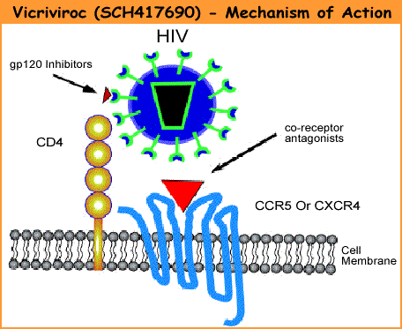
Here is the point of entrance of the AIDS virus!!!
Missing by mutation in CD
Is the CD associated Chemokine receptors

Slide 22
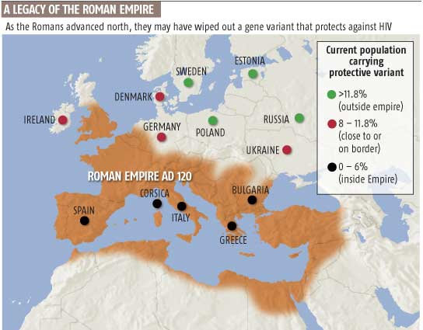
The CCR5-Delta32 mutation carrier has more chances to be proteced by the HIV Virus, because of the missing surface chain where the virus should be attached.
Togheter with the cultivation of wheat , the HIV virus moved to Europe

Slide 23
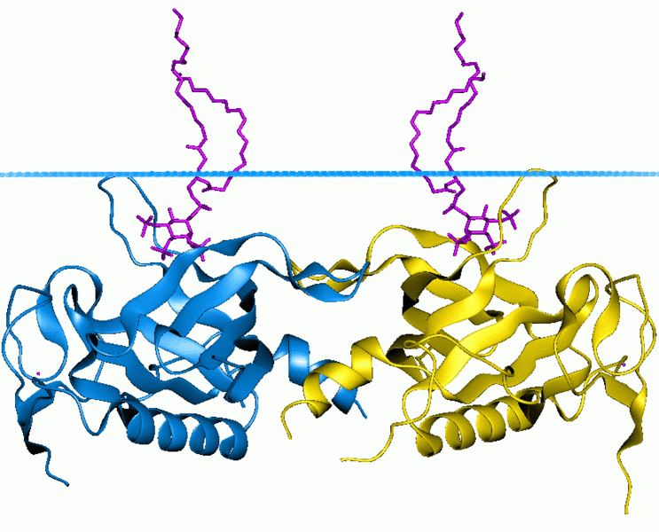
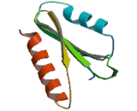
The SH2B3 gene is a cytokine signal inhibitor : it can reduce the level of intracellullar inflammation.
The CD associated Mutation of SHB3 works for the innate defense mechanisms, as a natural antibiotic

Slide 24
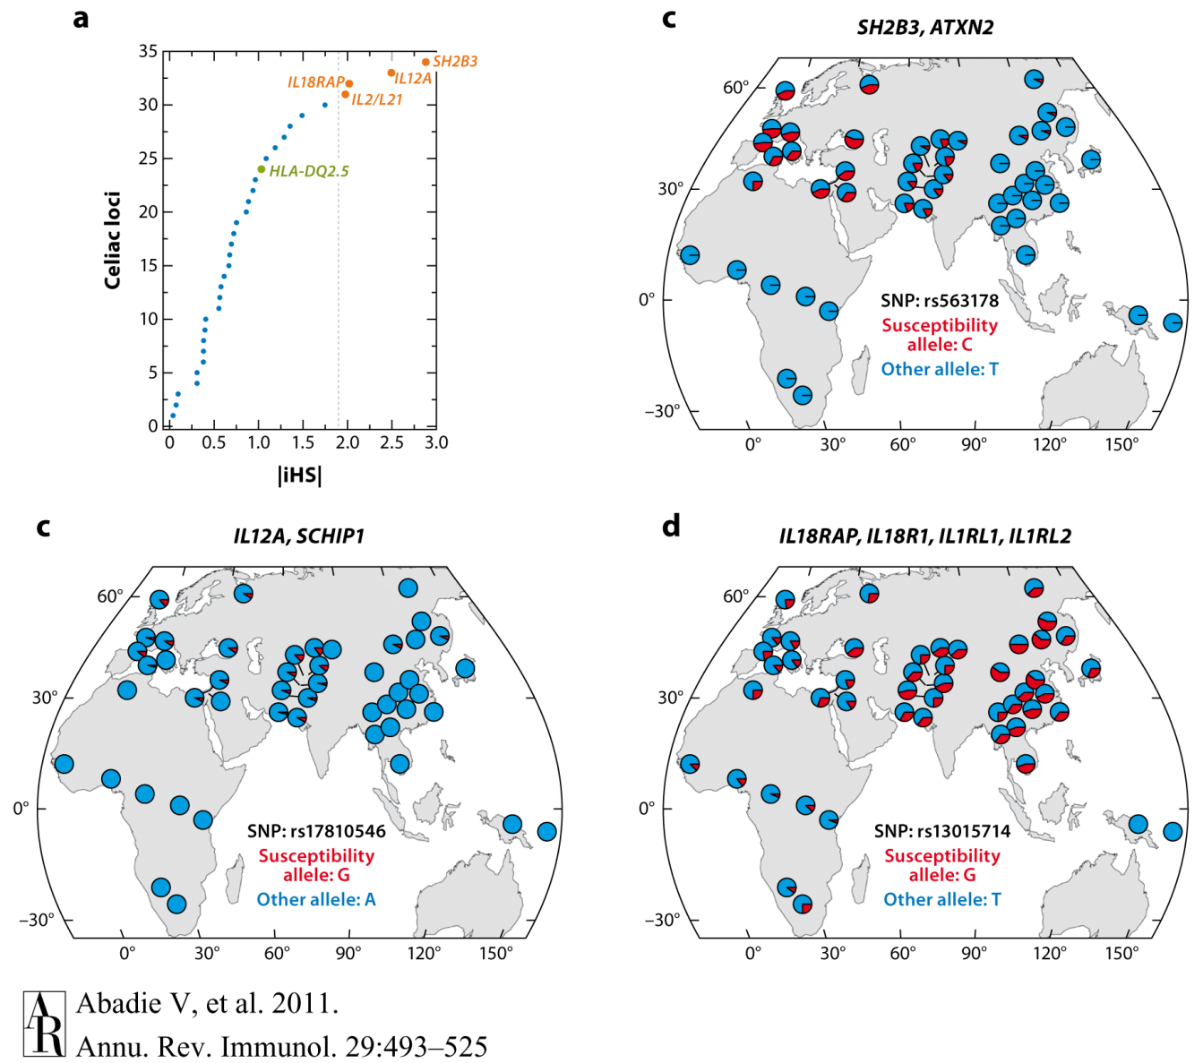
About a 1600 years ago , after some massive pest epidemics , individuals with a SHB3 mutation gained a selective advantage of survival
World distribution of the CD associated mutations

Slide 25
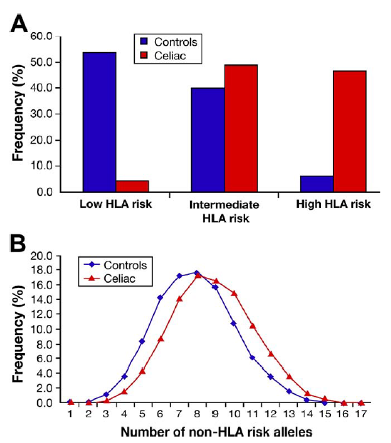
Biomarkers-pre weaning: genetics
54 Non HLA gene improve the estimate of genetic risk, expecially for children in a lower HLA risk class.
Romanos J. Et al. Gastroenterology 2009

Slide 26
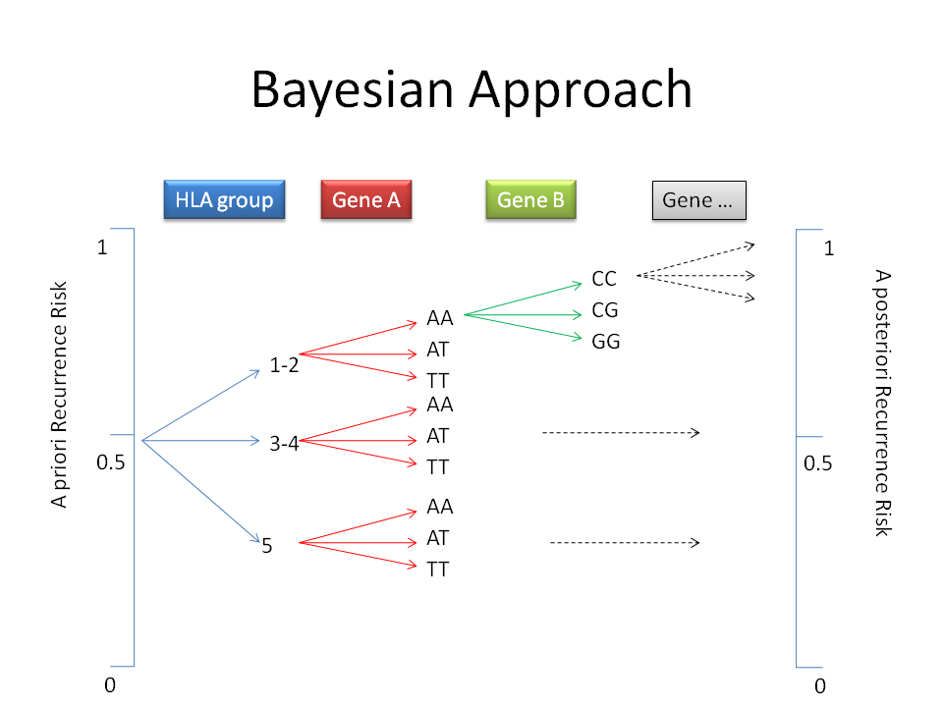
Predicting the Risk to get CD at birth
LPP
cREL
RGS1
0,20
0,04

Slide 28
No Dq2 or DQ8
DQ8
Double DQB1*02

Slide 29
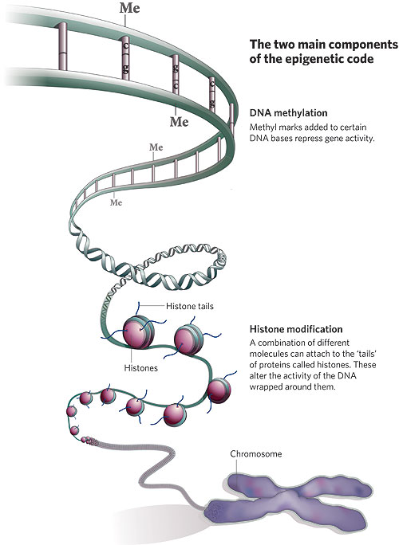
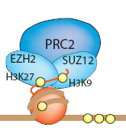
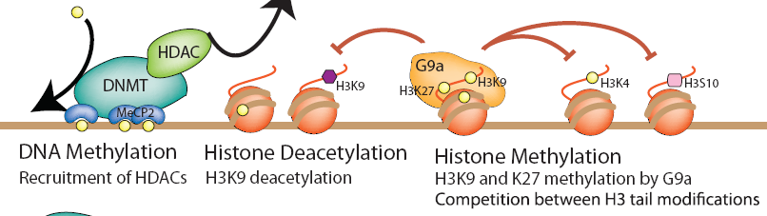
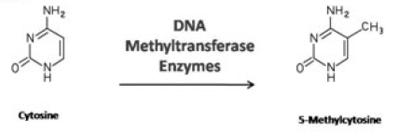
But the GENOMA is a written book : Life is the EXPRESSION of Genes

Slide 30


The expression of 5 candidate gene discriminate CD/CTRLS on a biopsy at 4 months before Gluten introduction
The aim of the discriminant analysis is to weigh the discriminating capacity of each single gene to obtain a single new composite variable.
Wilks' Lambda df1 Exact F Sig.
1 TNFAIP3 ,404 1 59,002 ,000
2 IL21 ,300 2 45,521 ,000
3 REL ,261 3 35,809 ,000
4 RGS1 ,235 4 30,143 ,000
LPP ,222 5 25,272 ,000
Wilk’s Lambda shows the ability to discriminate between Coeliac and Controls
1-------------------------------0
Wilks’ Lambda

Slide 31
DIFFERENT EXPRESSION PROFILES IN CASES AND CONTROLS AT 4 MONTHS

Slide 32


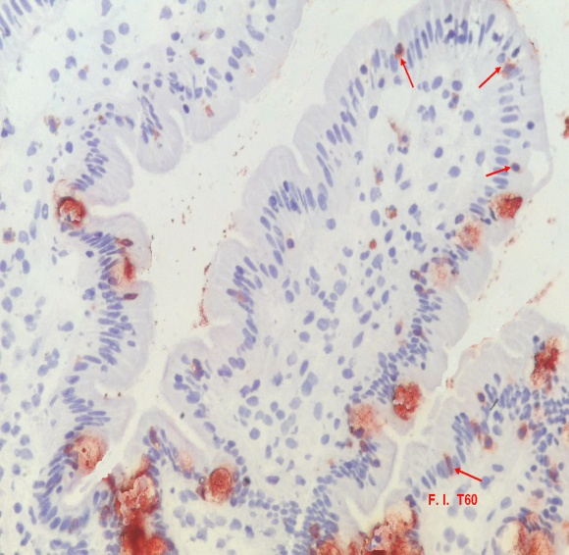
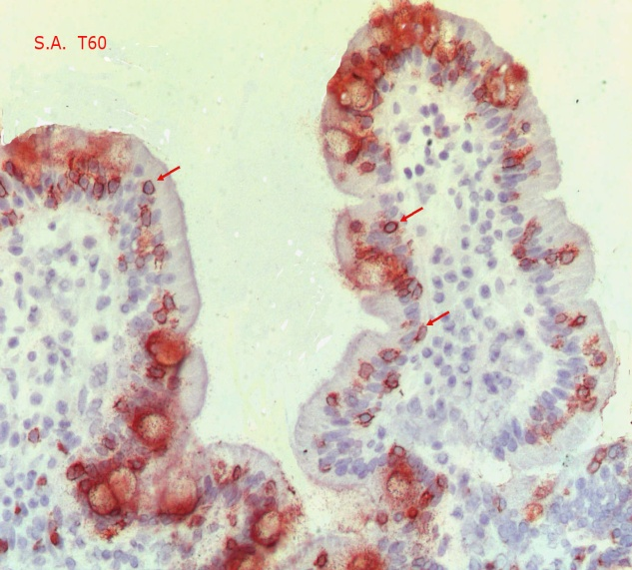
ON A BIOPSY ????
YOU JUST NEED GOOD EYES !

Slide 33

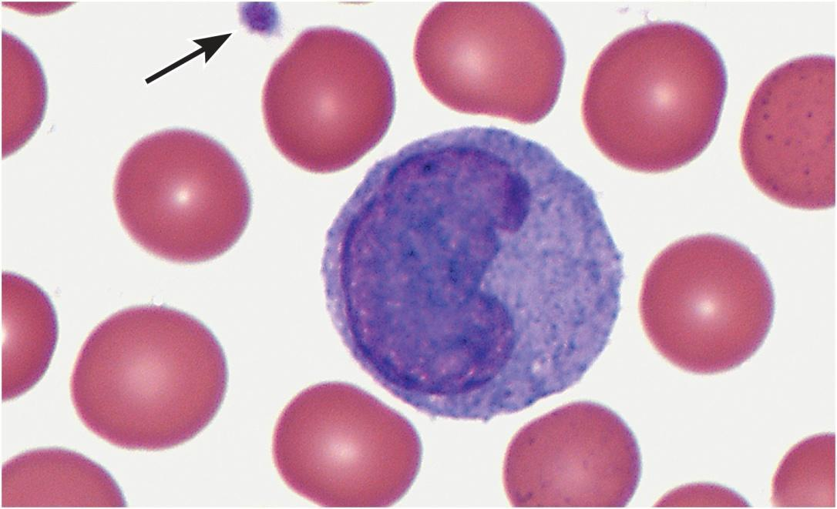
Could we try from Monocytes?

Slide 34
The expression of 4 candidate gene discriminate CD/CTRLS on blood monocytes Before Gluten introduction to the diet
we developed a similar linear discriminant analysis for the gene expression in peripheral blood monocytes. By stepwise statistic entered the expression of four candidate genes were selected by multivariate analysis of CD, similar to the results obtained in the duodenal tissue.
By computing the discriminant score and the relative membership probability, 95.5% of patients (91% controls and 100% celiac patients) were correctly classified.

Slide 35
HOW MUCH GENE EXPRESSION IN MONOCYTES SEPARATE CELIACS FROM CONTROLS: 95-100%?

Slide 36
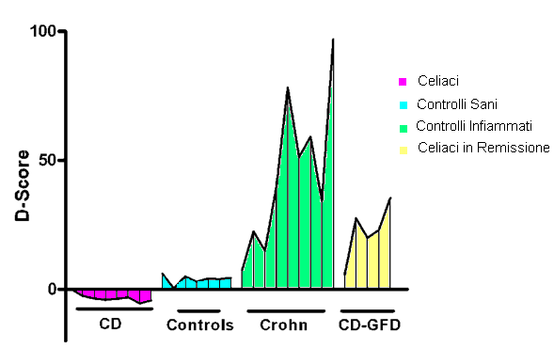
Gene expression discriminate CD from Crohn and celiac on GFD before the onset of disease
The D-Score for active celiac patients was negative in all cases, while it was positive for all the other groups on differentiated clusters.
celiac

Slide 37
CONCLUSIONS
We obtained a stimulating suggestion of the possible relationships among the expression of candidate genes in the target mucosa, and in the peripheral blood Monocytes.
By a discriminant analysis approach we identified different functional pathways involved in the complex gluten induced abnormal responses!
We now suggest that the expression of a small set of candidate genes identified CD patients without considering clinical data, HLA and anti-tTG antibodies.

Slide 38
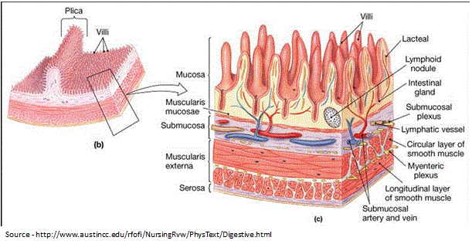
Ma un tessuto è troppo affollato! Separiamo Epitelio da Lamina Propria

Slide 39
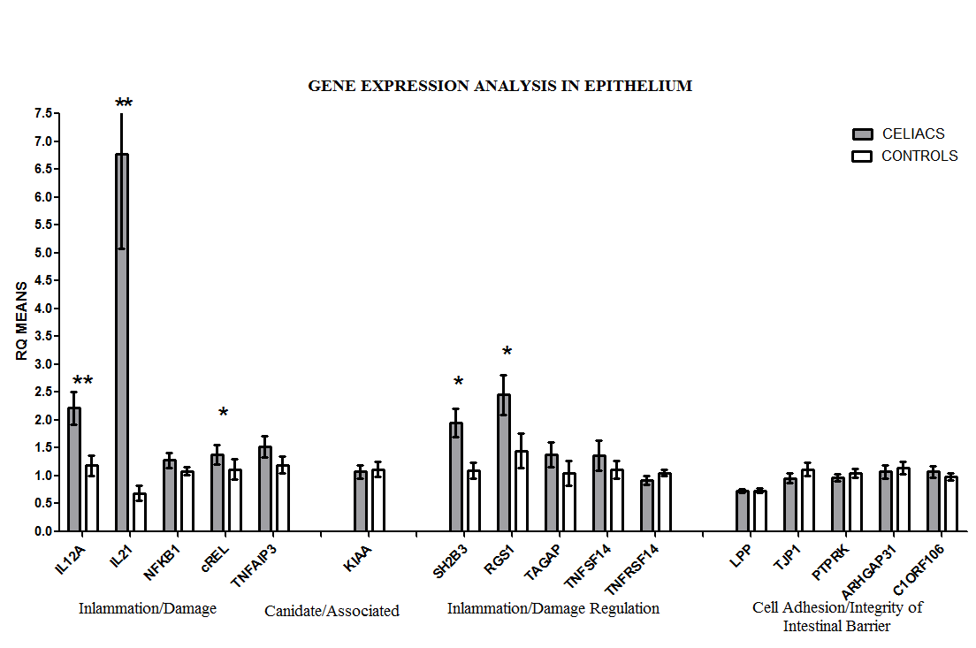
Gene expression in Epithelium
Strong up-regulation
Remarkable up-regulation
No activation
Difference between CeD patients and Controls were evaluated by the rank-sum test (Mann-Whitney) because there is asymmetry in their distribution.*p<0.05 **P<0.01

Slide 40
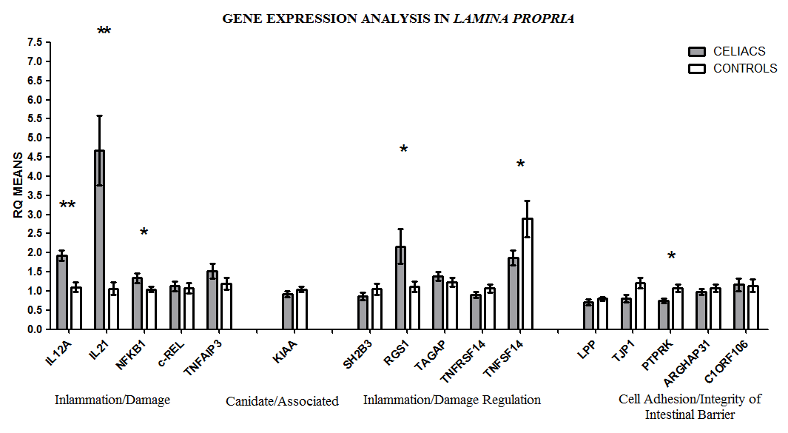
Gene expression in Lamina Propria
Still up-regulation
Here they are less expressed
Difference between CeD patients and Controls were evaluated by the rank-sum test (Mann-Whitney) because there is asymmetry in their distribution.*p<0.05 **P<0.01

Slide 41
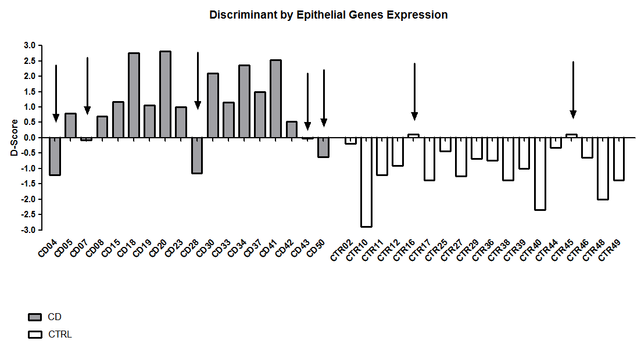
Signature of CeD versus Controls in Epithelium (80% correct)

Slide 42
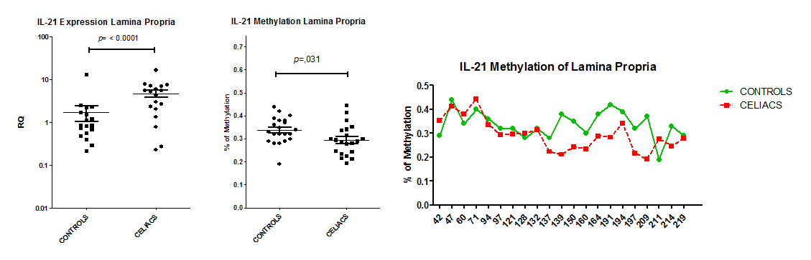
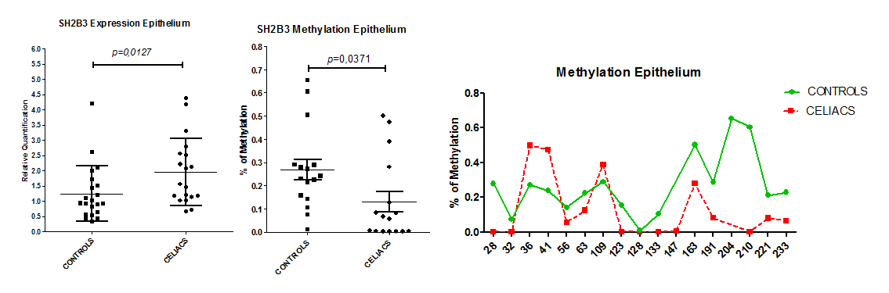
Methylation Analysis
IL21 and SH2B3 genes are more expressed and also less methylated in CeD vs CTRs.

Slide 43
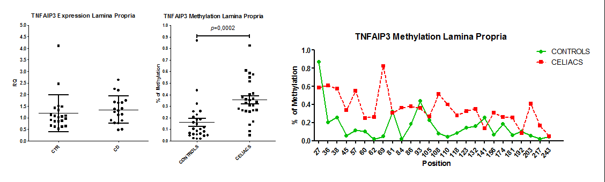
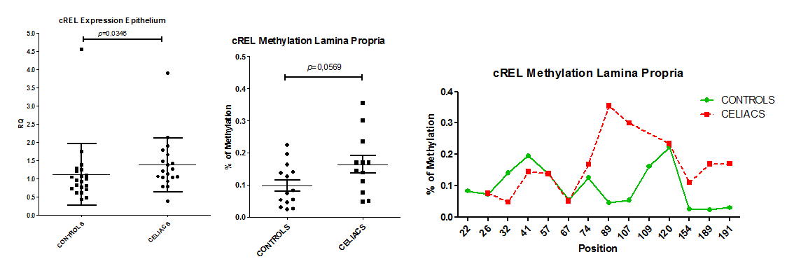
Methylation Analysis
TNFAIP3 showing low methylation in Lamina Propria of CeDs does not increases gene expression.
C-REL, shows higher expression in CeD versus CTRL in Epithelium, and an inverse methylation in Lamina Propria

Slide 44
CONCLUSIONS
Gene expression is the actual phenotype of the gluten-induced mucosal lesion (better than histology)
The pathway of relationship among functional gene is disrupted in CeD
The relationship between gene methylation and their expression is complex:
  not simply concordant
  other mechanisms of gene regulation are online

Slide 45

There are still many flowers to be find in this field!

Slide 46
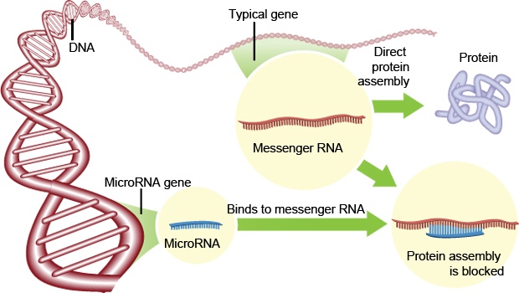
I microRNA regolano la trascrizione di molti geni
Inflammation and infection induce a coordinated program of miRNA expression in monocytes that regulate inflammatory response
SNPs of CTLA4 and IL23R alter recognition by microRNA resulting in dysregulated expression

Slide 47
miRNA expression pattern in small intestine of CD patients, Sacchetti & Greco 2011
A
25%
(n=90)
33%
(n=27)
Active CD
22%
(n=82)
Different from controls
Equal to controls
53%
(n=193)
67%
(n=55)
Not expressed
B
On GF Diet
25%
(n=90)
31%
(n=22)
19%
(n=71)
Equal to controls
69%
(n=49)
56%
(n=204)
Different from controls
miRNA expression in the small intestine of patients with active CD (Panel A) and of CD patients on a GFD (Panel B). Data are expressed as percentage of miRNAs tested (n=365). White areas, miRNAs whose expression levels were similar in the two CD groups and controls; gray areas, miRNAs not expressed; black areas, miRNAs whose expression levels differed between CD patients and controls (up-regulated ↑(RQ≥2.0) or down-regulated ↓(RQ≤0.5)).

Slide 48
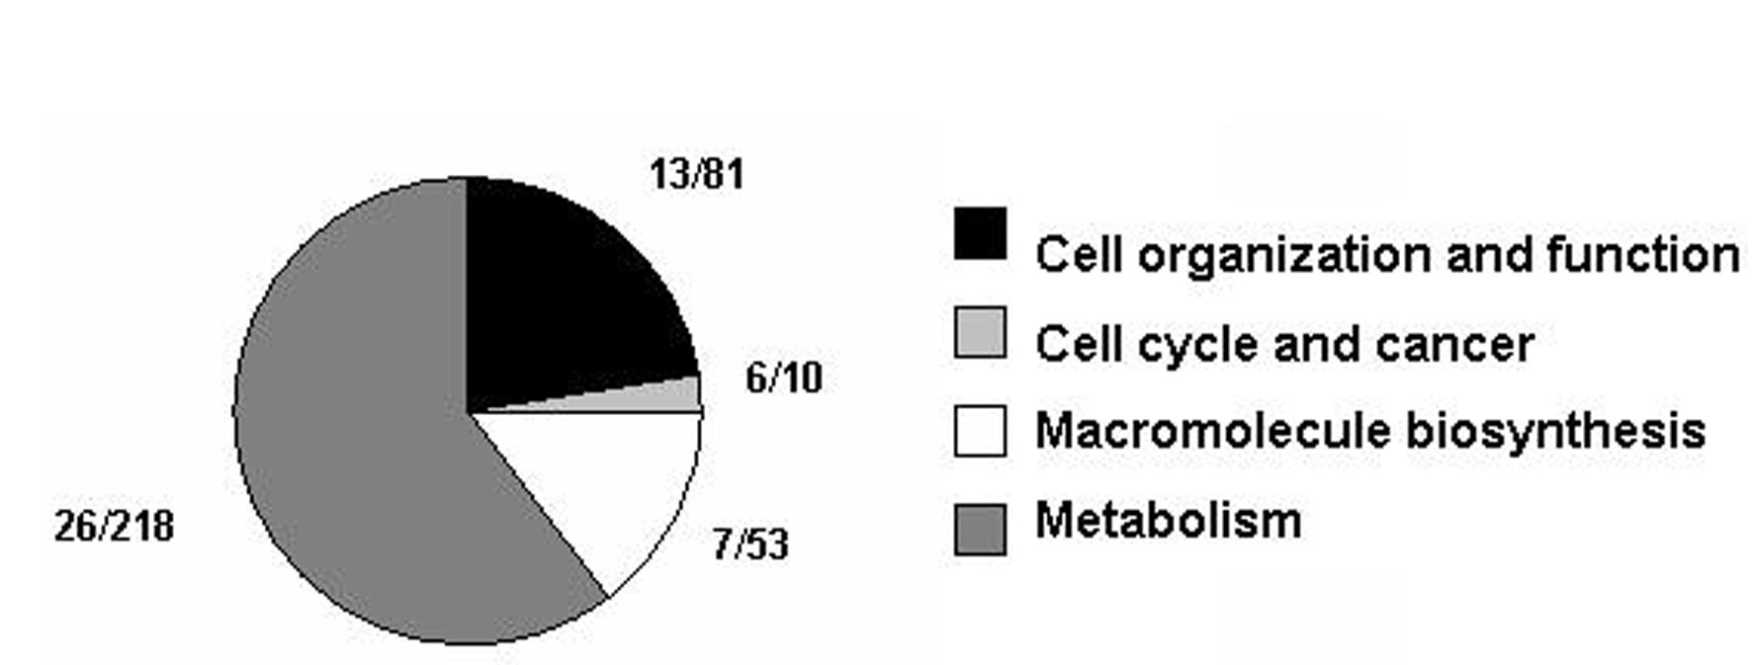
microRNA 449 is 55 volte higher in celiacs versus controls
miR-449a putative target genes with most favorable context score, selected by bioinformatics, were sorted into pathways using GOTM (http://bioinfo.vanderbilt.edu/webgestalt/) and then combined into functional groups.
In each functional group are reported the genes belonging to NOTCH pathway/total gene number.

Slide 49
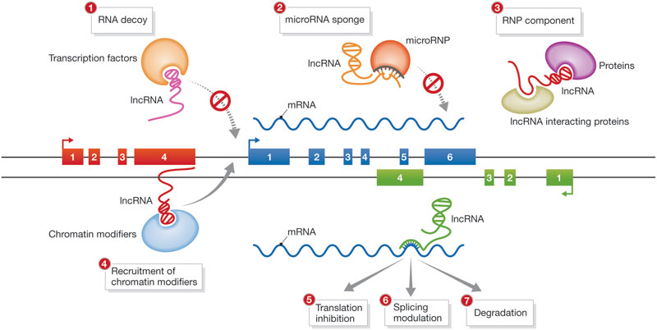
I long non coding RNA hanno un ruolo chiave, specifico per tessuto, nel modulare la Espressione
Epigenetic regulator of INF expression : susceptibility to infections

Slide 50

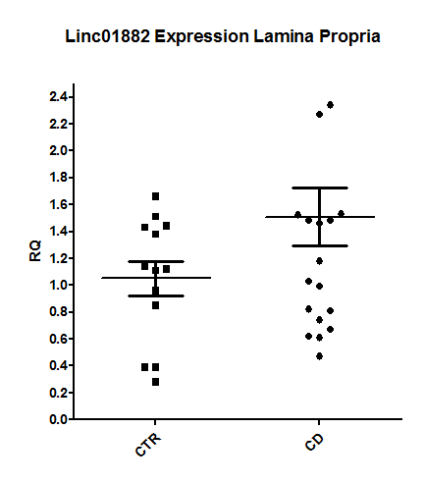
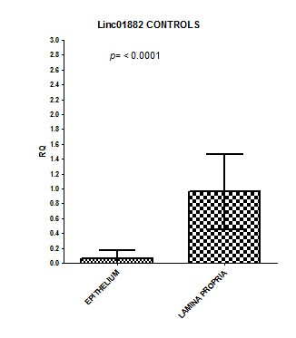
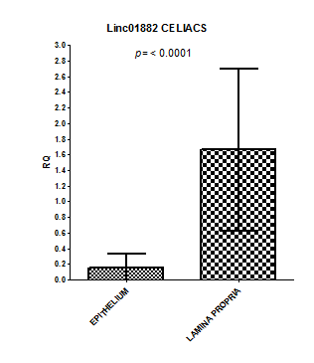
PROGRESS REPORT
GRANT 007_FC_2017
Long Non Coding RNA: gene-expression
AC007220.1
LINC01890
CCDC26
LINC02435
AL080284.1
6. AL139246.5
LINC01882
(AP005482.1)
No expression in intestinal cells
Equally expressed in CD and CTR , both in EP and in LP
Differentially espressed in CD vs CTR, in lamina propria
The gene expression analysis in epithelium is not avaible because it is not detectable.
LOCI | CHR | START (hg19) | END(hg19) | Genes* | Disease | LincRNAs | eQTLs
18p11.21 | 18 | 12773338 | 13372192 | PTPN2 | CeD, CD, T1D | AP005482.1 | Yes

Slide 51
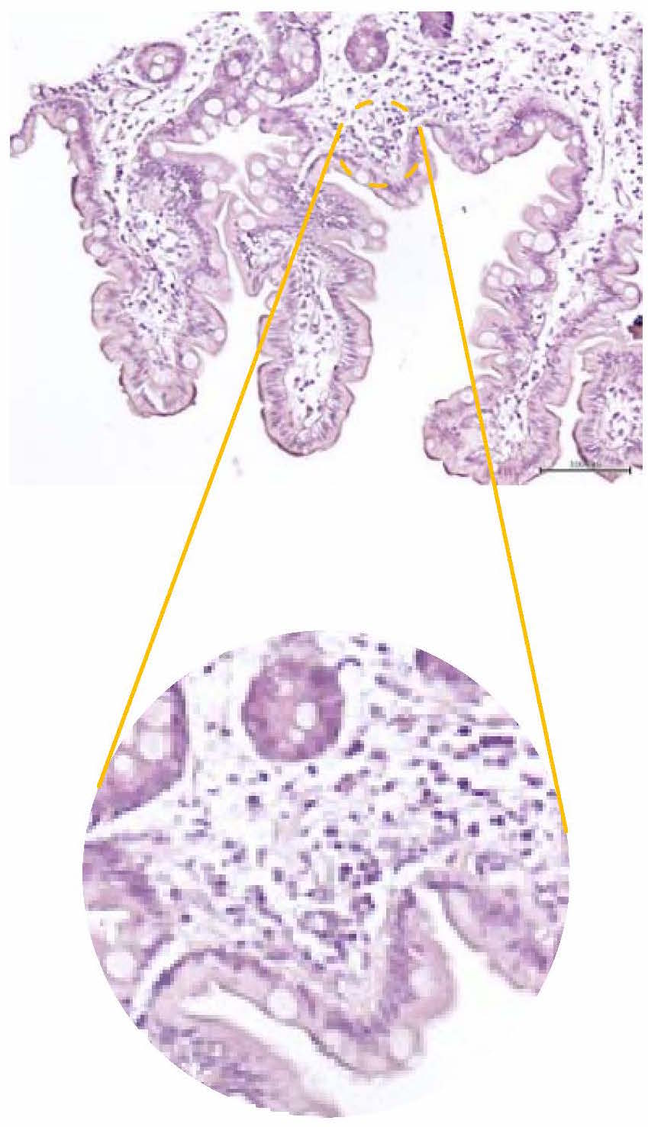
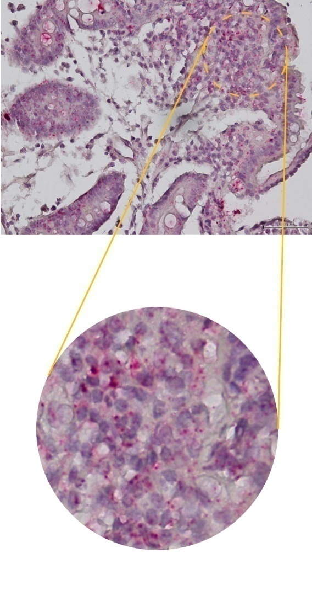
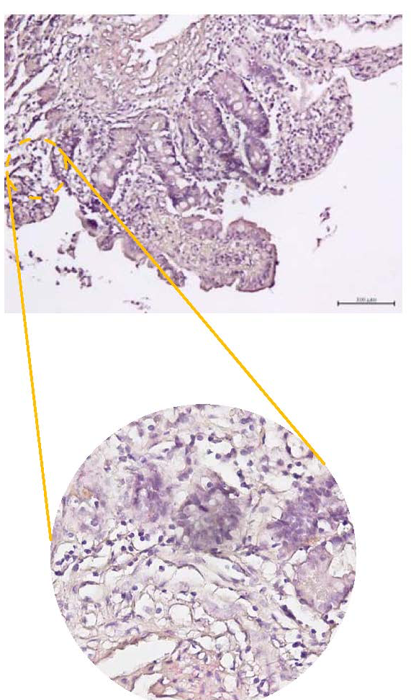
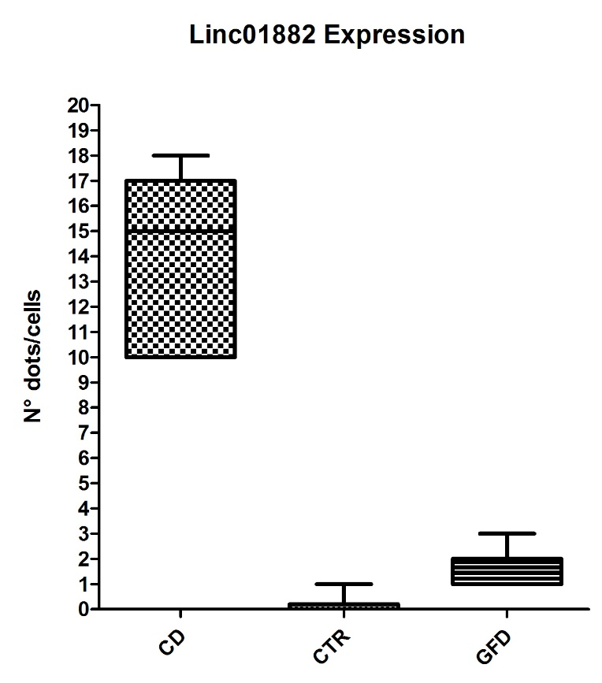
Linc01882 lncRNA expression in
Small intestinal mucosa
CTR
Linc01882 probe
Active CD
Linc01882 probe
Gluten free diet
Linc01882 probe
(<1dot/10cells)
(1-3 dot/cells)
(10-15 dots/cells)
100% analysed cells

Slide 52

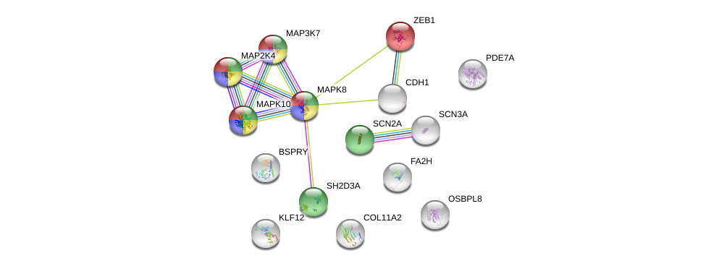
Bioinformatic Analysis of genes target of Linc01882
Toll-like receptor signaling pathway
TNF signaling pathway
Signaling by Interleukins
Cellular response to stress
NEXT STEP….
To analyze the Linc01882 target gene expression, and its effects on downstream pathways. In particular our attention is focused on the Zeb1 and MAP2K4 involved in T cell activation.
To evaluate the expression of Linc 01882 at peripheral blood cells and in the progression of Celiac Disease to consider it as potential biomarkers of diagnosis or of the damage to intestinal mucosa
We identified a long non-coding RNA (Linc01882) that could allow us to discriminate between CD and CTR
We characterized the expression of Linc01882 in intestinal mucosa and we highlighted the molecular pathways in which it’s involved

Slide 53
There are still many flowers to be find in this field!

