Slide 1
Genetics of Celiac Disease :
From the Bible of Genes to the expression
Discussion with luigi greco on September 2023
European Laboratory for Food Induced Diseases
University of Naples Federico II

Slide 2

HOW MUCH ‘GENETIC’
May we ask twins?
Celiac Dis. CONCORDANCE:
MONOZYGOTES = 85-90%
DIZYGOTES = 10-18%
SIBS = 10-12%
Greco L, Stazi M, Clerget-Darpoux F. Twins and family contribution to genetics of celiac disease,(2008) Pediatric and Adolescent Medicine, 2008;12:46-56.
Luigi ↔ Donato ??

Slide 3
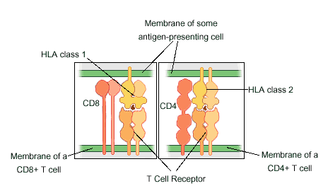
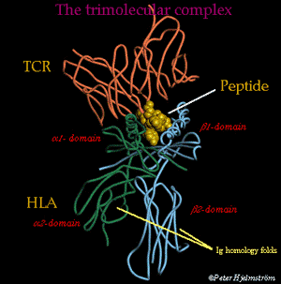
HLA gene first in line in CD!
90-92% carry the HLA-DQ2
(made by DQA1*0501,DQB1*02 heterodimer )
  8-10% carry the HLA-DQ8
  (made by the DQA1*0301,DQB1*0302 heterodimer)

Slide 4

HLA DQ associate risk estimate
 |  |  | HLA DQ | Rischio%
General Population |  |  | Unknown | 1-2%
 |  |  | DQ2 or 8+ | 2-4%
 |  |  | DQ2 and 8- | 0%
First Degree Relatives |  |  | Unknown | 10-15%
 |  |  | DQ2 and 8- | 0%
 |  |  | DQ2 o 8+ | >15%
N.B. 35-40% of the population carry the HLA DQ2 o DQ8

Slide 5


DQ2= a smart couple of cops!
TED
DQB1*0201
JANE
DQA1*0501
These are the one than entrap the gliadin peptide to T-Cells

Slide 6
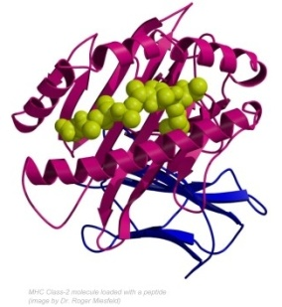


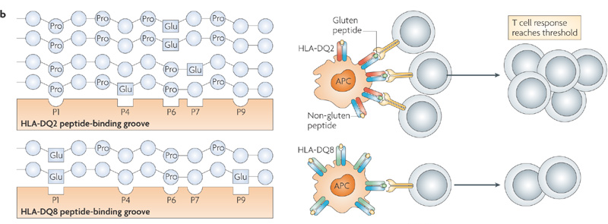
DQ2 + DQ2
DQB1*0201/DQA1*0501
DQB1*0201/DQA1*0501
The DQ2 couple are able to entrap negative charged peptides, (see Prolin sequences) in the P4,P6 and P7 pockets generating a strong T-cell response
Notes:
6

Slide 7


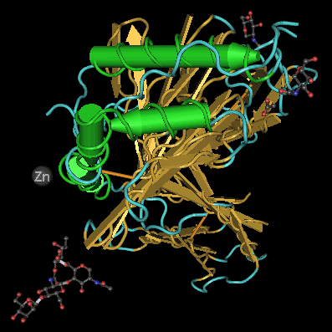
DQ2 + DQ2
DQB1*0201/DQA1*0501
DQB1*0201/DQA1*0501
DQ2 in trans
They are as potent as two couple of cops ??
DQB1*0201/DQA1*0501
DQ2 in cis
DQB1*0201/DQA1*0501
DQ8
DQB1*0302/DQA1*0301

Slide 8
Risk for a newborn from a family with a case according to the HLA haplotype of the parents
DQA05/05
DQA07/03
DQB02/02
DQB1*02/02
Estimate of the risk according the haplotype of parents
Risk > 20%
15% < Risk < 20%
10% < Risk < 15%
1% < Risk < 10%
Risk < 1%

Slide 9
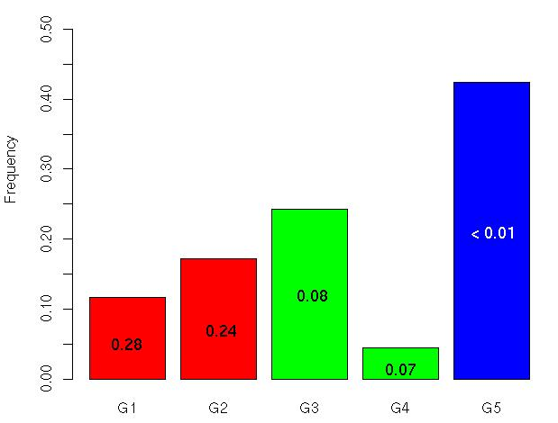
Probability to develop CD for a brother of Celiac Case according to his own HLA
DQ8 or 1/DQ2
Risk < 1 %
1% < Risk < 10 %
Risk > 20 %
0.42
Single DQ2
0.24
Double DQ2 or DQ2 Trans
0.17
0.12
0.05

Slide 10
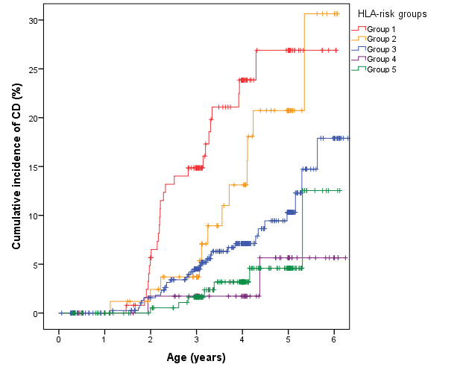
New cases by HLA Risk Group – PREVENT-CD
1000 newborns fro families with a proband
Risk 28-30%
DQ2/2
DQ2 trans
DQ2
DQ8/X
Why the single gene DQ2 in trans give the same risk of two copies of DQ2?

Slide 11
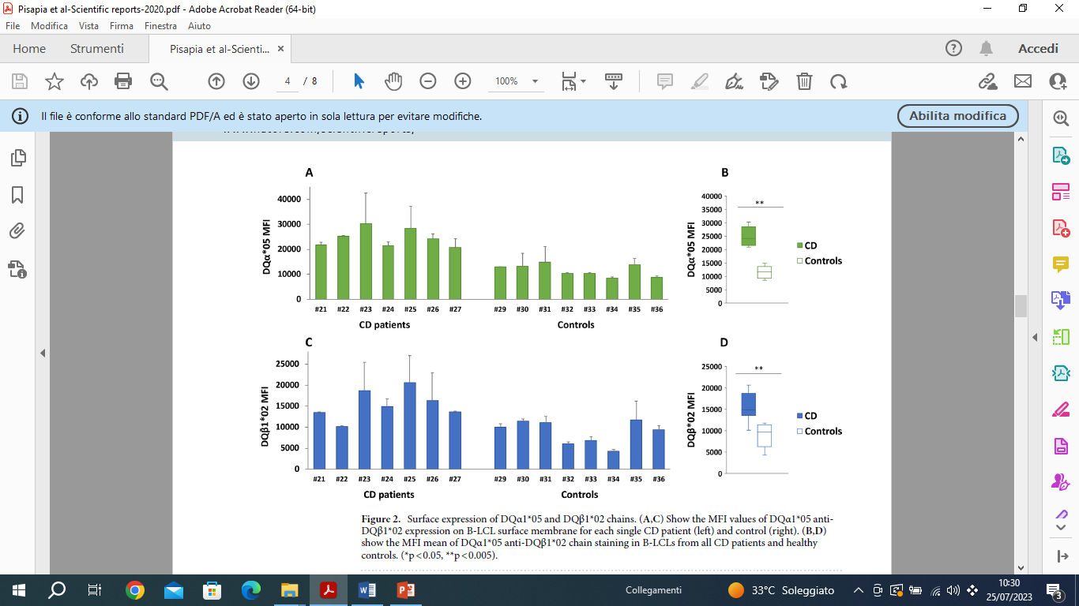
Expression of DQA*05 and DQB*02 chains in DR5/7 Celiac and Controls (Pisapia, 2020, Scient. Rep)

Slide 12
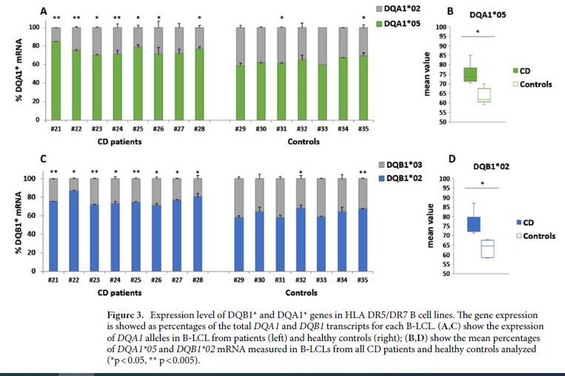
mRNA of DQB1 and DQA1 genes in HLA DR5/DR7 B cell lines of Celiac and Controls (Pisapia, 2020, Scient. Rep)

Slide 13
The risk to develop CD is due to the HLA Genetic profile + the regulation of the production of mRNA and the synthesis of the HLA Molecules on the Cell Surface (Del Pozzo, 2021, Ped Res)
The high expression of alpha and beta transcripts, encoding for the DQ2.5 molecules, is strictly coordinated by a mechanism acting at a transcriptional level.
In addition to the predisposing HLA-DQ genotype, also the expression of risk alleles contributed to the establishment of autoimmunity.
to support an early, accurate, and non-invasive diagnosis, and to define genotype-guided preventive and therapeutic strategies for CeD a stratification of genetic risk and DQ2.5/DQ8 expression measurement and magnitude of T cell response to gluten is mandatory. Pediatric Research (2021) 89:307–312; https://doi.org/10.1038/s41390-020-01217-4

Slide 14
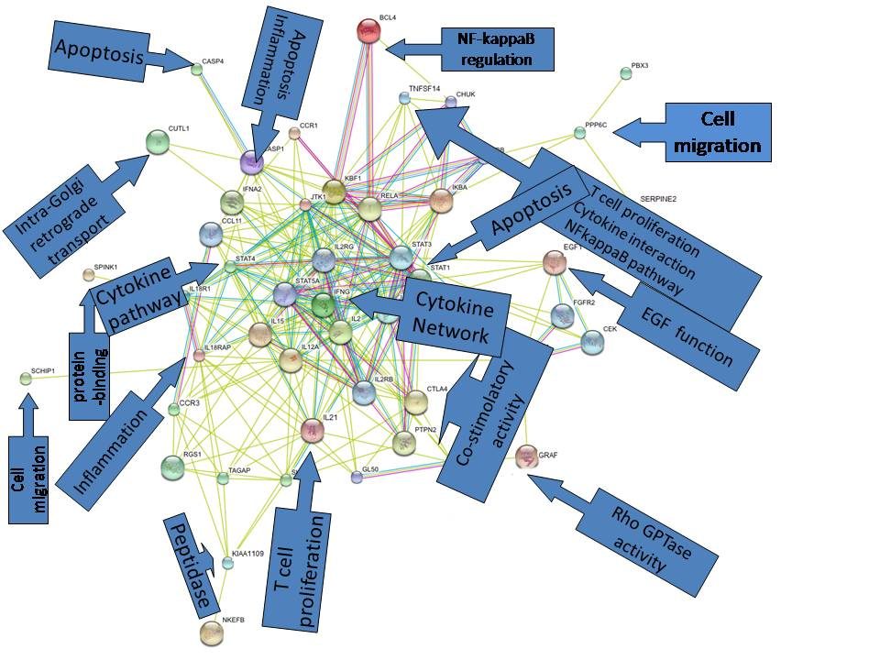
NON-HLA
Celiac disease, >
associated
genes and
pathways

Slide 15
How many genes explain the very strong genetic component of CD ?

Slide 16
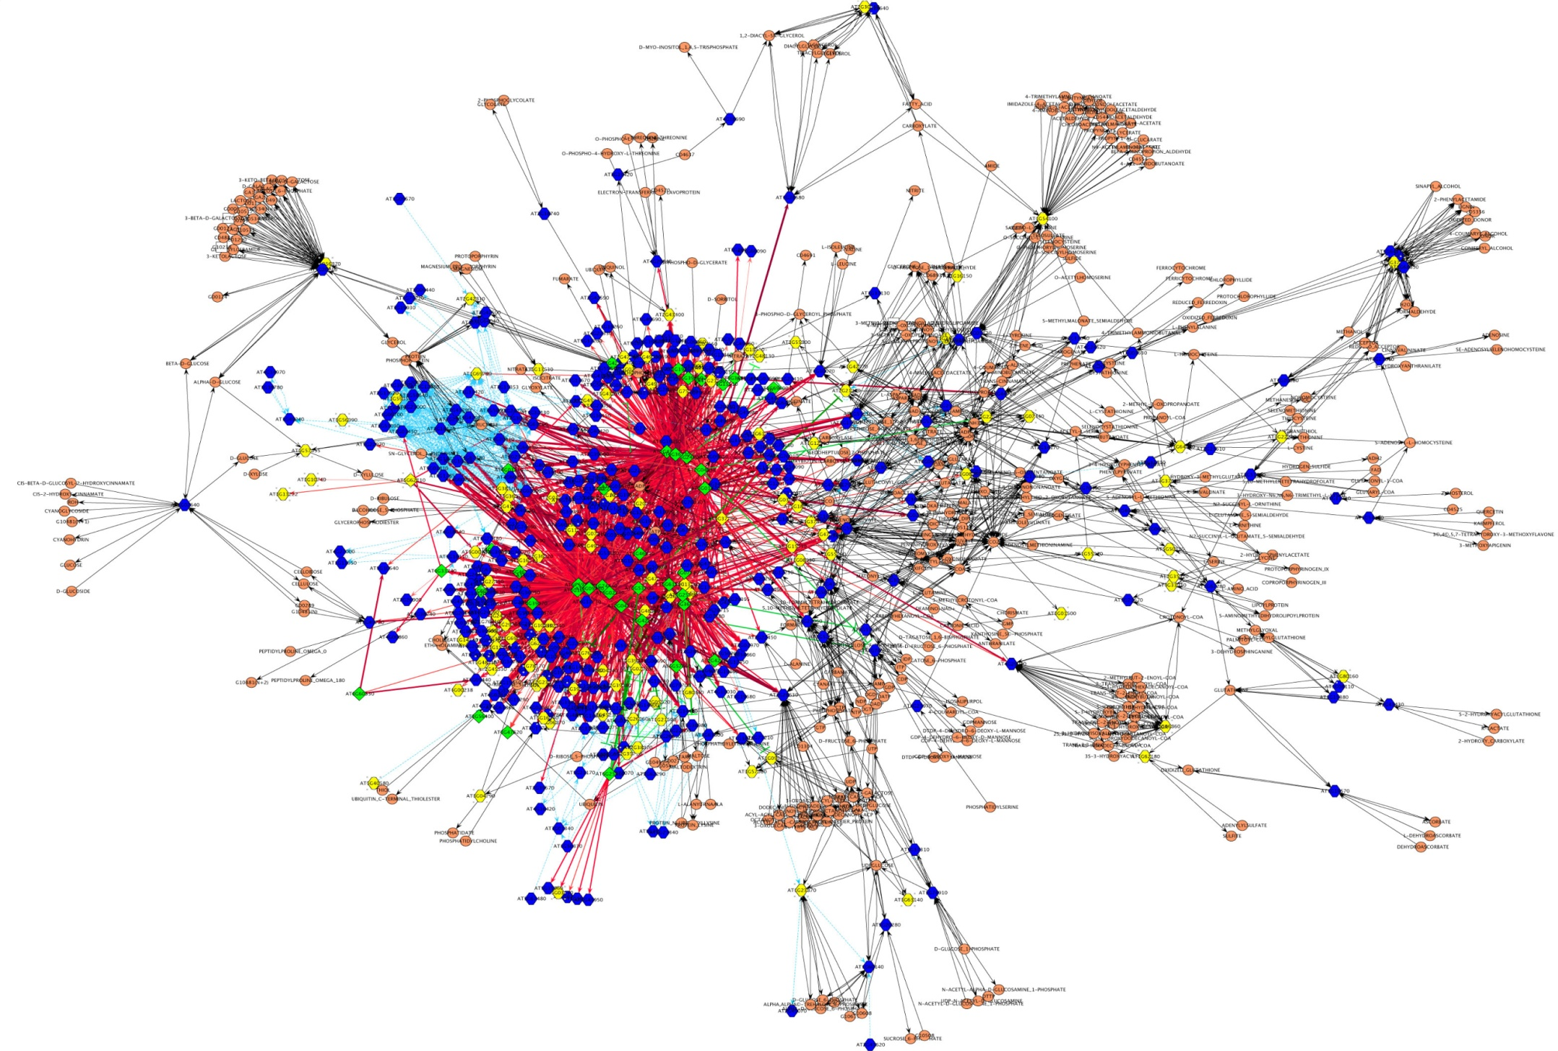
CD Associated Pathways??? Physiology ?

Slide 17
WHICH MESSAGE FROM THESE GENE POLYMORPHISMS ?
There are no ‘defective’ genes
The majority have a regulatory function
Many of them are active in the normal immune response to pathogens
Others are implicated in the innate immuno function and inflammation
There is a selective advantage of several of these gene, otherwise Celiac Disease should be extinct

Slide 18
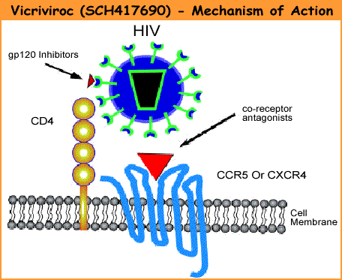
Here is the point of entrance of the AIDS virus: the Chemokine CCR5!!!
Missing by mutation in CD
Is the CD associated Chemokine receptors
The CCR5-Delta32 mutation carrier has more chances to be proteced by the HIV Virus, because of the missing surface chain where the virus should be attached.

Slide 19
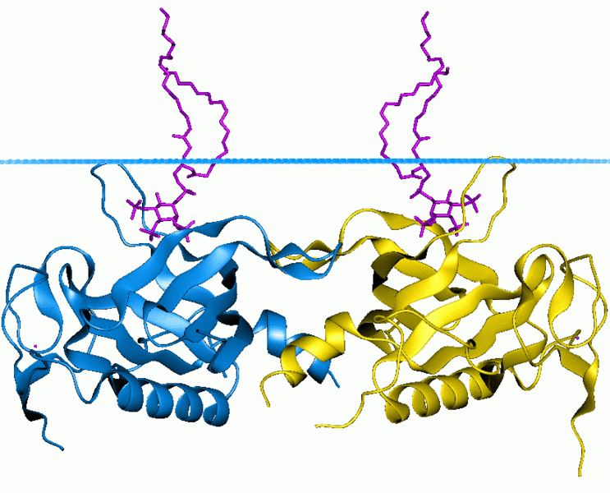
The SH2B3 gene is a cytokine signal inhibitor : it can reduce the level of intracellullar inflammation.
The CD associated Mutation of SHB3 works for the innate defense mechanisms, as a natural antibiotic
About 1600 years ago , after some massive pest epidemics , individuals with a SHB3 mutation gained a selective advantage of survival

Slide 20
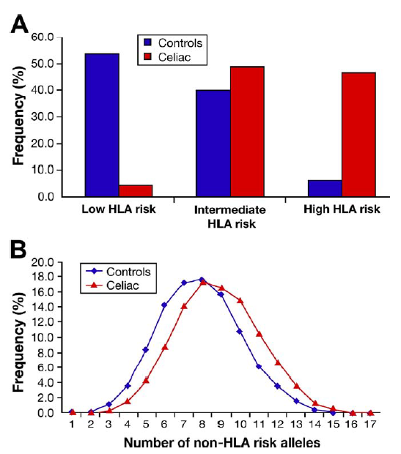
Biomarkers-pre weaning: genetics
54 Non HLA gene improve the estimate of genetic risk, expecially for children in a lower HLA risk class.
Romanos J. Et al. Gastroenterology 2009

Slide 21
No DQ2 or DQ8
DQ8
Double DQB1*02

Slide 22
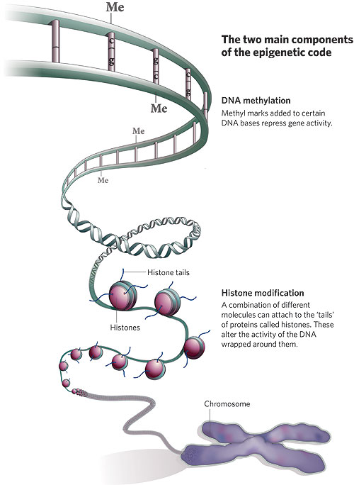

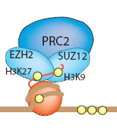
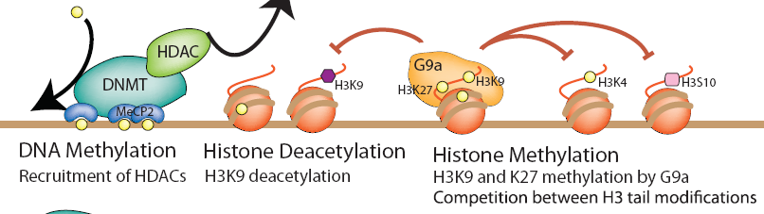
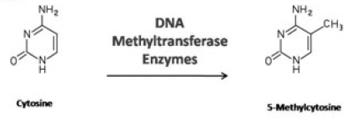
From the Bible to the expression
But the GENOMA is a written book : Life is the EXPRESSION of Genes

Slide 23
The expression of 4 candidate gene discriminate CD/CTRLS on blood monocytes Before Gluten introduction to the diet
The expression of 12 ‘candidate’ gene were analyzed in blood monocytes at 4-6 months, before gluten introduction, in infants who later developed CD and controls.
By computing a discriminant score and the relative membership probability, 95.5% of patients (91% controls and 100% celiac patients) were correctly classified.

Slide 24
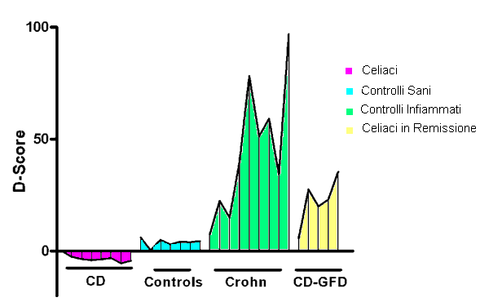
Gene expression discriminate CD from Crohn and celiac on GFD before the onset of disease
The D-Score for active celiac patients was negative in all cases, while it was positive for all the other groups on differentiated clusters.
celiac

Slide 25
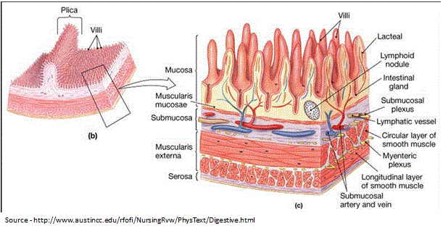
But the Tissue is too crowded!
We have to separate Epithelia from Lamina Propria

Slide 26
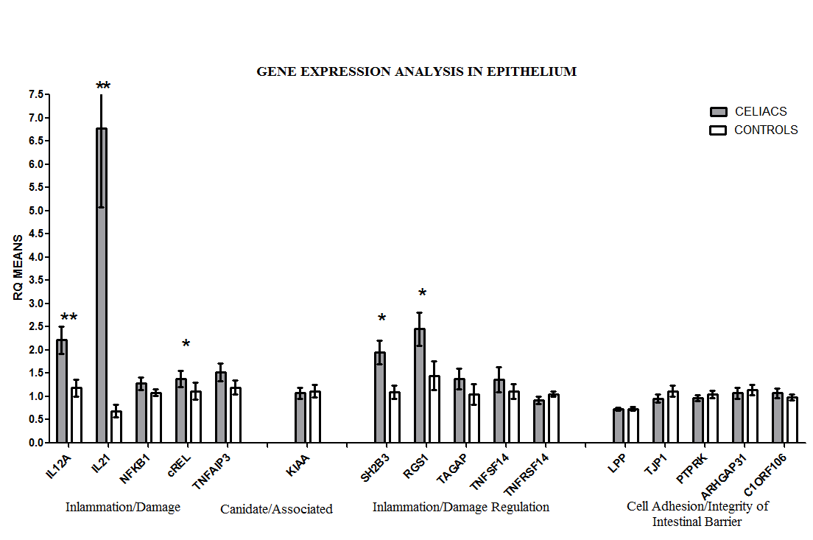
Gene expression in Epithelium
Strong up-regulation
Remarkable up-regulation
No activation
Difference between CeD patients and Controls were evaluated by the rank-sum test (Mann-Whitney) because there is asymmetry in their distribution.*p<0.05 **P<0.01

Slide 27
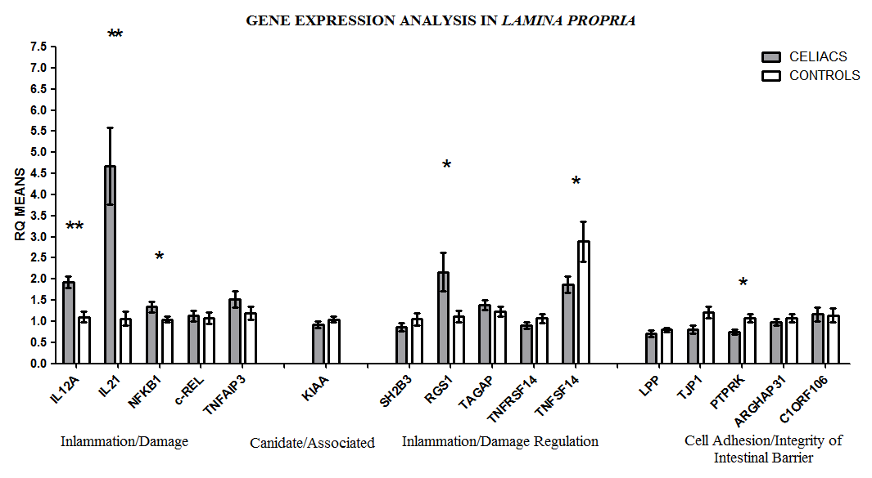
Gene expression in Lamina Propria
Still up-regulation
Here they are less expressed
Difference between CeD patients and Controls were evaluated by the rank-sum test (Mann-Whitney) because there is asymmetry in their distribution.*p<0.05 **P<0.01

Slide 28
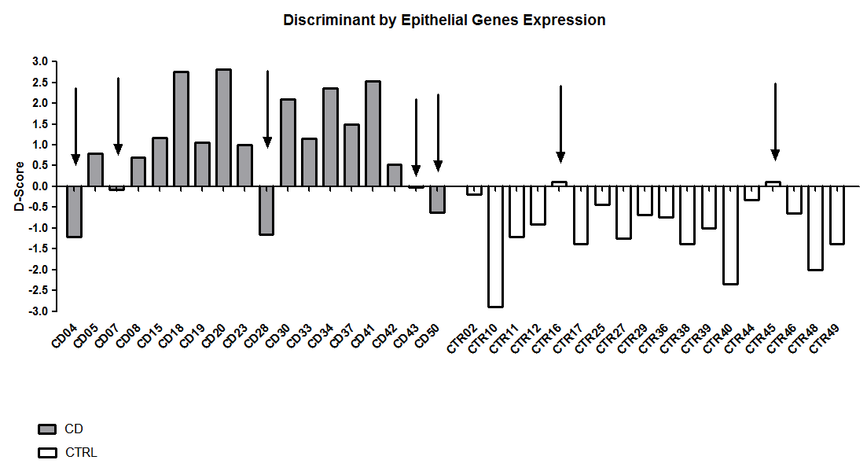
Signature of CeD versus Controls in Epithelium (80% correct)

Slide 29
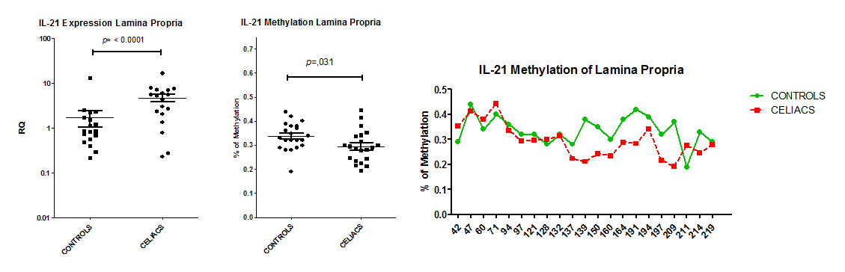
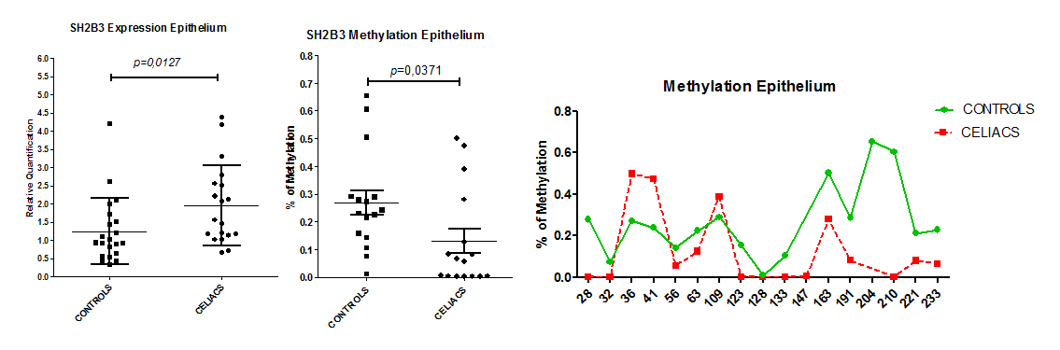
Methylation
IL21 and SH2B3 genes are more expressed and also less methylated in CeD vs CTRs.

Slide 30
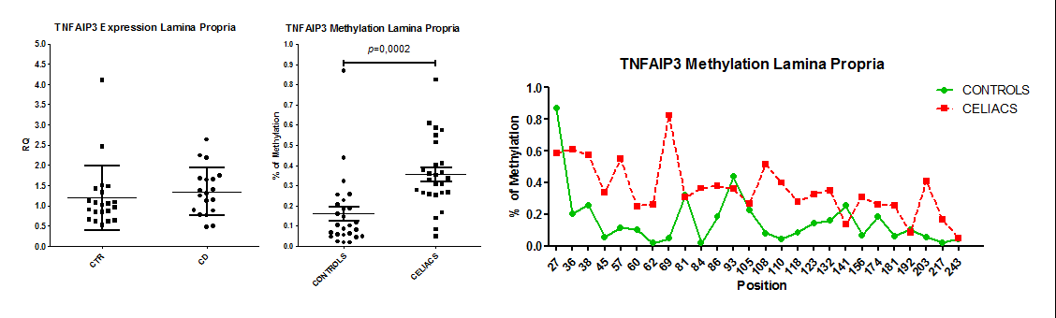
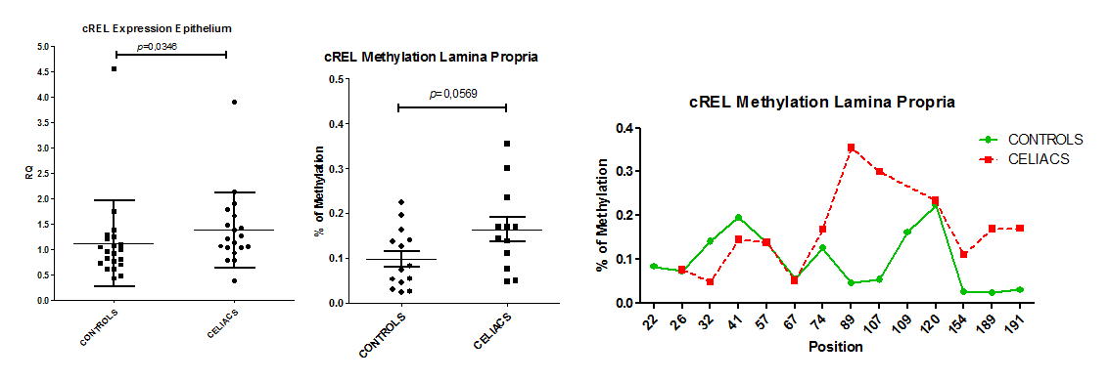
Methylation
TNFAIP3 showing low methylation in Lamina Propria of CeDs does not increases gene expression.
C-REL, shows higher expression in CeD versus CTRL in Epithelium, and an inverse methylation in Lamina Propria

Slide 31
CONCLUSIONS
  We found decreased methylation of SB2H3 and IL-21 gene causing an over expression of these gene, so modifying the immune response to the gliadin antigen.
  In epithelial cells, SH2B3 was differentially methylated between CD patients and controls, whereas IL21, TNFAIP3 and cREL showed differences in methylation level between CD and CTRLs in the lamina propria.
  IL21 expression in the lamina propria was greater in CD patients than in controls: this gene was 20% less methylated in CD patients.
  Similarly, the lower methylation of the SH2B3 gene in CD epithelial cells was associated with higher expression of the gene

Slide 32
miRNA expression pattern in small intestine of CD patients, Sacchetti & Greco 2011
A
25%
(n=90)
33%
(n=27)
Active CD
22%
(n=82)
Different from controls
Equal to controls
53%
(n=193)
67%
(n=55)
Not expressed
B
On GF Diet
25%
(n=90)
31%
(n=22)
19%
(n=71)
Equal to controls
69%
(n=49)
56%
(n=204)
Different from controls
miRNA expression in the small intestine of patients with active CD (Panel A) and of CD patients on a GFD (Panel B). Data are expressed as percentage of miRNAs tested (n=365). White areas, miRNAs whose expression levels were similar in the two CD groups and controls; gray areas, miRNAs not expressed; black areas, miRNAs whose expression levels differed between CD patients and controls (up-regulated ↑(RQ≥2.0) or down-regulated ↓(RQ≤0.5)).

Slide 33
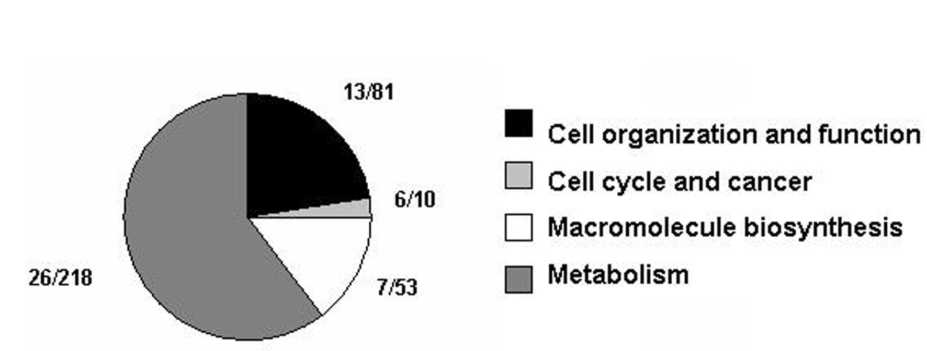
microRNA 449 is 55 folds higher in celiacs versus controls
Some CeD-associated miRNAs deregulate genes that are also affected by genomic CeD-risk variants, adding an additional layer of complexity to the deregulated transcriptome in CeD.(Barisani 2021)
CeD-associated miRNAs might play a role in promoting inflammation and decreasing lipid metabolism in the small intestine, thereby contributing unbalanced cell turnover in the intestinal crypt. .(Barisani 2021)

Slide 34
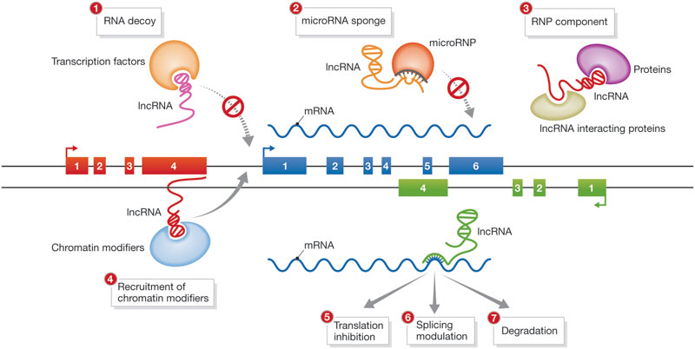
long non coding RNA have a key role, tissue specific specic, in modulating Gene Expression
long non-coding RNAs (lncRNAs) have been described to be influenced by disease-associated SNPs and to drive many important mechanisms involved in the development of inflammatory diseases
  (Castellanos-Rubio, Bilbao’s group).

Slide 35

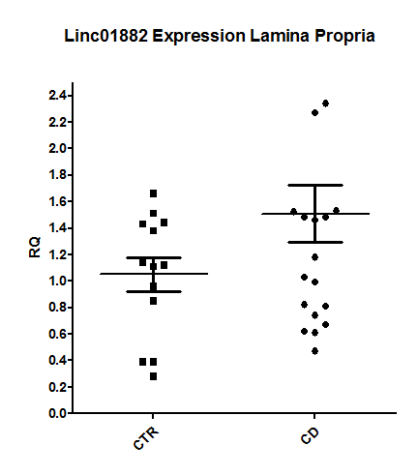
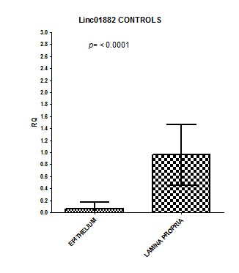
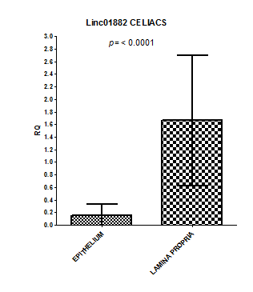
Long Non Coding RNA: gene-expression
AC007220.1
LINC01890
CCDC26
LINC02435
AL080284.1
6. AL139246.5
LINC01882
(AP005482.1)
No expression in intestinal cells
Equally expressed in CD and CTR , both in EP and in LP
Differentially espressed in CD vs CTR, in lamina propria
The gene expression analysis in epithelium is not avaible because it is not detectable.
LOCI | CHR | START (hg19) | END(hg19) | Genes* | Disease | LincRNAs | eQTLs
18p11.21 | 18 | 12773338 | 13372192 | PTPN2 | CeD, CD, T1D | AP005482.1 | Yes

Slide 36
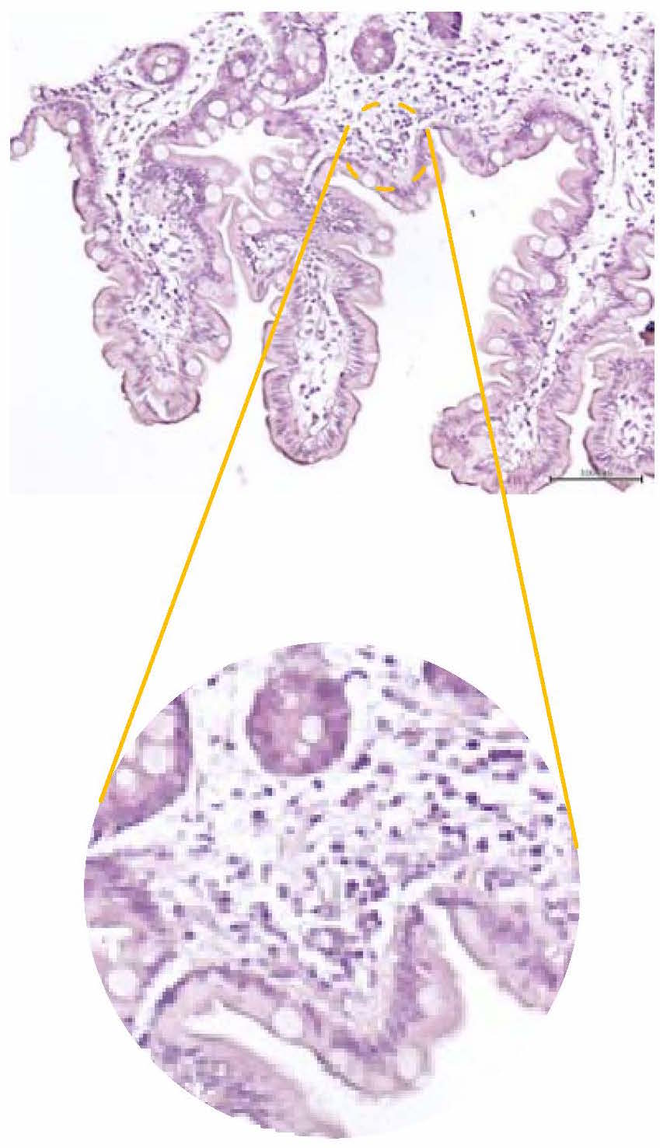
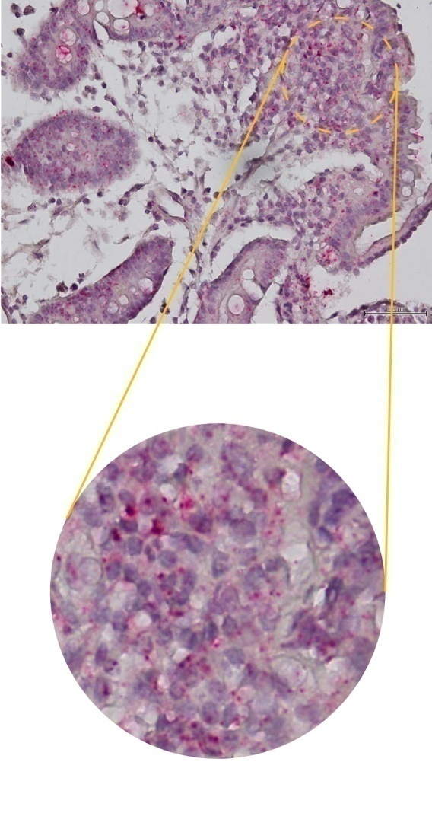
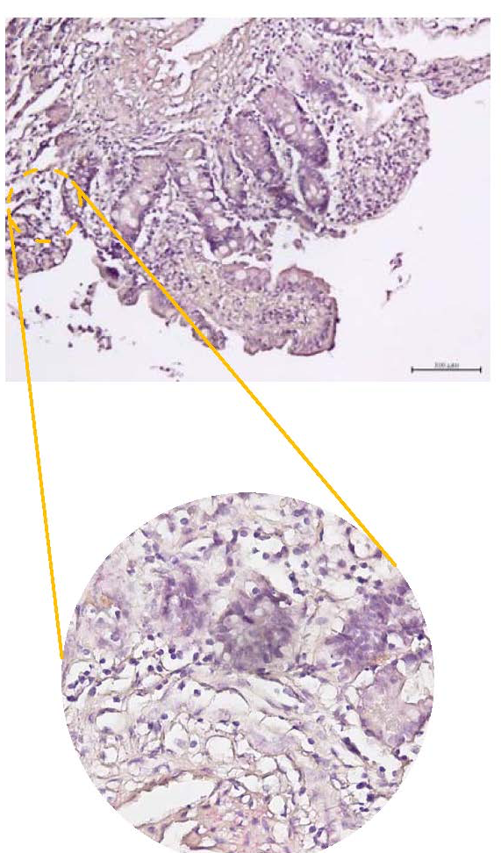
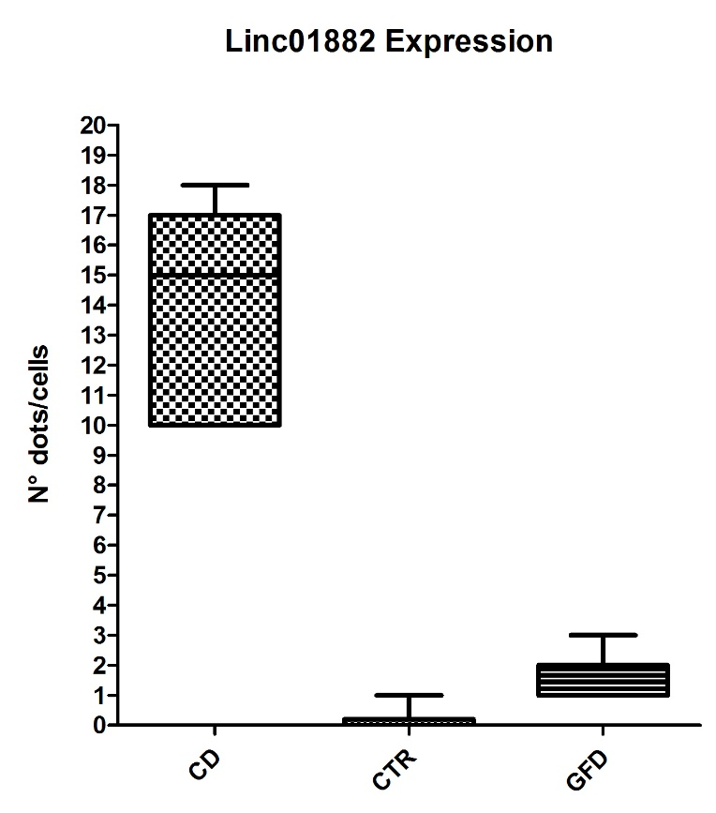
Linc01882 lncRNA expression in
Small intestinal mucosa
CTR
Linc01882 probe
Active CD
Linc01882 probe
Gluten free diet
Linc01882 probe
(<1dot/10cells)
(1-3 dot/cells)
(10-15 dots/cells)
100% analysed cells

Slide 37

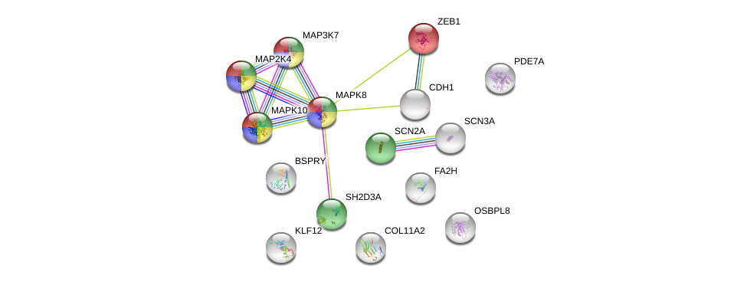
Bioinformatic Analysis of genes target of Linc01882
Toll-like receptor signaling pathway
TNF signaling pathway
Signaling by Interleukins
Cellular response to stress
NEXT STEP….
To analyze the Linc01882 target gene expression, and its effects on downstream pathways. In particular our attention is focused on the Zeb1 and MAP2K4 involved in T cell activation.
To evaluate the expression of Linc 01882 at peripheral blood cells and in the progression of Celiac Disease to consider it as potential biomarkers of diagnosis or of the damage to intestinal mucosa
We identified a long non-coding RNA (Linc01882) that could allow us to discriminate between CD and CTR
We characterized the expression of Linc01882 in intestinal mucosa and we highlighted the molecular pathways in which it’s involved

Slide 38

There are still many flowers to be find in this field!

