Slide 1
REPORT OF THE CHILDREN’S WARD RBF PROJECT 2018-2020 October 29° 2021
Team of St.Mary’s Hospital Lacor
Team of Ambrosoli Hospital Kalongo
Data Analysis : L.Greco M.Arcidiaco

Slide 2
Esito dei Progetti di Solidarietà Internazionale
Perché: Joseph Ki-Zerbo, filosofo e storico africano, ha scritto: “Aiuta davvero soltanto l'aiuto che aiuta a eliminare l'aiuto”
I fallimenti: L'assistenza senza limiti offerta ai governi africani ha aumentato la dipendenza economica, incoraggiato la corruzione, in definitiva perpetuato la povertà (Dambisa Moyo, Zambia, dirigente della Banca Mondiale). Dal 50 al 70% degli interventi di cooperazione negli ultimi 20 anni non hanno raggiunto gli obiettivi prefissati e non hanno modificato in modo costante il contesto in cui hanno operato

Slide 3
Problemi della Cooperazione Internazionale
In Italia: Tutti i soggetti del sistema Italia della cooperazione sembrano concordare sulla esigenza di migliorare la capacità della cooperazione italiana di fare valutazione dei programmi e delle politiche.
La Legge 125 parla di “valutazione di impatto …”, nel documento OCSE – DAC si dà enfasi al “result based approach”.
La routine e non le apparecchiature: la maggioranza dei donatori, proprio nel timore di una dispersione delle risorse, preferisce acquistare ‘cose’ attrezzature, edifici, pozzi, interventi tangibili e facilmente valutabili.
Ma una attrezzatura viene rapidamente malmessa se non ci sono le risorse umane, motivate e formate, per il suo utilizzo.
Nell’area della pediatria, molti ospedali africani hanno gli scantinati pieni di costose incubatrici mai utilizzate, mentre le mamme avvolgono i neonati nei loro panni.
Spese correnti: il problema principale della assistenza sanitaria in centro Africa, è la scarsità di risorse per le spese correnti, per la gestione giornaliera, sia in termini di risorse umane che per materiale di consumo. Nessuno vuol sostenere queste spese.

Slide 4
Migliorare la qualità dell’assistenza pediatrica
salvare vite. : a Lacor ogni giorno muoiono 3 bimbi in media
non basta soddisfare la domanda di risorse per garantire interventi efficaci sulla salute:
abbiamo verificato l’uso eccessivo di farmaci (es. antibiotici) o la richiesta inappropriata di indagini in contesti ove erano disponibili le risorse.
La qualità dell’intervento sanitario fa una grande differenza in termini di ‘case-fatality-ratio’, salvataggio di vite umane e di morbilità.
Dunque il controllo di qualità, che in occidente ha un’aria efficientistica-alberghiera, in Africa si tramuta facilmente in intervento salva vita.

Slide 5
La procedura di Result Based Financing:
Il progetto prevede i seguenti parametri per i reparti di Pediatria:
Una definizione condivisa di obiettivi di qualità dei servizi e dell’assistenza, da verificare ogni 3 mesi per 3 anni.
Per ciascun bambino ricoverato, per qualsiasi durata e complessità un costo di base di €15 (parametro numerico in funzione del numero degli assistiti)
Un controllo di qualità trimestrale, eseguito da una commissione indipendente, con un membro del Ministero della Sanità Ugandese, sul progresso degli obiettivi di qualità fissati nel progetto. La commissione assegna un punteggio da 1 a 5 in base alla percentuale di raggiungimento degli obiettivi.

Slide 6
VERIFICA DELLE PROCEDURE CLINICHE
Triage del bambino malato Conoscenza del Pediatric Life Support
identificazione corretta del paziente anamnesi completa dei sintomi
esame clinico guidato dall’anamnesi non richiesta di esami superflui
considera la malaria se c’è febbre controllo della malnutrizione
uso appropriato dei percentili gestione corretta dell’anemia
diagnosi specifica per le sepsi
Questi criteri sono applicati a pazienti con:
Malaria - Disidratazione - Convulsioni
Anemia - Polmonite - Infez Vie Urinarie
Meningite - Sepsi

Slide 7
Il meccanismo di compenso al personale:
il progetto eroga un compenso aggiuntivo ai €15 per ciascun ricovero dello 0%, 5%,10%,15%, 20%, 25% a seconda del punteggio raggiunto nella verifica trimestrale, pari ad un totale, per ogni ricovero di 1 se non si sono stati progressi, di €1,5 per 2 punti, €2,25 per 3 punti, €3 per 4 punti e €3,75 per 5 punti. Questo compenso è stato distribuito al personale di tutto l’ospedale, non solo quello della Pediatria.
Punti Totali | <60% | 60-70% | 70-80% | 80-90% | 90-100%
Qualità | 1 | 2 | 3 | 4 | 5
Moltiplicatore | x 1 | x 1,10 | x 1,15 | x 1,20 | x 1,25
Euro aggiuntivi ai 15 | 0 | 1,5 | 2,25 | 3 | 3,75

Slide 8
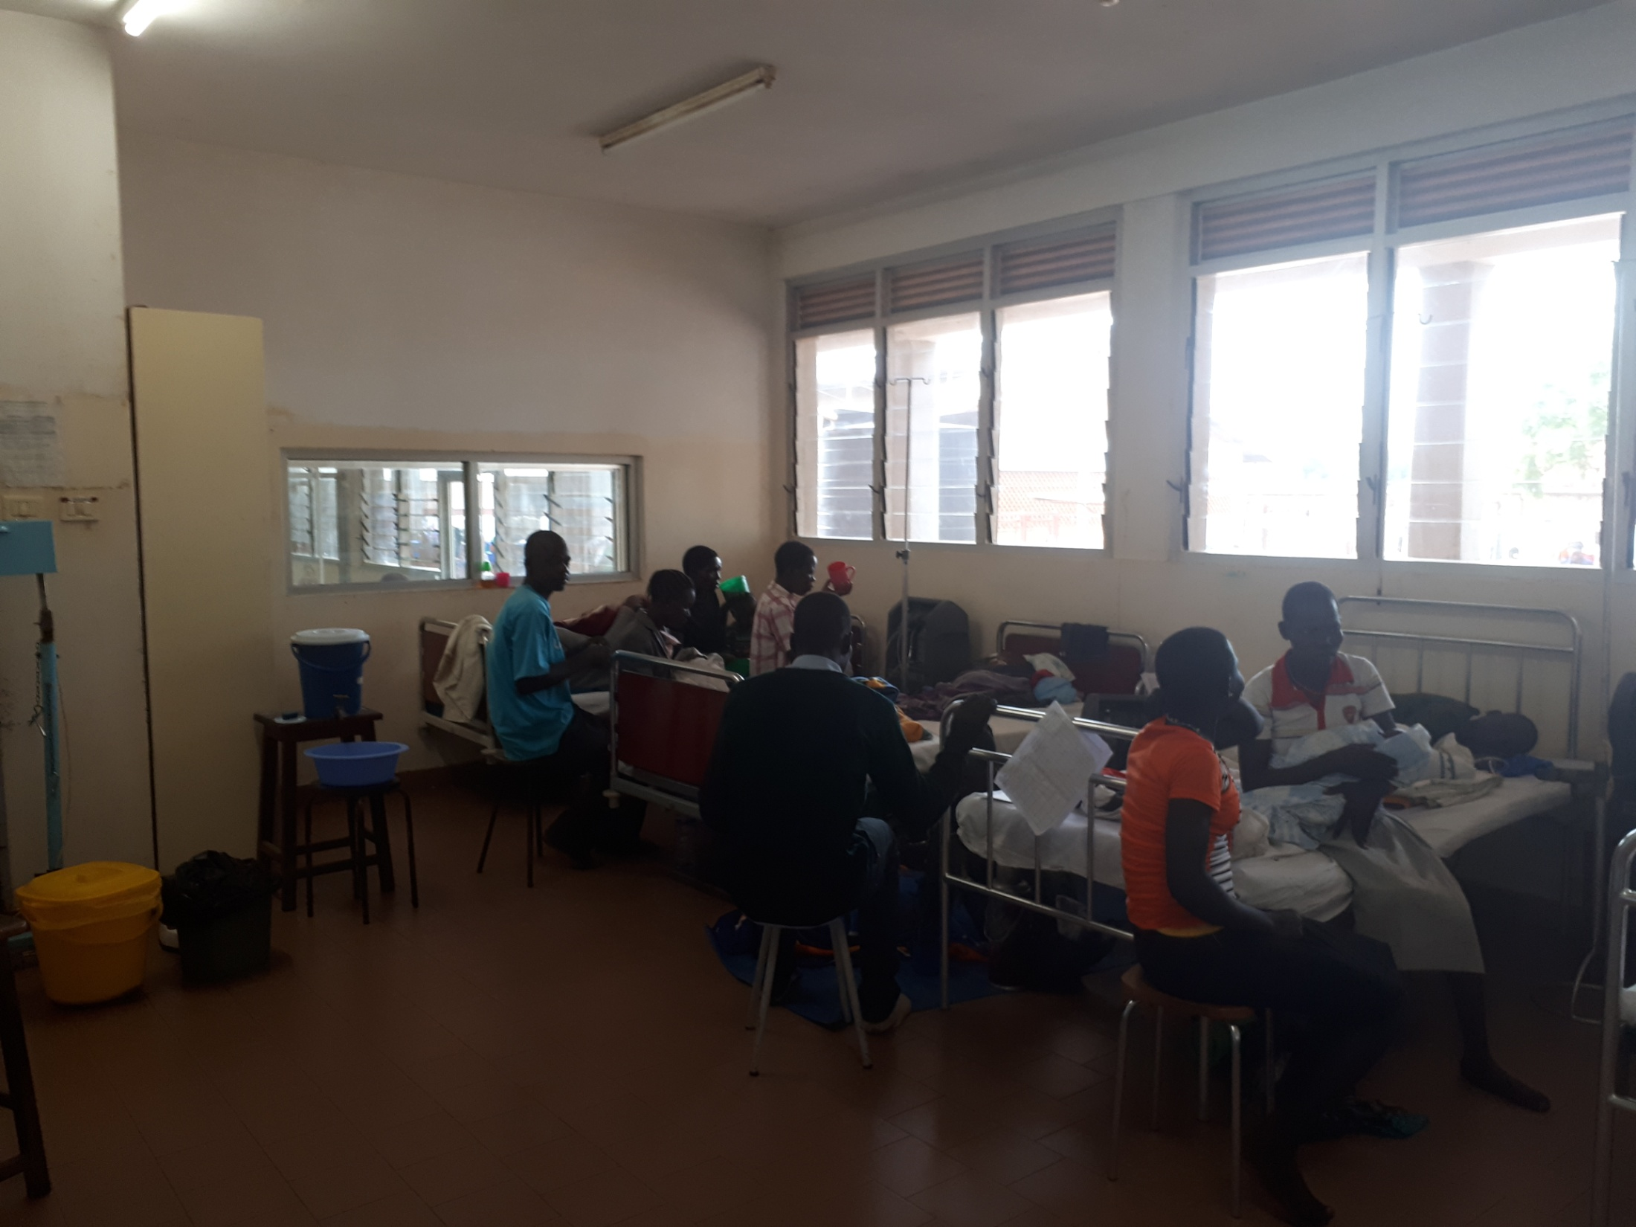
GAPS BEFORE THE START OF THE RBF PROJECT FEB 2018
RESPIRATORY UNIT : BABIES SHARE BEDS AND CROSS-CONTAMINATE – O2 CONCENTRATORS SHARED, often tubes lay on the floor

Slide 9
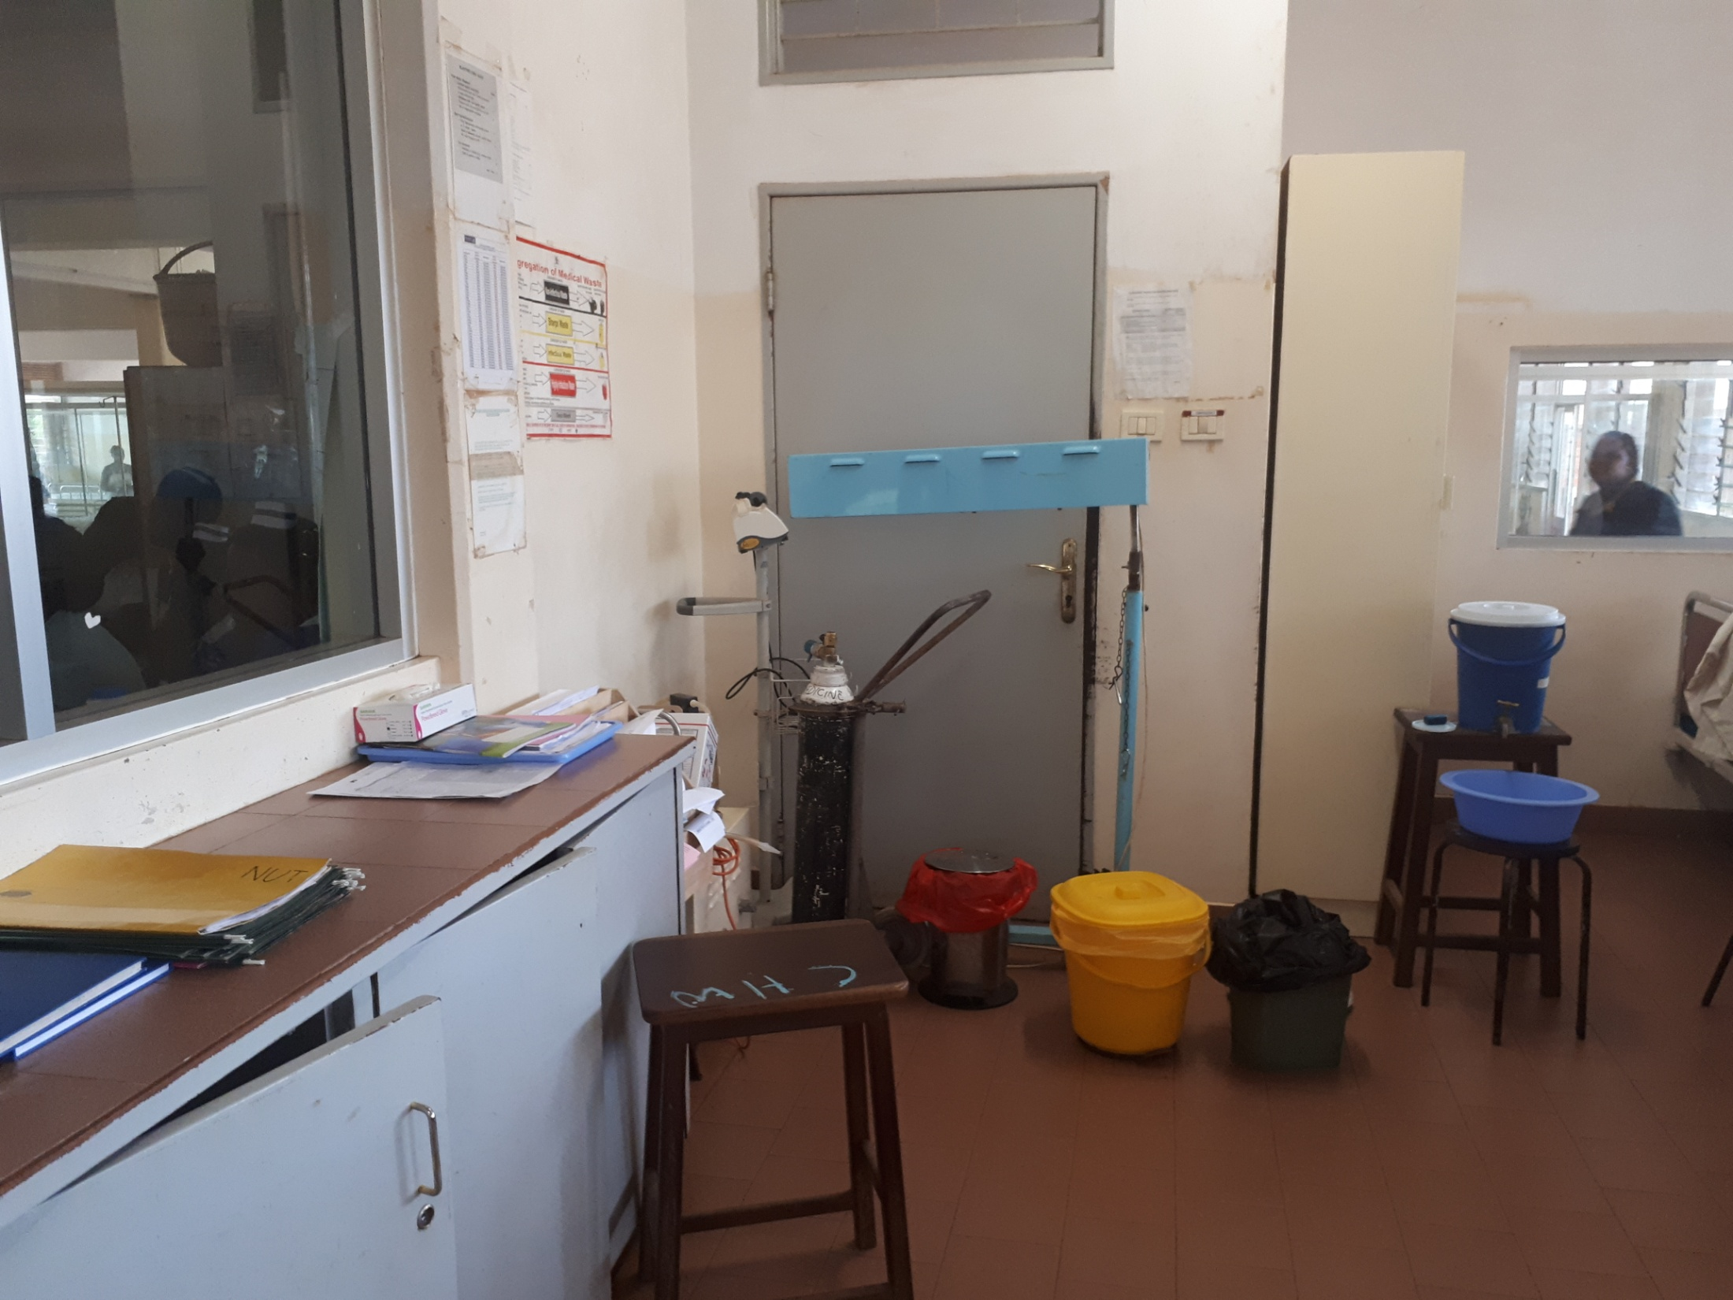
Need to rearrange the Cupborad for Emergency Prepardness, EMERGENCY PROCEDURES AVAILABLE ON THE WALL AS POSTERS
Need a new Ambu Balloon with sized masks for children to neonates
Suction to be repaired.
Desired 2 nebulizer + 2 infusion pumps

Slide 10
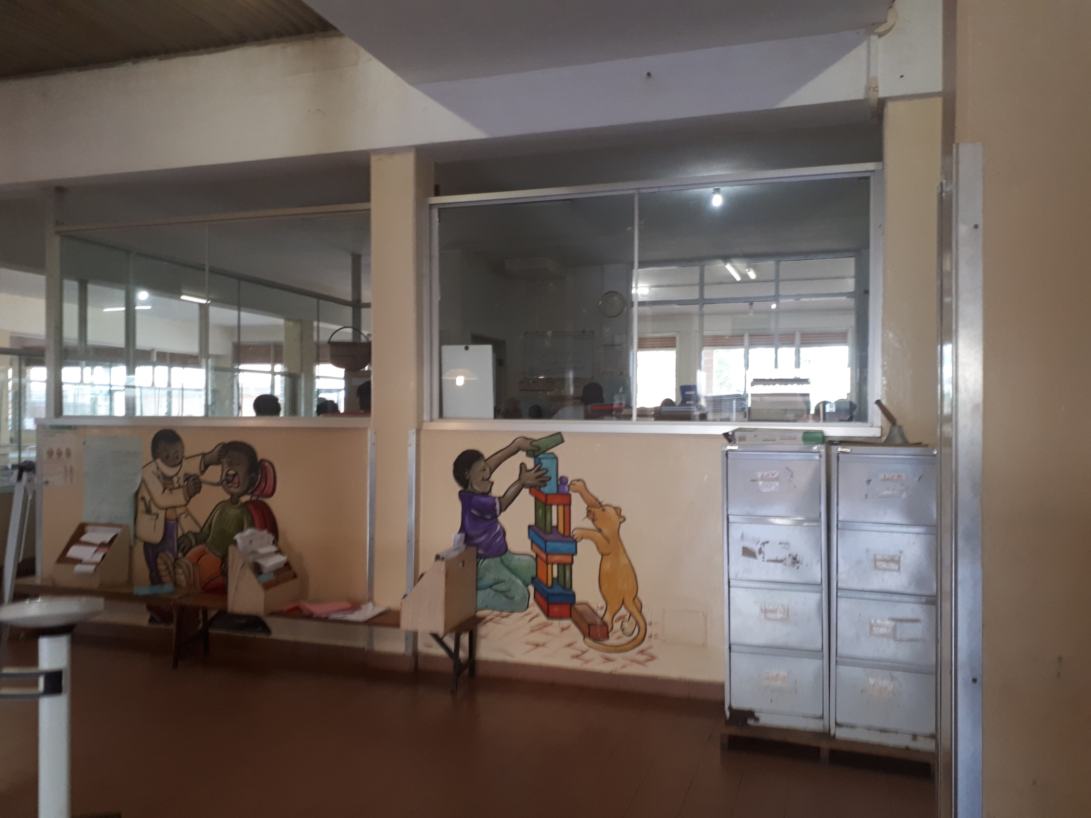
Trash Bins should not be ‘mini’ but large and functional

Slide 11
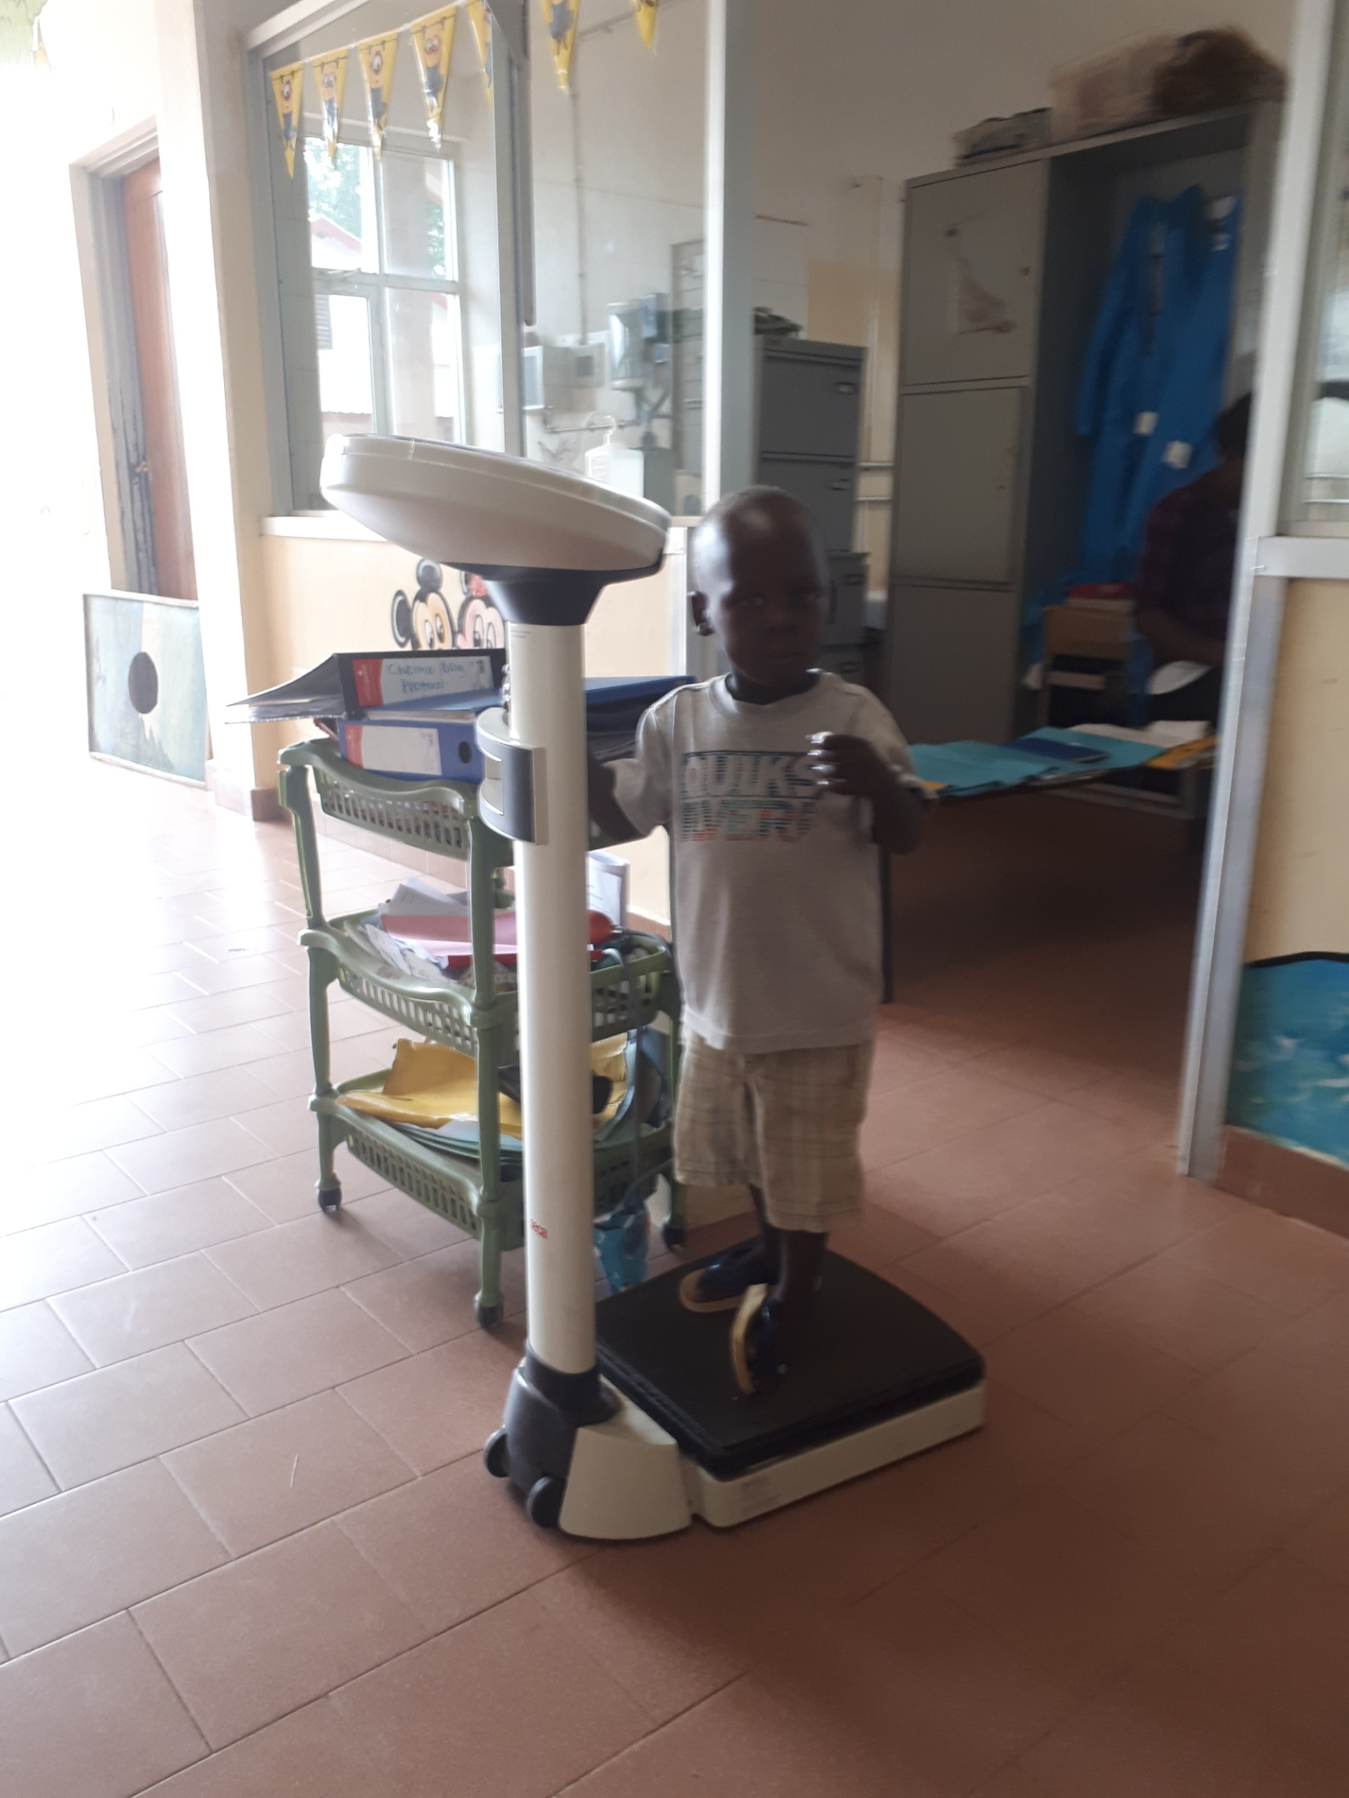
There is the need for a further scale for small infants

Slide 12
Checklist: Structures and Management
CKECKLIST ITEMS 1. | CRITERIA | SCORES | Your Priority 1 to 5
Basic infrastructures working and in acceptable conditions 1) Doors and windows regularly checked, 2) Beds and ward facilities repaired when required, 3) Mattress changed when required, 4) Baby and children height and weight scale available and in working condition | 3-4 items controlled | 0-3 |  | 1 MORE WEIGHT SCALE NEEDED
Hygienic conditions appropriate 1) Cleanliness of the ward, 2) Accurate disposal of sick children vomit/feces, 3) Disposal of remains of foods | Bad, moderate, good, optimal | 0-3
Safe environment 1) Electrical safety for children(cover etc), 2) Children's don’t have access to drugs, 3) Fire readiness | 1.% safe electric 2=100% 3.Accept- good- excel | 0-3 |  | Cover the great Main at the rx end of corridor (Meter Box?)
Prevention of infections 1) Facilities to wash hands, 2) Alcohol available, 3) Reduce cross-contamination among children (beds?) | Renovation of O2 room | 0-3 | Infants sharing beds is a CRITICAL point that has to be changed , espec in O2 room | More large beds than small: change 10-20, not in Burkitt & Nutrition & Neonates
Available and functional equipment and supplies: Oxig tester, Infusion pump, Suction machine, O2 concentrator | O2 line coming | 0-3 | Nose prongs and tubes on the floor | Suction to repair. Need an Head Lamp for procedures. Desired 2 nebulizer + 2 infusion pumps
Are the right Drugs available when needed? 1) Essential Medicine and Health Supplies are available 2) Timely provision of drugs after requests | List 20 drugs % Check 3 request-time | 0-3
Adequate support from the laboratory ? 1) Lab is functional every day of the week 2) Scheduled time kept as planned (delivery of samples and provision of results) | 1. OK 2. Check 3 request-time | 0-3 |  | Only 1 technit on weekends, loaded. Lab send children from YCC to be sampled especially in we: OPD nurses should do.
Adequate support from the Radiology Department? 1) Lab is functional every day of the week 2) Scheduled time kept as planned (delivery of samples and provision of results) | US critical, Cardiac US critical | 0-3 |  | Lack of staff, many request
TOTAL SCORE |  | 24
Cleanliness
Safety
Hygiene
Equipment
Drugs
Laboratory
Radiology

Slide 13
Checklist: 2. HYGIENE AND CLEANLINESS
CHECKLIST ITEMS | CRITERIA | SCORES | Your priority 1 to 5 | CRITICAL
Presence of cleaning products: Supply record cards indicating amounts in and out correspond to physical supplies (soap, bleach, chloramine, chlorhexidine, and at least one detergent) | Record card monthly of supplies on ordering-requisition book once a wk Thursday | 0-3 |  | To be checked with in Charge
Stock Management. Reserve of disinfectants, equipment used soaked in disinfectants in treatment rooms, | Requisition book | 0-3
All beds having mattresses covered with impermeable plastic intact | Check monthly | 0-2 |  | Most are torn/spoiled, need new covers, done locally
Cleanliness of rooms, halls, and grounds: 1) presence of trash receptacles (in waiting room and corridor) 2) no loose trash;3) receptacles for syringes present in treatment rooms | N. trash bins N. special dispensers Sharp containers | 0-3 | Tiny ‘Paediatric’ dust bins useless | Dispensers not always functional, change to big dust bins
No organic waste, syringes, or dangerous products in any location that is easily accessible to the public | Inspection 1 to 3 score | 0-3
Availability of water source (running water or well, pump, or water tower/tank) | Yes/not | 0-2
Water dispensers available in service rooms where there is no tap w. | Yes/not | 0-2
Presence of latrines and showers 1) usable; 2) no organic matter within or outside; 3) door that closes from the inside; 4) covered pit (for latrines) | To be checked | 0-3 | None of 20 latrines flushes, showers dismantled | Repair flushes and reassemble 4 showers
Available and functional sterilization materials: cocotte, autoclave, or heat sterilizer | Check transport of drums from ward to steril centre | 0-3
Clean, neat uniforms worn by all staff | Inspection 1-3 | 0-2
TOTAL SCORE |  | 26
Supplies
Beds
Rooms
Waste
Water
Latrines
Sterilization

Slide 14
CLINICAL AND NURSING PROCEDURES
CHECKLIST ITEMS | PROTOCOLS | YOUR SUGGESTIONS | Your priority 1 to 5 | CRITIC
Proper diagnosis of 10 admitted cases (analysis of randomly selected hospitalization records): 1) identification of patient 2) complaints or symptoms on admission reported 3) clinical examinations guided by anamnesis 4) no unnecessary diagnostic tests prescribed, 5) Malaria is excluded or treated in patients with fever 6) Malnutrition diagnosis according to WHO - Check sub-liminal malnutrition, 7) Percentile charts available and in appropriate use 8) Anemia diagnosed according to guidelines, 9) Sepsis: Increasing the percentage of specific diagnosis (origin) | 1.Triage of sick child 2. Paediatric Life Support 3. Malaria 4. Dehydration 5. Convulsions 6. Anemia 7. LRTI-Pneumonia 8.Urinary Tract Infect 9. Meningitis 10. Sepsis | 0-8 |  | Very hard to specify origin of sepsis : rotation of interns is critical : require a month to be trained and then have to be surveilled ESR and blood count – scarce microbiology
Proper prescription of therapy of at least 10 admitted cases (analysis of selected hospitalization records): 1) proper treatment according to evidence from anamnesis, and accepted protocols, 2) no unnecessary prescriptions, especially antibiotic, 3) Appropriate prescription of drugs in children with URTI, 4) Appropriate use of Oxygen & Antibiotics for children with LRTI, 5) Appropriate request of blood transfusions. 6) Checking regularly the vaccination record and recommend accordingly | According to previous protocols | 0-8 |  | Blood often not available –in Kalongo they may use their own donors, screened for HIV & Hep B and Syphil Oximeter required, HoD engaged into this performances (drug use etc) Mother do not bring vaccination record
Proper administration of therapies of 10 admitted cases 1) Therapies have been given properly (Oral, injection, IV line, fluids) , 2) Charts correspond to the correct patients, 4) Fluids have been changed and are dropping correctly 5) IV lines changed correctly 6) doctor's check and nurse's check x24 hours for Gastroenteritis | OK 1 to 5. N 6 important : give 500ml plastic bottle with rehydration dose for the night | 0-8 |  | Nurses’ project ongoing Difficult collaboration by mothers
Deaths properly reviewed 1) Death reviews regularly carried out 2) staffs informed about findings of death reviews, 4) evidence of follow up of consistent follow up of findings from death reviews | In the daily morning meeting, not ready for 3 & 4 | 0-3 |  | in Kalongo once a week
Appropriate supervision and mentorship by Specialists and Head of Department 1) Clinical Audits carried out on a regular basis, findings shared, and followed up, 2) death reviews regularly carried out, findings shared, and followed up, 3) Evidence of effective specialist supervision and mentoring, 4) Evidence of proper consultation and referral with specialists 5) evidence that staffs are encouraged to consult with Specialists and consultants | Audit in the daily morning meeting, Distribution of responsibilities between specialist and medical officer | 0-3 |  | Kalongo: only two people, do not need meeting, they work together, general meeting once a week
Nice and caring communication to Patients and attendance | Talk with mothers at discharge, explain problems and therapy | 0-3 |  | COMMUNICATION project ongoing in Lacor e Kalongo
TOTAL SCORE |  | 33
Diagnosis according to protocols
Proper Prescription of Therapy
Proper Administration of prescribed Therapy
Deaths reviewed
Mentorship available and functional

Slide 15
Checklist: Emergency readiness
CHECKLIST ITEMS | CRITERIA FOR SCORING INDICATORS | SCORE | SCORE OBTAINED | SCORING JUSTIFICATION
Emergency CUPBOARD ready 1) Emergency equipment checklist filled and signed correctly at each shift 2) emergency drugs and equipment present on the box in the shelf, not expired, functioning, clean, dust free and easily accessible | Kalongo, not a trolley but a BOX with drugs & Equipment Are preparing basic guidelines for emergency according to international standards | 0-4 |  | Trolley not there, equipment: a new Ambu with sized masks In Charge
Emergency protocols available and known 1) staff trained on the protocols 3) Students know it and trained 4) updated and consistent National and International Standards 4) key parts hanging on the wall close to emergency trolley | Refer to Lacor-made booklet Updated WHO guidelines available in Kalongo. | 0-4 |  | Posters-Cartoon in preparation (dr.Smarrazzo)
TOTAL SCORE |  | 8

Slide 16
Checklist: Training
CHECKLIST ITEMS |  | SCORE
Student Nurses Give basic written guidelines at entry Students are exposed to basic nursing procedures Students actively collaborate to keep the objectives | Acquire basic nursing skills, manage nursing report, sit with mothers also in overtime | 0-3
Medical Students Instruction of students about their task at entry Students are exposed to basic protocols (locally available and listed) Students participate to reaching objectives Students participate to scheduled verification | Sit at bedside, collect anamnesis, survey therapies, learn basic nursing procedures | 0-3 |  | Medical students have to participate to the 8,30-9,30 ward meeting. Immediately allocated to a specific line of patients. To be cared for along the term
Post-Doc Residents acquire responsibility of medical objectives Regular audit on clinical forms to comply with 'Outcome' listed items Resident participate to data collection and reporting Residents interact regularly with nursing staff | Presentation of cases at morning meeting Participate to the application of protocols | 0-3
TOTAL SCORE |  | 9

Slide 17
Più frequenti diagnosi di dimissione in Pediatria
LACOR | YEAR |  | KALONGO | YEAR
 | 16 | 20 |  | 16 | 20
Sepsis | 34 | 4 | Pneumonia | 50 | 21
Malaria | 33 | 34 | Sepsis | 45 | 9
Diarrhea | 29 | 2 | Malaria | 40 | 27
Pneumonia | 13 | 5 | Diarrhea | 38 | 10
Sickle | 11 | 15 | Sickle | 24 | 13
Anemia | 10 | 7 | Meningitis | 4 | 0
NeonatalSepsis | 7 | 13 | URTI | 4 | 6
URTI | 5 | 2 | Malnutrition | 3 | 0
Cerebral Malaria | 4 | 0 | Allergy | 2 | 0
Meningitis | 4 | 0 | Anemia | 2 | 8
Hepatitis | 2 | 0 | Bronchiolitis | 2 | 0
Ileus | 2 | 0 | Convulsion | 2 | 0
Other | 8 | 29 | Other | 2 | 17
TOTAL | 162 | 111 | TOTAL | 218 | 111

Slide 18
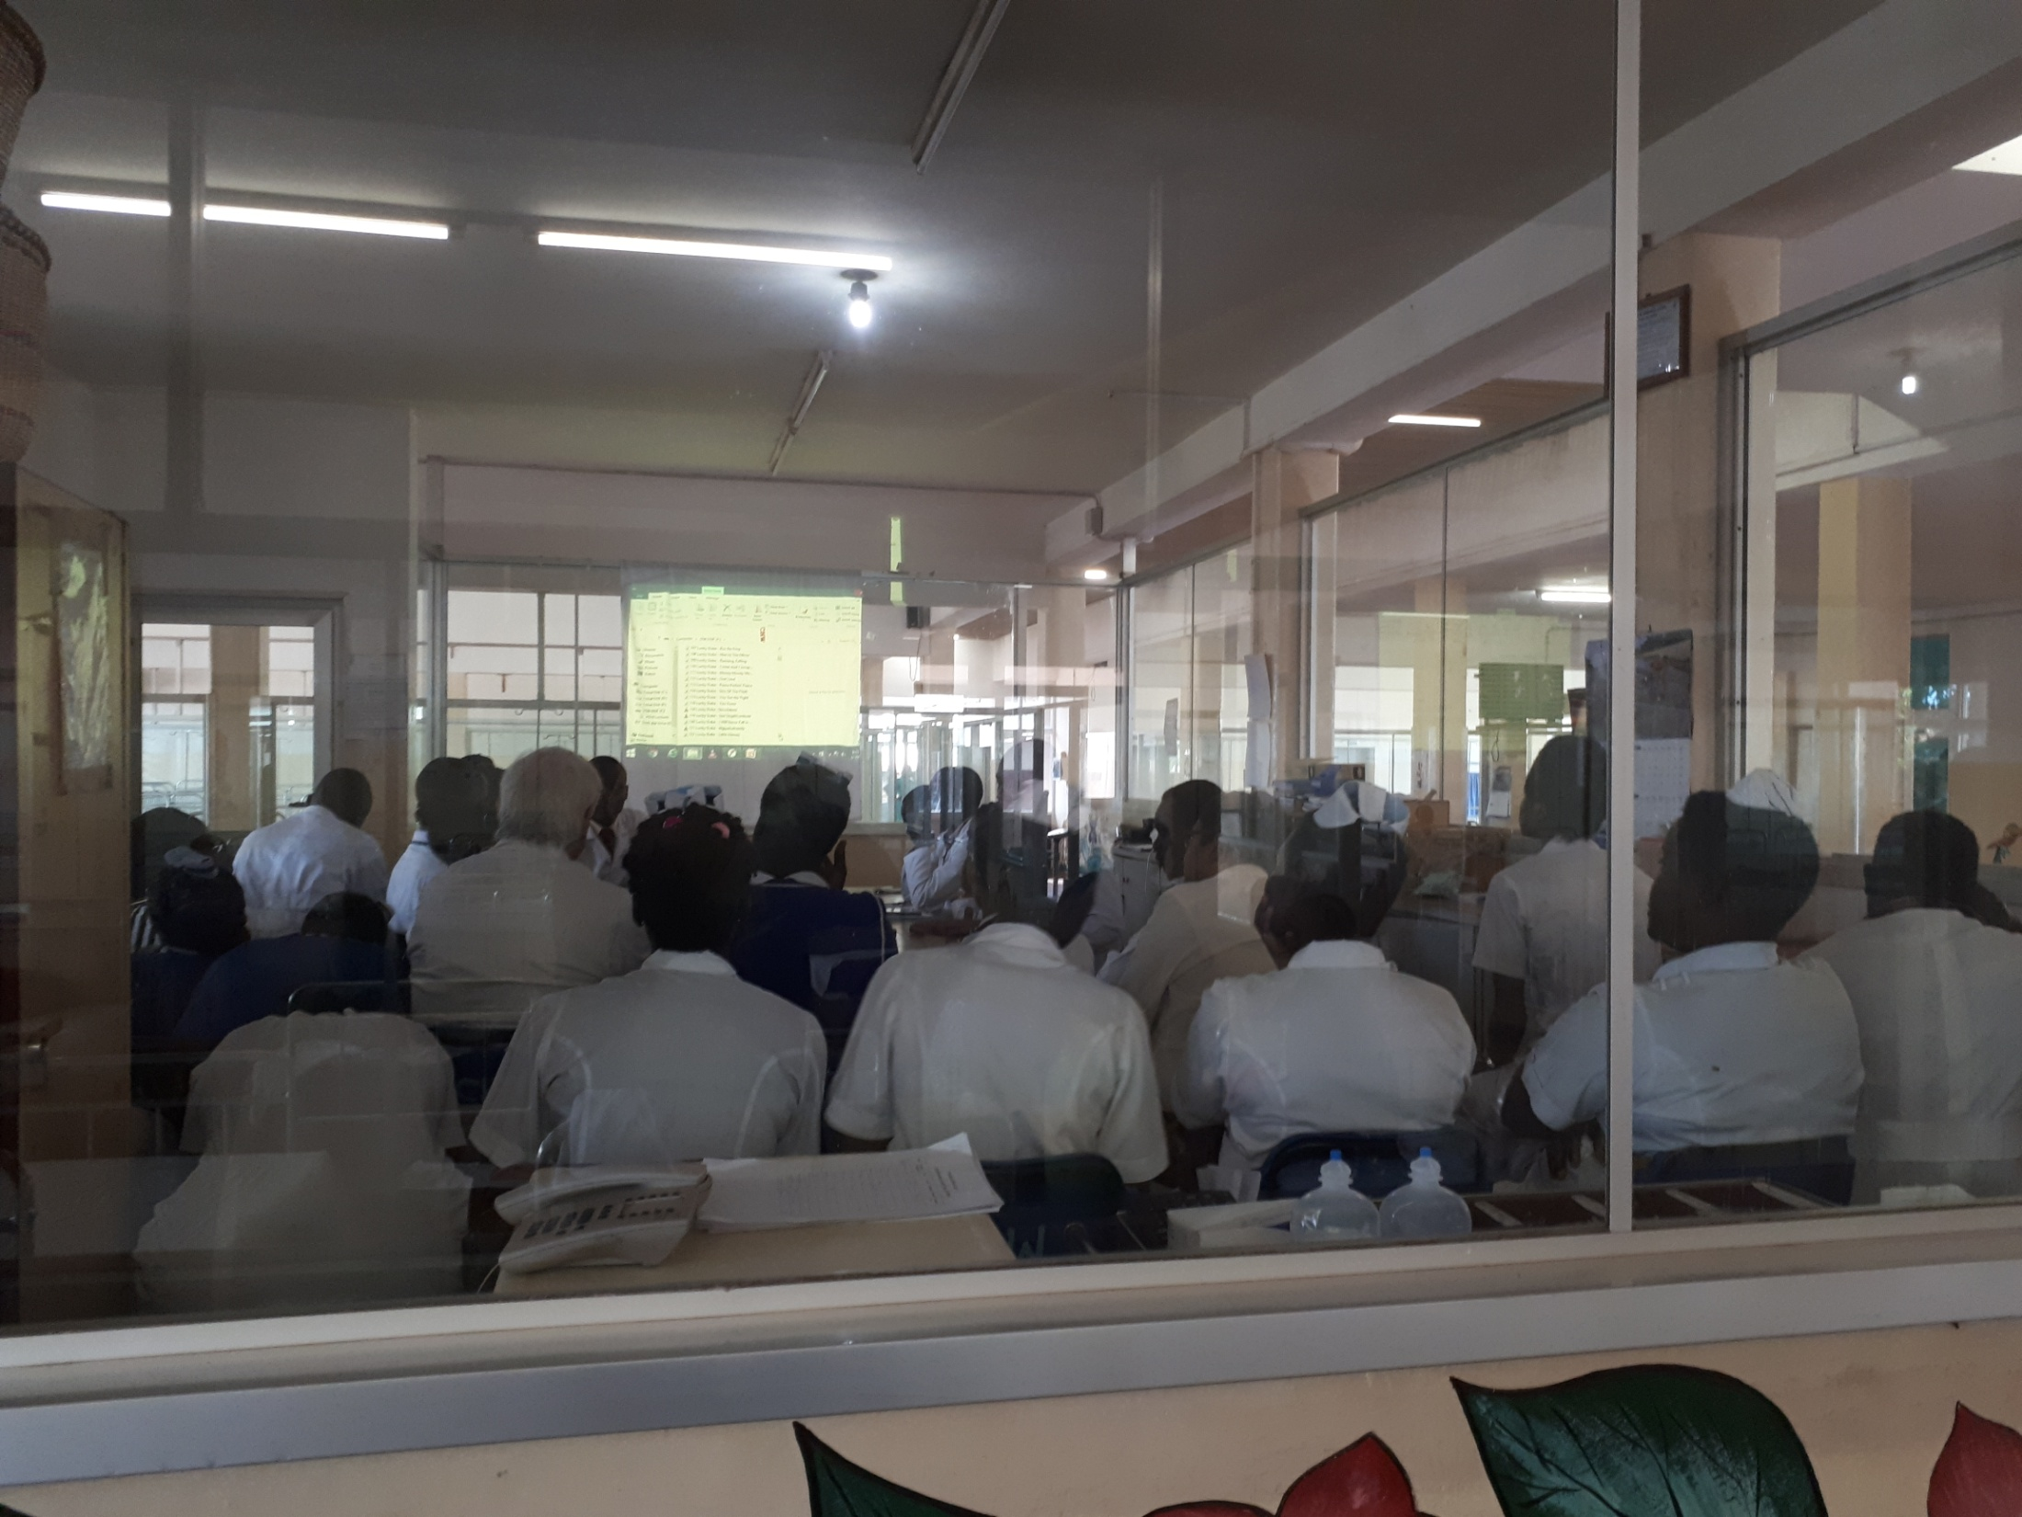
Weekly meeting to discuss general management with doctors and nurses

Slide 19
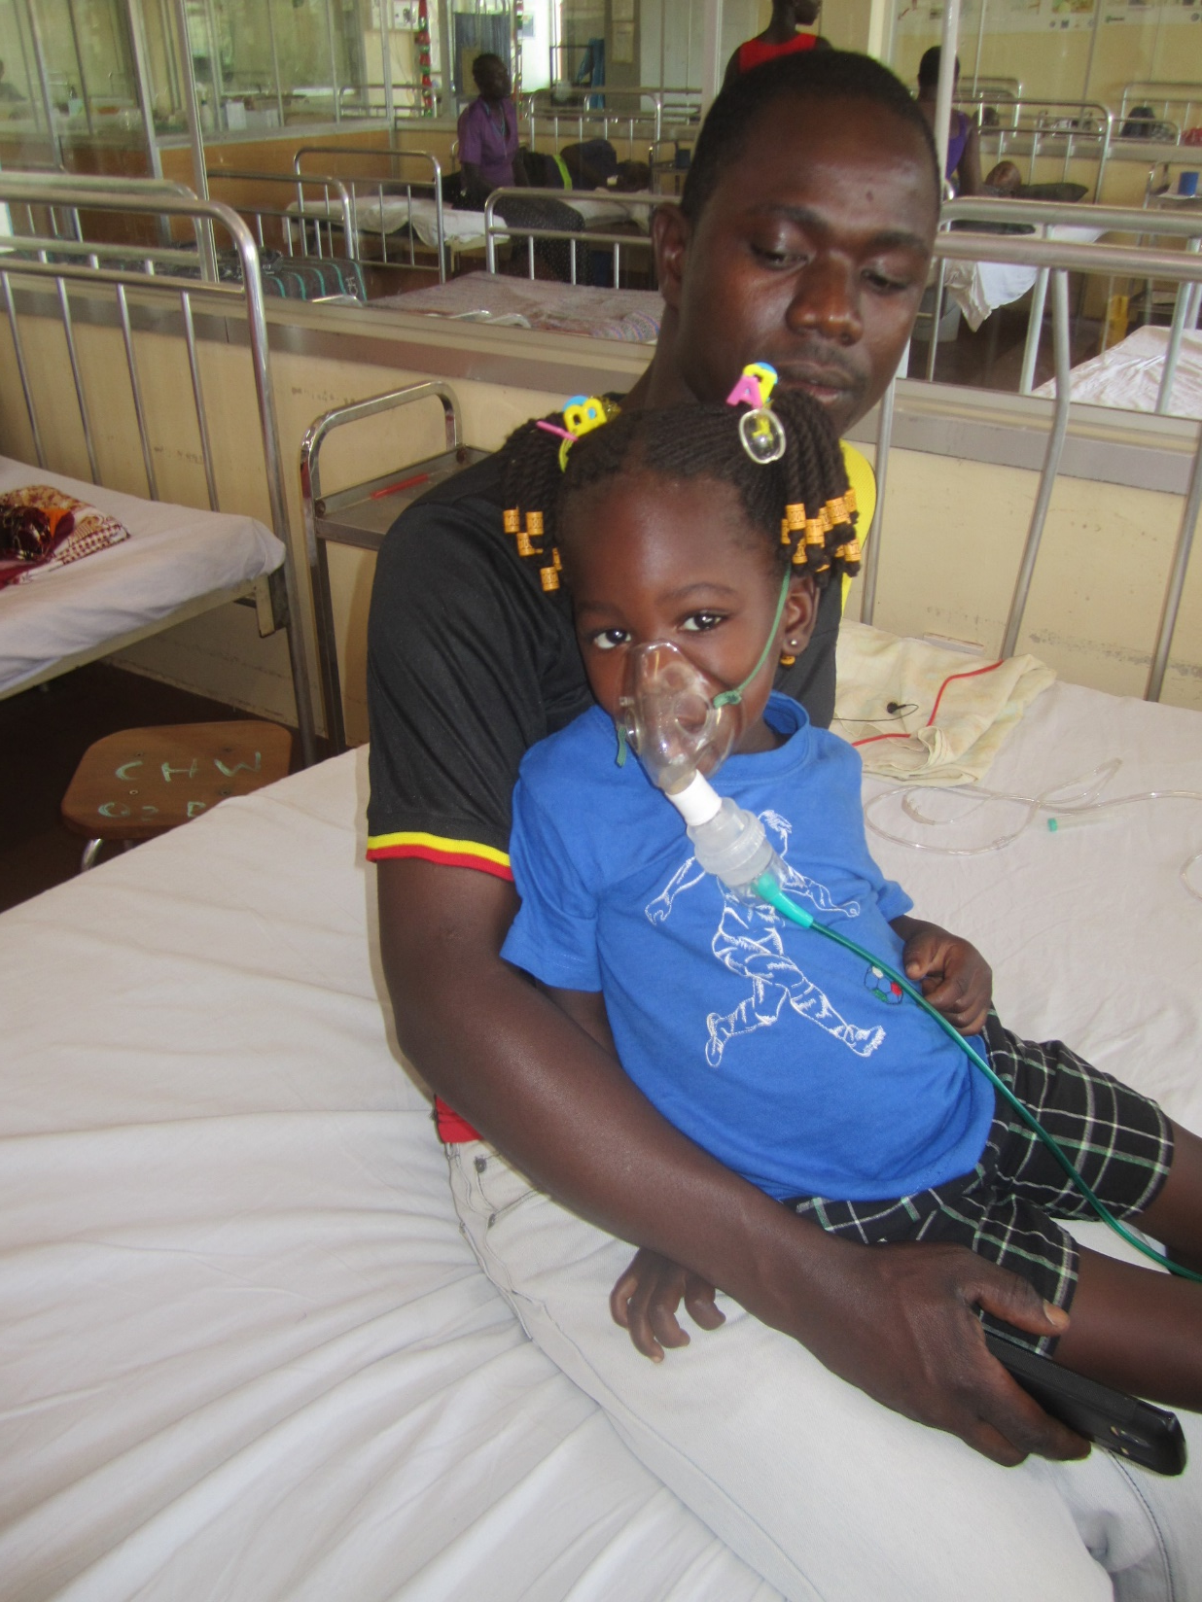
LESS BED SHARING – INDIVIDUAL EQUIPMENTS

Slide 20
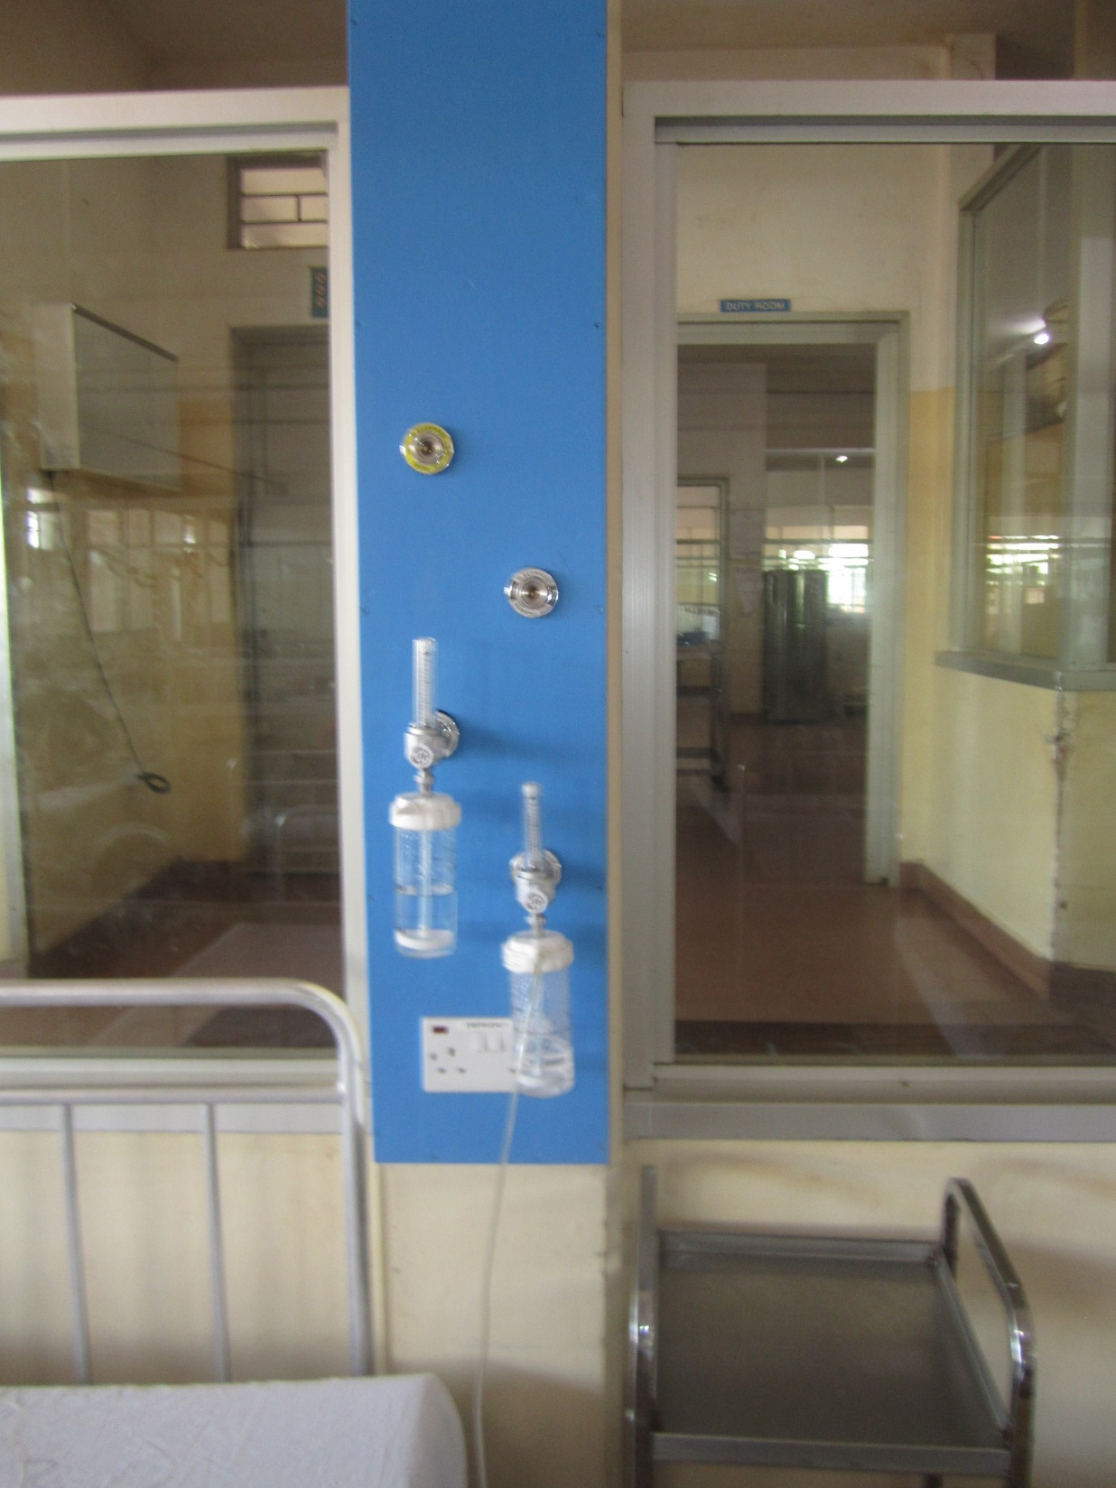
OXIGEN WIDELY AND INDIVIDUALLY AVAILABLE

Slide 21
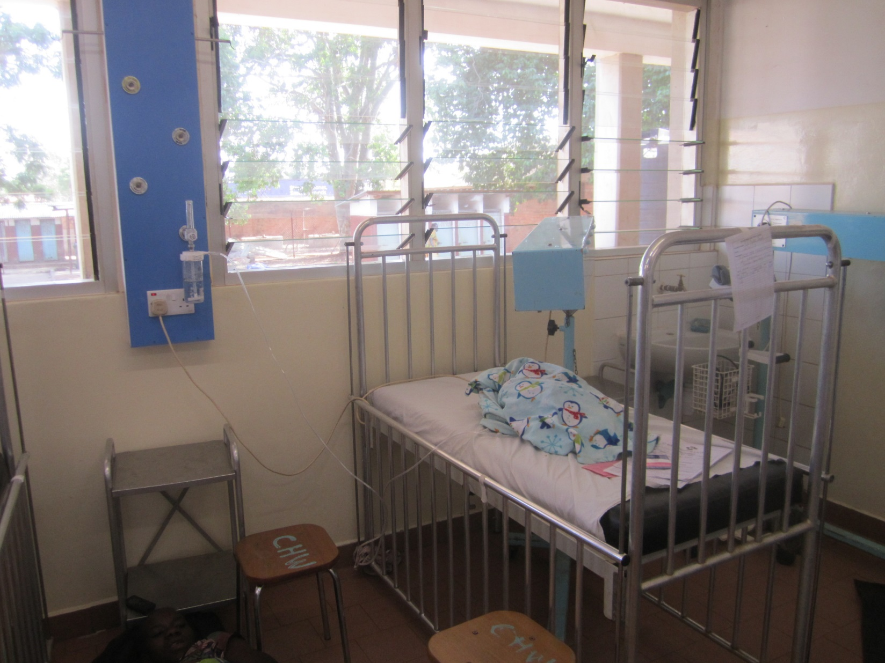
INTENSIVE CARE IMPROVED

Slide 22
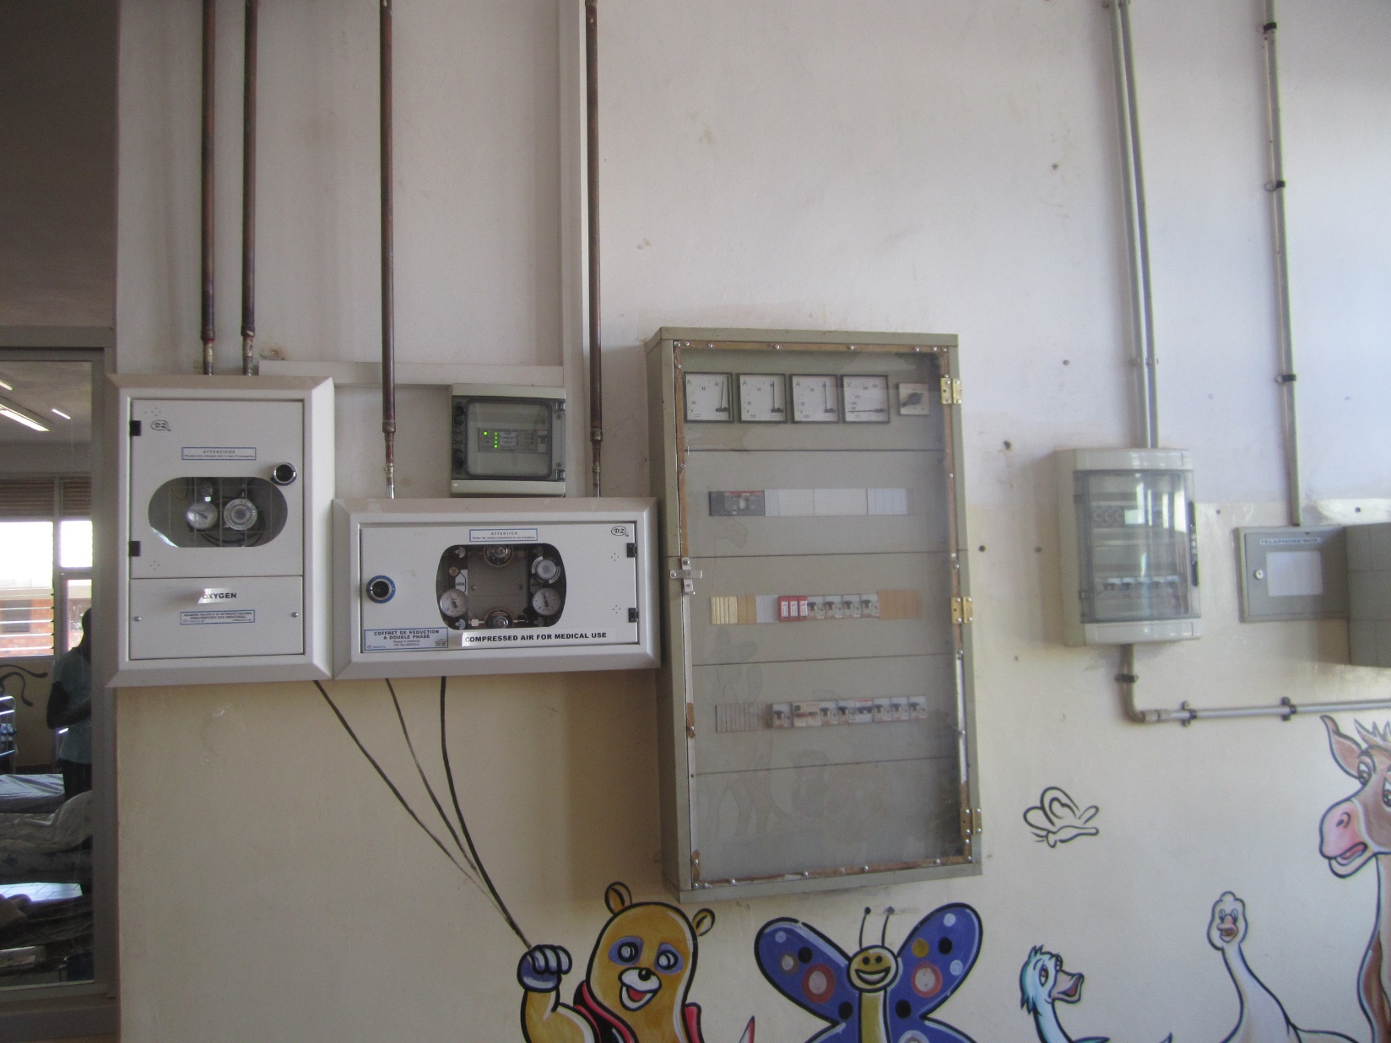
ELECTRICAL SAFETY IMPROVED

Slide 23
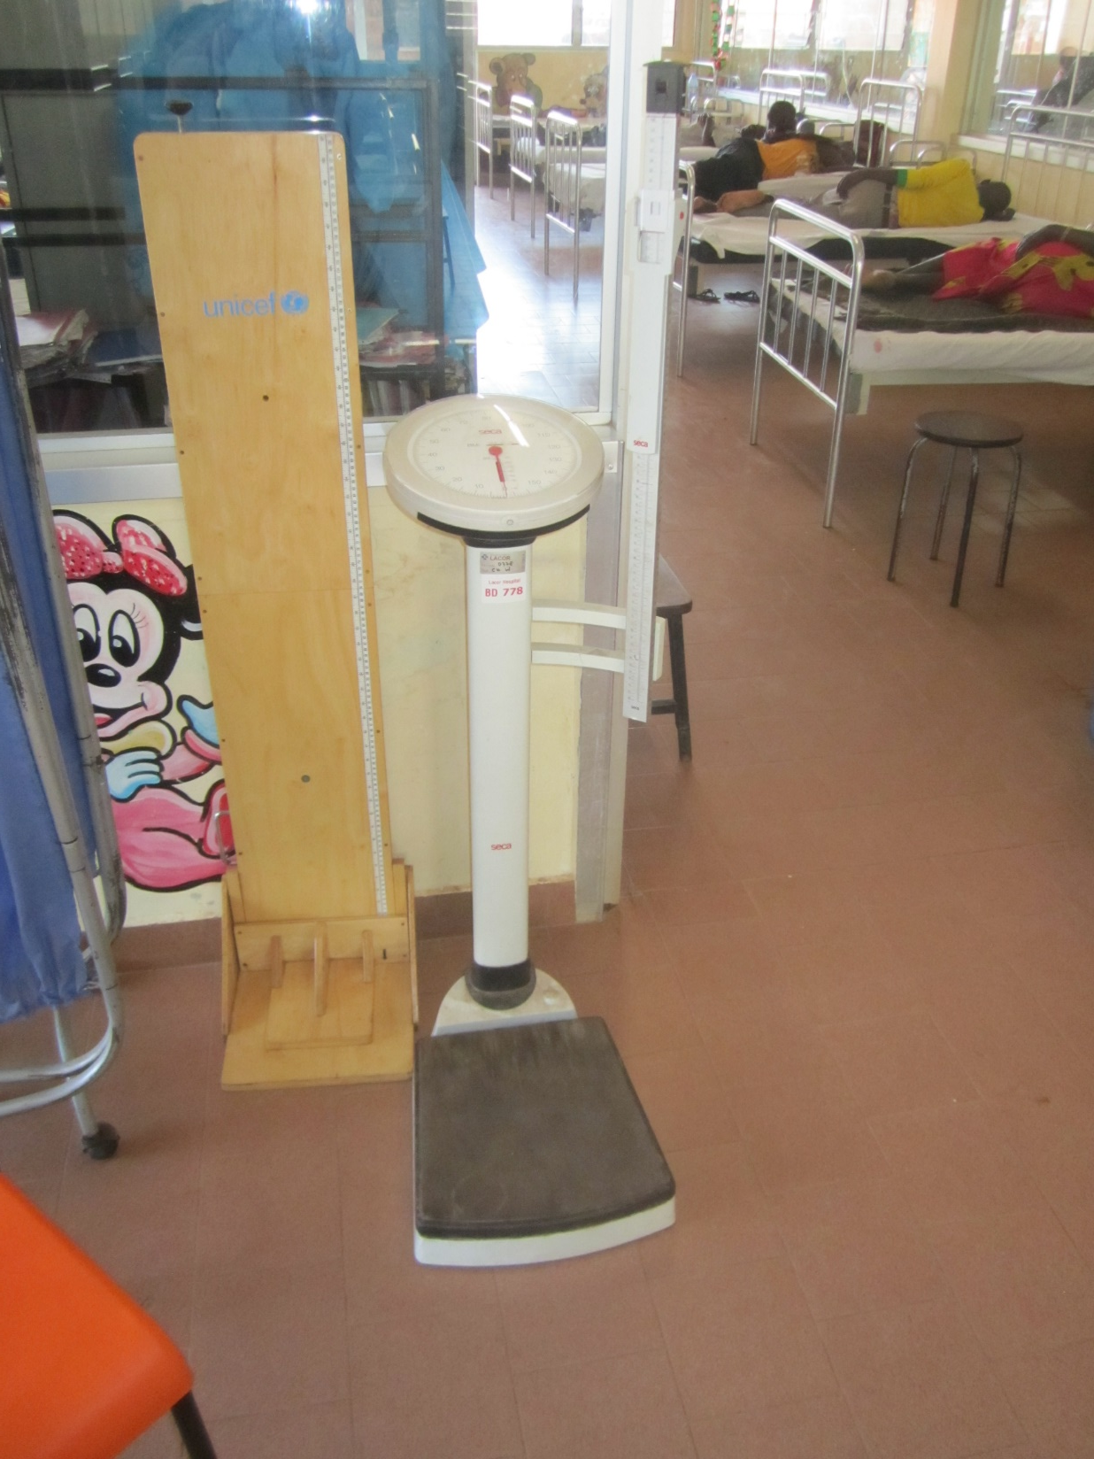
WEIGHING SCALES AVAILABLE

Slide 24
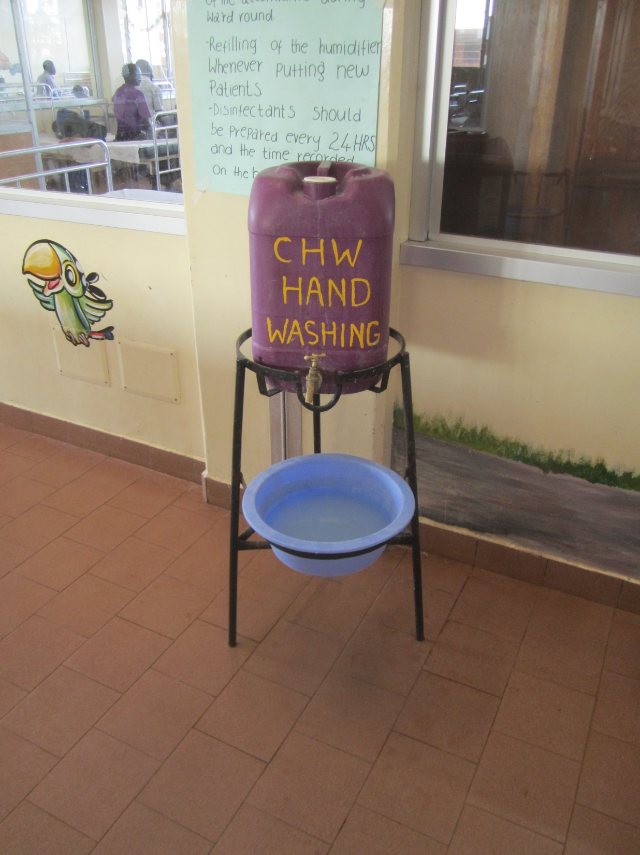
HAND WASHING IN USE

Slide 25
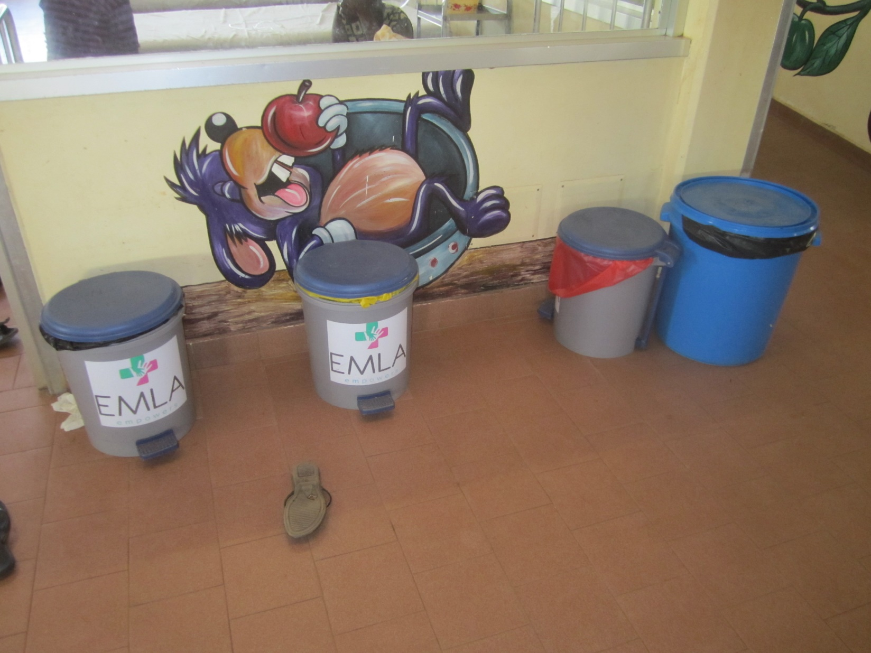
WASTE MANAGEMENT IMPROVED

Slide 26
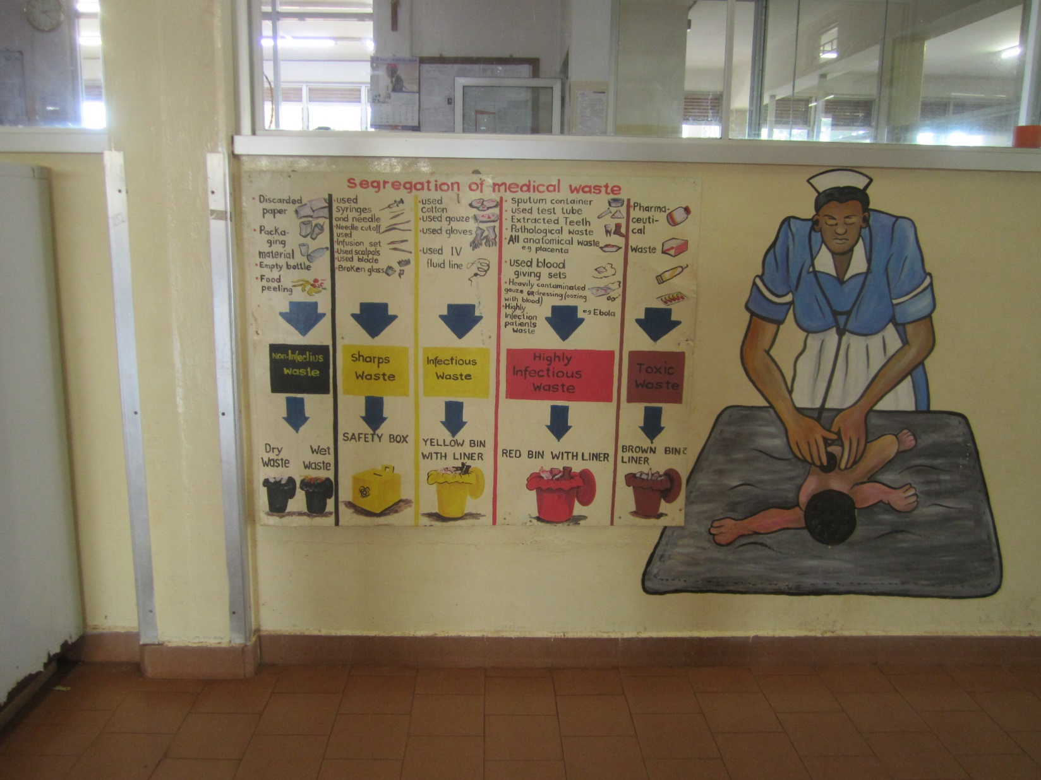
INSTRUCTION FOR WASTE MANAGEMENT

Slide 27
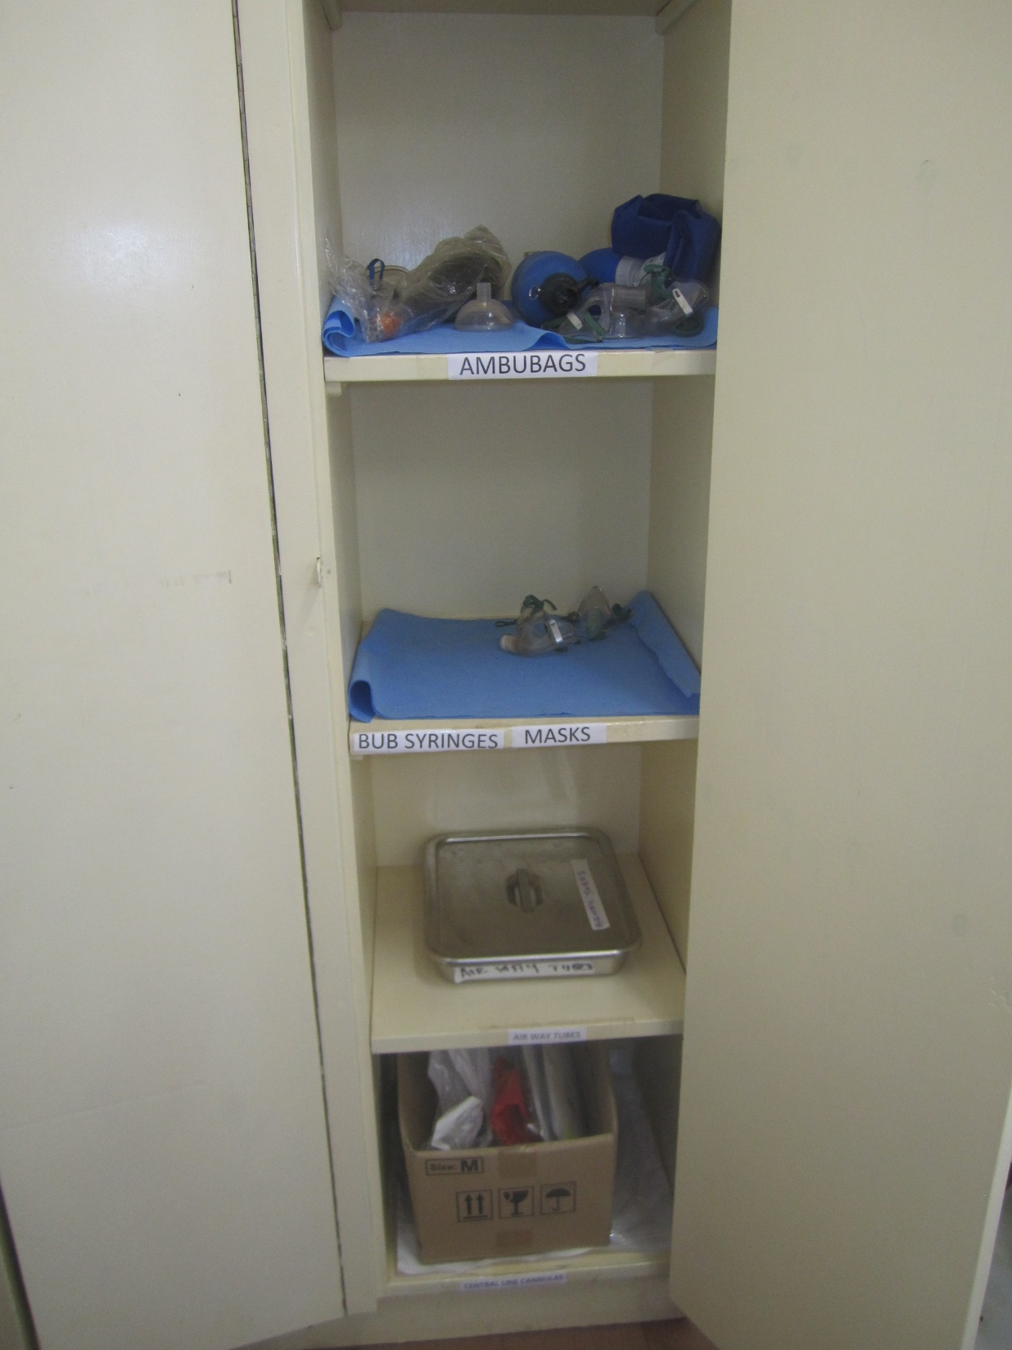
EMERGENCY CUPBOARD IMPROVED

Slide 28
Increase by time of the 5 scores at Lacor 3rd degree polinomial fitted

Slide 29
Increase by time of the 5 scores at Kalongo Exponential model fitted

Slide 30
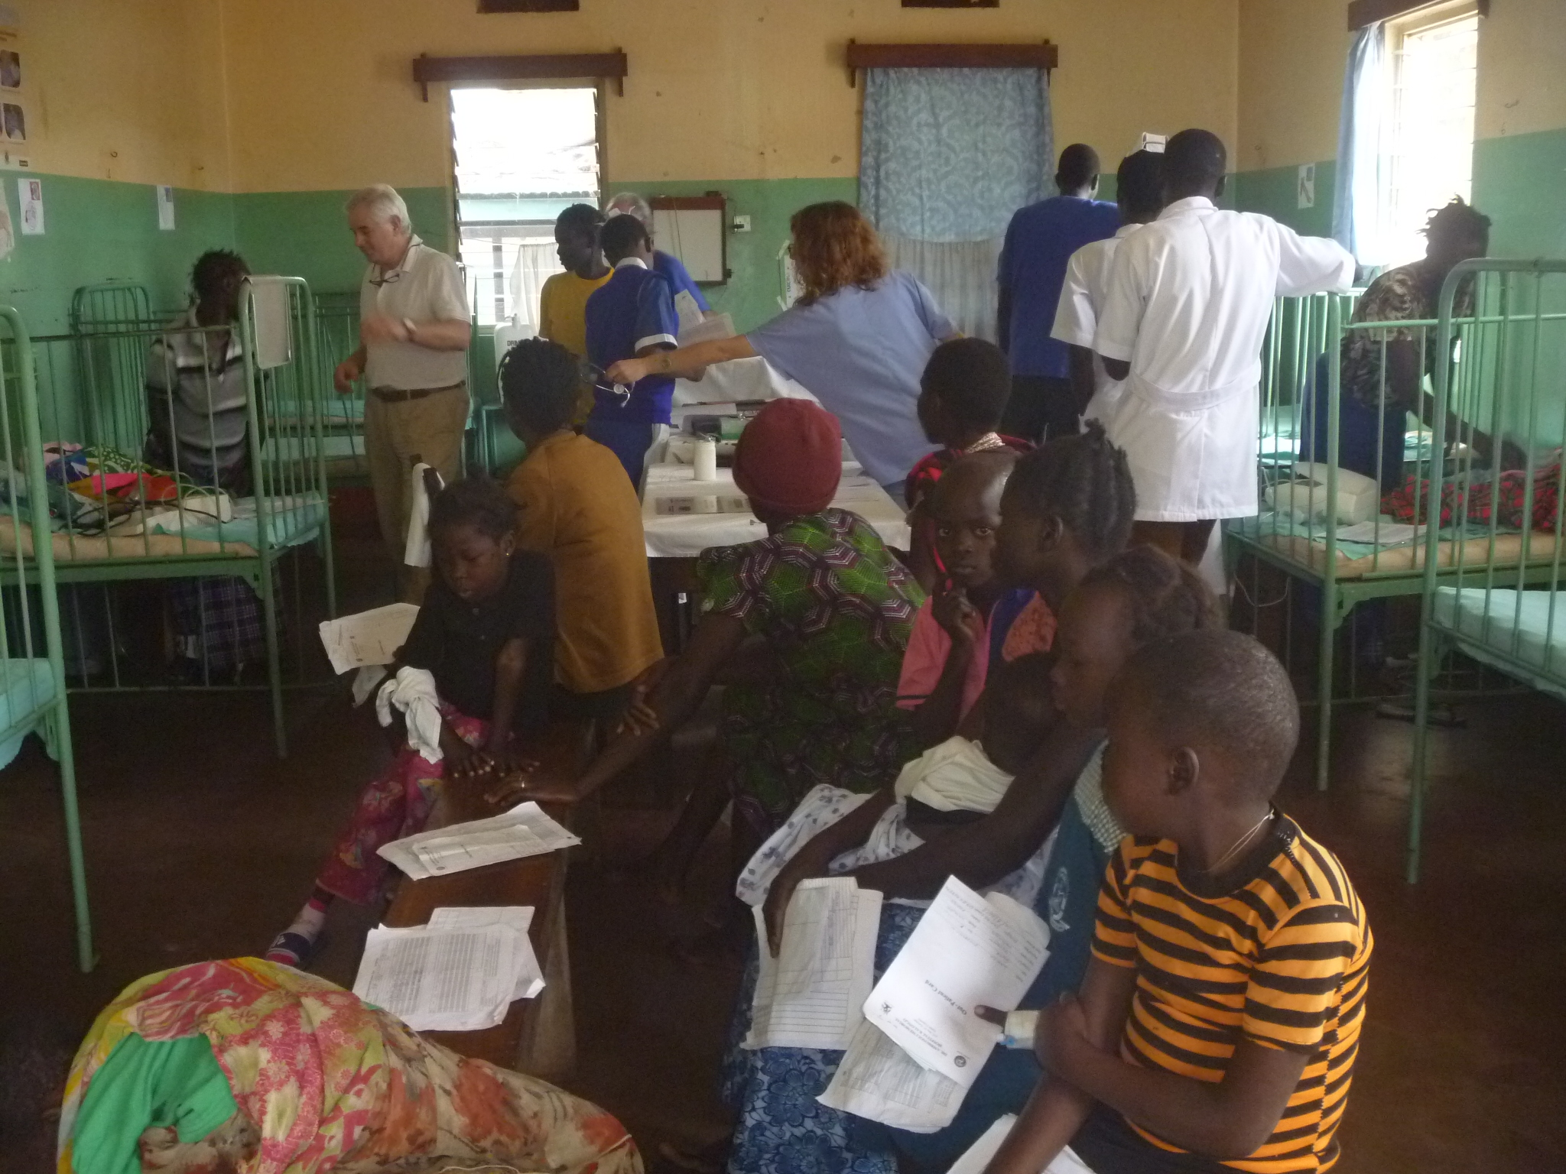
The ‘old’ children’s Ward in Kalongo 2018

Slide 31
Percentage of the Optimal Target Score Lacor

Slide 32
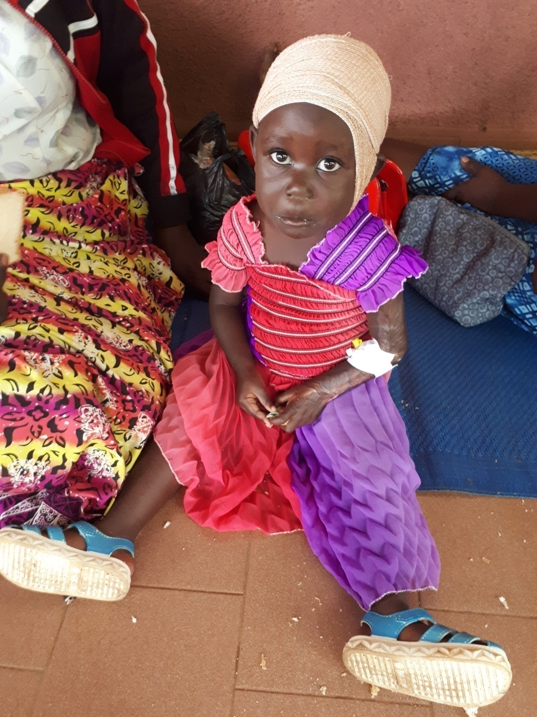

Slide 33
Percentage of the Optimal Target Score Kalongo

Slide 34
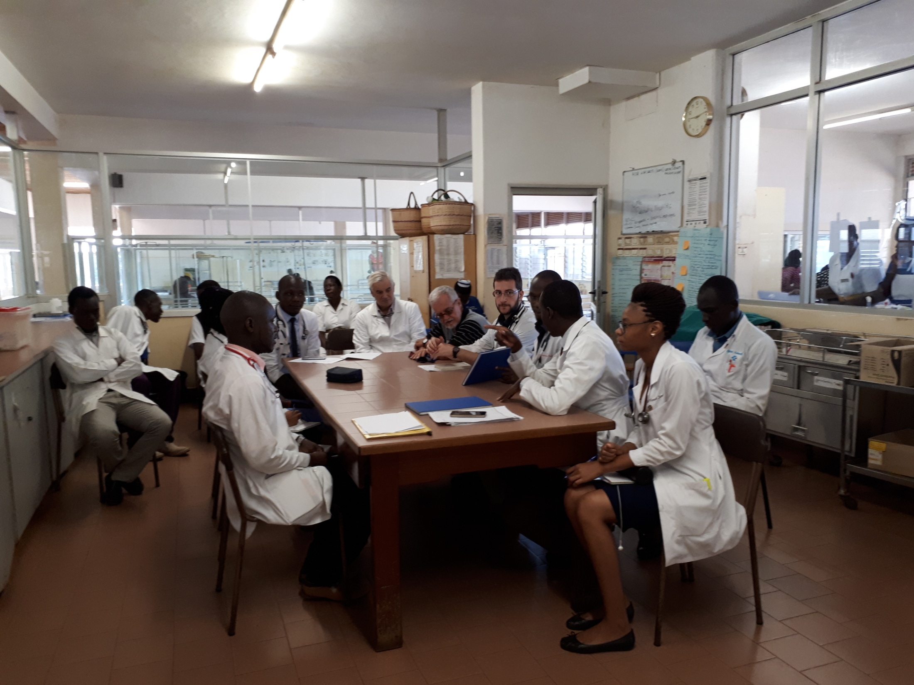
Daily morning meeting to discuss deaths and clinical cases

Slide 35
Change in the quality scores from 2018 to 2020 as % of starting score

Slide 36
PRELIMINARY COMMENTS
LACOR: the actions put in place to improve the structure, the management and the procedure at the Children’s ward, allowed a steep rise in the achieved percentage of the maximum score.
It should be considered that the starting status at Lacor was already very decent in 2018, so dramatic changes could not be expected. After the first year (Time 3 = 3rd trimester) minimal changes were observed for most items.
KALONGO: The starting status at Kalongo suffered in 2018 by several gaps, so the scores of each domain improved gradually over the first 5 trimesters.
The children’s ward was completely re-established in 2018-2019, and this allowed a significant catch up in the scores achieved.
The erratical presence of a paediatric specialist was related to the several gaps observed in the Clinical procedures.
Training suffered from the absence of supervision and the occasional presence of trainees.

Slide 37
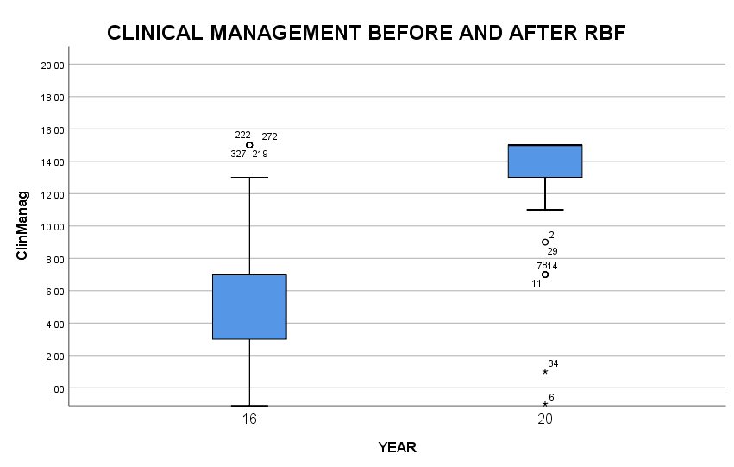
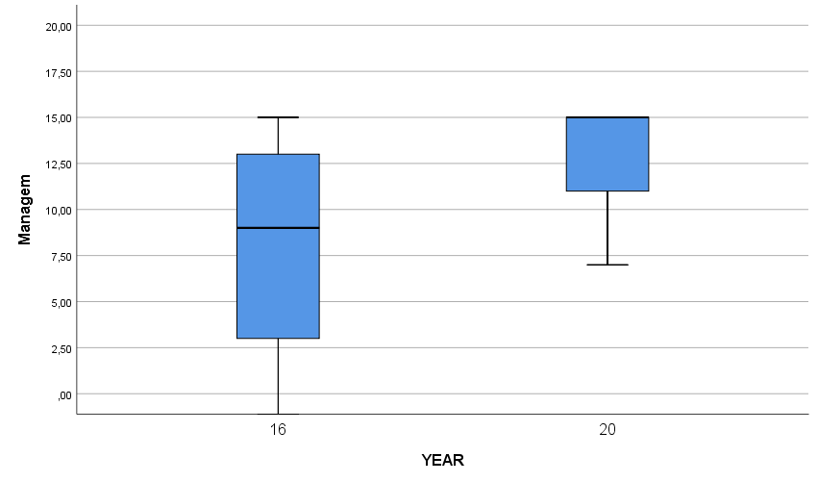
Improvement of Clinical Management at Kalongo and Lacor comparing 150 clinical records of 2016 (Start) to 150 of 2020 (End) in each hospital
KALONGO
LACOR

Slide 38
Multivariate analysis of variables discriminating before/after the RBF initiative
Fase | ACTION
 |  | WilKsl
 |  |  | Variance R. | Sign.
1 | Symptom | 0,816 | 58,451 | 0,000
2 | Weigth | 0,731 | 47,521 | 0,000
3 | Exam | 0,711 | 34,865 | 0,000
The accuracy of reporting the symptoms of the patient according to his clinical history and environment
The detailed examination of the child
The systematic reporting of weight and growth parameters
DO BUILD THE SIGNIFICANT IMPROVEMENT AFTER THE RBF INITIATIVE

Slide 39
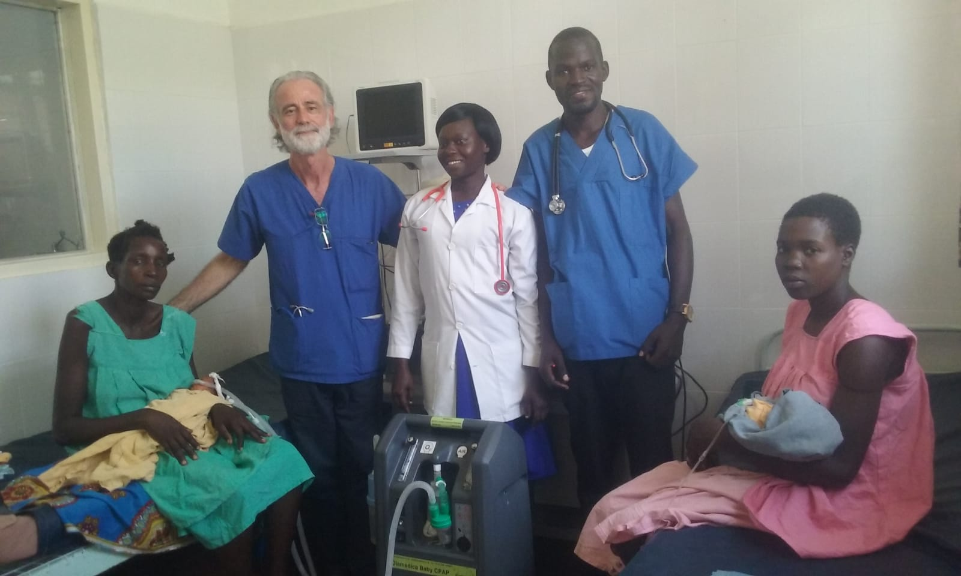
Staff of Kalongo dealing with a new oxygen concentrator

Slide 40
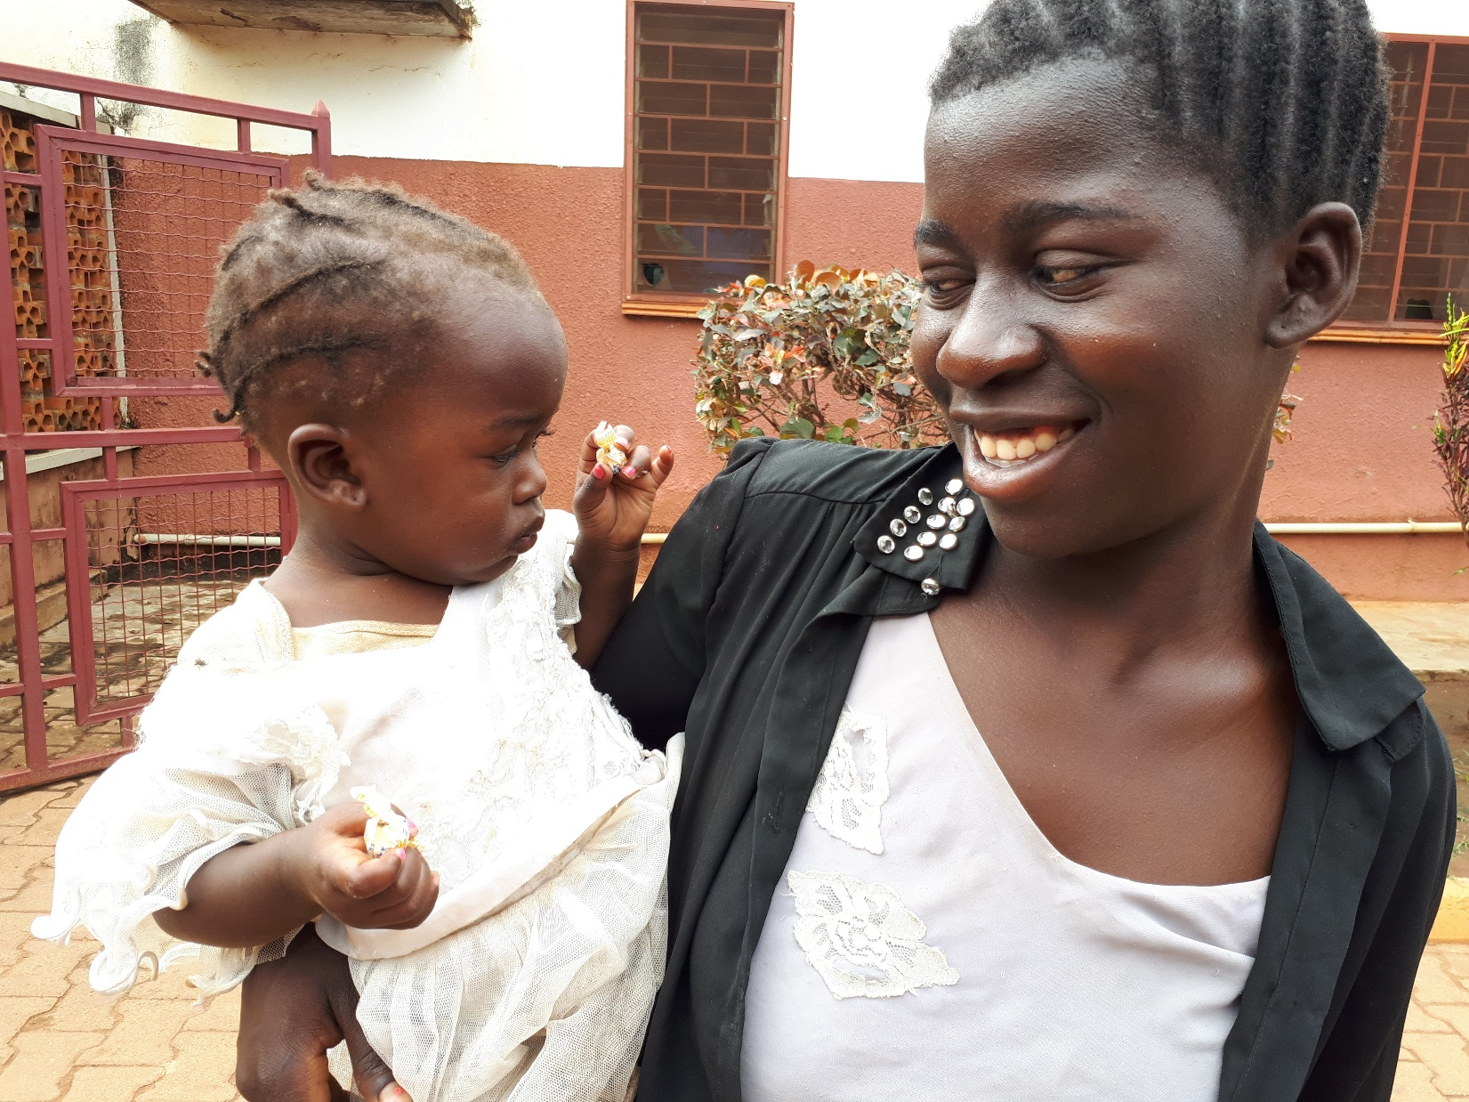

Slide 41
NURSING PROCEDURES REVIEW FORM
CASE ID __________ Admitted |__|__|____| Discharged |__|__|____| Age mo|_____|
DIAGNOSIS:_______________________________________________________________
Proper administration of therapies of 10 x 8 admitted cases | SCORE
1) Therapies have been given properly (Oral, injection, IV line, fluids) | N.A. 0□ NO -1□ Unclear 1□ YES 3□
2) Charts correspond to the correct patients | N.A. 0□ NO -1□ Unclear 1□ YES 3□
3) Weight and vital signs recorded (Wt, Temp, Resp Rate etc) | N.A. 0□ NO -1□ Unclear 1□ YES 3□
4) Fluids balance chart is present, when applicable | N.A. 0□ NO -1□ Unclear 1□ YES 3□
5) Bowel actions recorded in case of diarrhea - dehydration | N.A. 0□ NO -1□ Unclear 1□ YES 3□
TOTAL SCORE

Slide 42
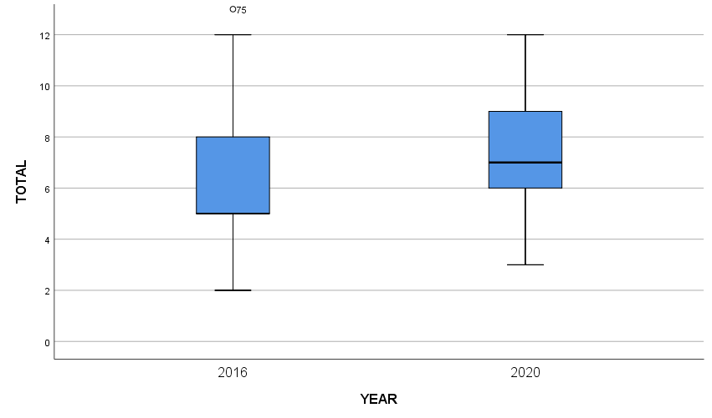
Score of Nursing Procedures in Kalongo and Lacor comparing > 100 Nursing records Before/After by Valentina Mozzi (R.N.)
KALONGO
LACOR

Slide 43
Informazioni per i nuovi specializzandi
PER MATERIALE DIDATTICO IN PEDIATRIA : http://www.pediatria.unina.it/ Scuola di Specializzazione – Materiali Didattici - Visionare anche ‘VIDEO’
Luigi Greco, ydongre@unina.it sito: https://www.docenti.unina.it cerca: Greco Luigi ‘IL CICLO DELLA VITA’
visitare MATERIALE DIDATTICO: AREA PUBBLICA DEL DOCENTE
Visitare la Cartella: ‘Pediatria Generale e Specialistica’ per le lezioni e Area Pubblica ‘NUTRIZIONE’
VISITARE REGOLARMENTE IL SITO DI NEW ENGLAND JOURNAL OF MEDICINE:
http://www.nejm.org/ In MultiMedia vedere ‘Videos in Clinical Medicine’ bellissimi
‘ clinical implications of basic research’ ‘Perspectives’ ‘review articles’
Per materiale didattico e divulgativo veder il sito www.luigigreco.info tutto accessibile apertamente senza registrazione
PER AFRICA VISITARE IL SITO www.gulunap.unina.it
PER MUSICA VISITARE IL SITO www.nuovaorchestrascarlatti.it

